Slide 1
Foothill College Accreditation Self-Study Update
Andrew LaManque, PhD, Accreditation Liaison Officer
August 29, 2016 – Board of Trustees Study Session

Slide 2
Accreditation: Voluntary System of Self-Regulation
Self-Study – Institution Evaluates Attainment of Standards
Peer Review – Evaluation Team Visit
Recommendation from the Accrediting Commission for Community and Junior Colleges (ACCJC)
Six-Year Cycle (next time 7)

Slide 3

Purposes of Accreditation
Promotes Institutional Improvement
Certifies Value and Legitimacy of Student Award
Assures Institutional Quality to Taxpayers
Source: adapted from http://www.chea.org/

Slide 4
Accreditation Standards Updated June 2014
Standard 1: Mission, Academic Quality and Institutional Effectiveness and Integrity
A. Mission
B. Academic Quality and Institutional Effectiveness
C. Institutional Integrity
Standard 2: Student Learning Programs and Support Services
A. Instructional Programs
B. Library and Learning Support Services
C. Student Support Services
Standard 3: Resources
A. Human Resources
B. Physical Resources
C. Technology Resources
D. Financial Resources
Standard 4: Leadership and Governance
A. Decision-Making Roles and Processes
B. Chief Executive Office
C. Governing Board
D. Multi-College Districts
Note: Self-Study now requires a Quality Focused Essay (QFE).

Slide 5
Standard Assignments – Foothill
PaRC
Accreditation Steering Committee
Standard II Team
Standard III Team
Standard IV Team
Standard I Team
Academic and Classified Senate Presidents,
AOL, Director of Communications
Teams are led by a Steering Committee member.
About 75 faculty, staff, and administrators are serving on a team.
Note: ACCJC Standards now require responses related to the awarding of a Bachelor degree.

Slide 6
Foothill College Accreditation Timeline
Fall 16
Teams review evidence
Fall Retreat – decide Quality Focused Essay topics
Winter17
First draft
College Review
Spring 17
PaRC Approval
Board Approval
Spring 2016 - teams begin meeting
Fall 2017 - evaluation team visit

Slide 7
Accreditation Survey Administration Spring 2016
Survey Administration
Developed jointly by the De Anza and Foothill Offices of Research and Planning
Shared with governance groups at both colleges
Survey included:
Questions pertaining to Standards I, II, III and IV
Additional student questions regarding overall satisfaction
Institutional Core Competencies at each college
Opportunity to provide feedback on an open-ended question
Emailed to students and employees via an on online link in May 2016
Open for two weeks with one reminder sent after the first week
Developed jointly by the De Anza and Foothill Offices of Research and Planning
Developed jointly by Foothill and De Anza research offices
Shared with governance groups at both colleges
Survey included:
Questions pertaining to Standards I, II, III and IV
Additional student questions regarding overall satisfaction
Institutional Core Competencies at each college
Opportunity to provide feedback on an open-ended question
Emailed to students and employees via an on online link in May 2016
Open for two weeks with one reminder sent after the first week

Slide 8
Student Accreditation Survey

Slide 9
Employee Accreditation Survey

Slide 10
Board Involvement in Self-Study Process
Team Evaluation Report, Fall 2011
“The team validated that board members were appropriately involved in the current Self Study and accreditation process. Board members served as liaisons on Standard IV teams, received regular reports from college representatives on accreditation preparations and the Self Study process, and approved the Foothill Self Study Report before its final submission to ACCJC.” p. 45

Slide 12

Accreditation Update
Mallory Newell, Accreditation Liaison Officer

Slide 13
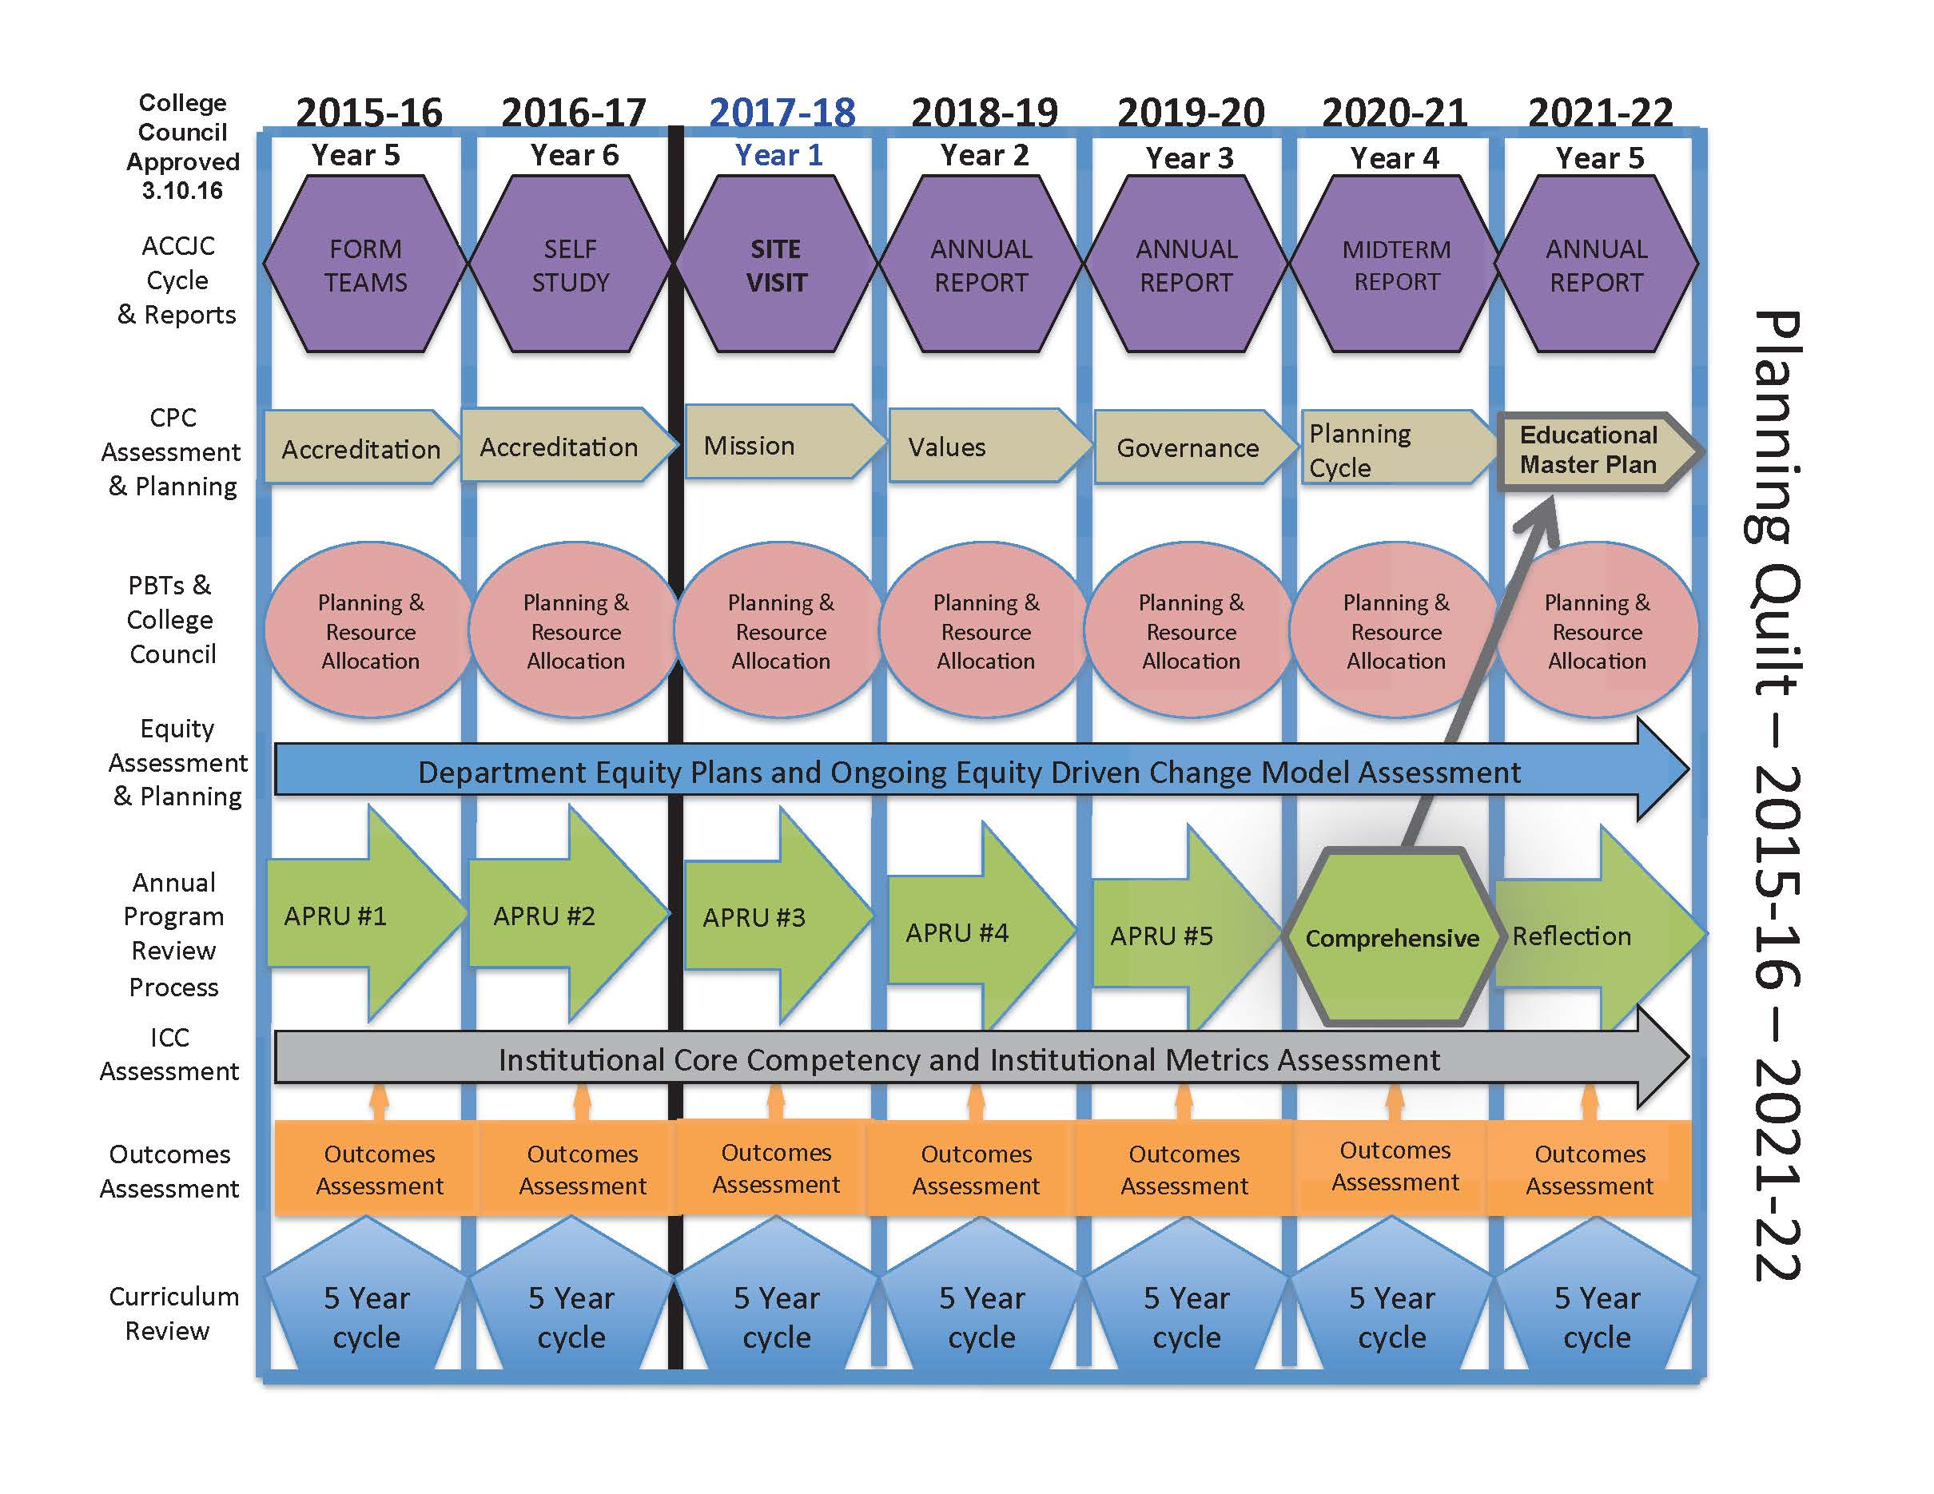

Slide 14
Self-Study Process
Led by the Accreditation Steering Committee
Representatives from all shared governance groups
Meet monthly
Liaison to their governance group
Assigned Standards to each existing shared governance group
Developed a Progress Tracking Template
Includes monthly goals and deadlines
Provided numerous trainings on the Standards and writing the Self-Study report
Each ‘Standard Team’ is responsible for completing the Accreditation Matrix and Self-Study report for their area
Accreditation 2017 webpage: http://deanza.edu/accreditation/2017/index.html

Slide 15
Self-Study Teams
College Planning Committee | IPBT | Library | SSPBT | FERPBT | Technology Taskforce
Standard 1.A., 1.B., 1.C. | Standard 2.A. | Standard 2.B. | Standard 2.C. | Standard 3.A., 3.B., 3.D. (Liabilities, Contractual Agreements) | Standard 3.C.
Campus Budget | Academic Senate | Classified Senate | President and Senior Staff | District Advisory Team
Standard 3.D. (Planning and Fiscal Responsibility and Stability) | Standard 4.A. | Standard 4.A. | Standard 4.B. | Standard 4.C., 4.D.

Slide 16
Timeline
January 2016 | February 2016 | March-April 2016 | May 2016 | June 2016
District provides functional map | Assign Standards to teams and provide training on the Standards | Teams begin work on Accreditation Matrix; Develop Accreditation Survey | Accreditation survey sent to students and employees | Teams finalize Accreditation Matrix assignments; Analyze Accreditation Survey results
September 2016 - November 2016 | December 2016 | January 2017 | February 2017 | March 2017
Teams begin work on Self-Study report based on Accreditation Matrix notes and evidence | Accreditation Steering Committee determine areas for Quality Focus Essay (QFE) - Teams finalize Self-Study reports | Self-Study draft shared with governance groups - Steering Committee drafts QFE -First copy edit of Self-Study begins | QFE finalized and shared with governance groups - Copy edit of QFE begins | Campus feedback and public comments on process, Self-Study report, and QFE collected
April 2017 | May 2017 | June 2017 | July - September 2017 | October 2017
Campus feedback incorporated into final draft of Self-Study report | All documents due for final editing | Final draft of Self-Study due to Board of Trustees | Self-Study to printer; Copies sent to team; Accommodations for site visit; Compile hard copies of evidence for team room | Site Visit

Slide 17

Student Accreditation Survey
Total responses: 865

Slide 18
Employee Accreditation Survey
Total responses: 145

Slide 19
Thank you!
Mallory Newell, Accreditation Liaison Officer

Slide 20
Accreditation --District Focus--
Foothill – De Anza CCD
Office of Institutional Research & Planning
August 29, 2016

Slide 21
Accreditation Standards
Standard 1: Mission, Academic Quality and Institutional Integrity (27 Standards)
Standard 2: Student Learning Programs and Support Services (28 Standards)
Standard 3: Resources (40 Standards)
Standard 4: Leadership and Governance (33 Standards)
C. Governing Board (13)
D. Multi-College Districts (7)

Slide 22
“District” Standards
Standard 4C: Governing Board
Standard 4D: Multi-College Districts
13 Standards
Authority of the board
Act as a collective entity
Is independent, policy-making body
Bylaws and policies are published and evaluated
Act in accordance with bylaws and policies
Reviews key indicators of student success
Program for board development and evaluation
Upholds code of ethics
Is informed re: accreditation and supports college efforts to improve
7 Standards
CEO provides leadership in setting and communicating expectations; and assures support for colleges
Delineation of responsibilities
Effective resource allocation policy
District CEO delegates to College CEOs to implement district policies
Planning and evaluation are integrated with colleges
Communication across district is timely, accurate, and complete
Regular evaluation
EVIDENCE

Slide 23
“District” Standards - Evidence
Standard 4C8: Reviews key indicators of student success and institutional plans for improving academic quality
Annual review of CCCCO Scorecard
College Plans
Education Master Plans
Equity Plans
Student Success and Support Program Plans
District Strategic Plan
Standard 4D2: Delineation of responsibilities by the district/system CEO. Where district/system has responsibility, it is evaluated against the standards.
Functional Map

Slide 24
Functional Map
District and Colleges reviewed all 128 standards.
Primary (P), Secondary (S), Shared (SH) responsibility of standard. – College AND District
District gets a ‘P’ if we have independent responsibility.
Is this something the district does and can accomplish independently?
Primary – 48, Shared - 27

Slide 25
Functional Map Examples
Both College and District are Primary
Standard 1A1: Mission Statement
Only College is Primary
Standard 2A6: Scheduling of Courses
Only District is Primary
Standard 3C3: Technology resources are implemented, maintained, and secure.
Shared Responsibility
Standard 3D7: Effective oversight of finances
District
Evidence

Slide 26
Thank You
Foothill – De Anza CCD
Office of Institutional Research & Planning
August 29, 2016

