Slide 1
Professionalism and Education / Conceptual and Philosophical Basis of Nursing
Catherine Hrycyk, MScN, RN

Slide 2
Work with the colleague sitting next to you to discuss and answer the following questions (write the answers):
What are the differences between a profession and ‘occupation’?
3. Define the following terms:
    1. Value
    2. Belief
    3. Health

Slide 3
Occupation vs. Profession
OCCUPATION | PROFESSION
Training may occur on the job. | Education takes place in a college or university.
Length of training varies. | Education is prolonged.
Work is largely manual. | Work involves mental creativity.
Decision making is guided largely by experience or by trial and error. | Decision making is based largely on science or theoretical constructs (evidence-based practice).
Values, beliefs, and ethics are not prominent features of preparation. | Values, beliefs, and ethics are an integral part of preparation.
Commitment and personal identification vary. | Commitment and personal identification are strong.
Workers are supervised. | Workers are autonomous.
People often change jobs. | People are unlikely to change professions.
Material reward is main motivation. | Commitment transcends material reward.
Accountability rests primarily with employer. | Accountability rests with individual.

Slide 4
Eight Characteristics of a Profession (Kelly, 1981)
1. The services provided are vital to humanity and the welfare of society.
  Caring is the core of professional nursing through which nurses intervene for their patients.
  How do nurses demonstrate caring in highly technologically advance healthcare environment?
    Nurses MUST focus on maintaining human aspects of caring
2. There is a specialized body of knowledge that is continually enlarged through research.
  Research nursing degrees
  Nursing relies on theory and research as a basis for practice.
    Example: Evidence-based practice

Slide 5
Eight Characteristics of a Profession
3. The services involve intellectual activities; individual responsibility (accountability) is a strong feature.
  Critical and creative thinking serves as basis for providing nursing care. Example: Nursing process
  ANA definition of accountability
4.Practitioners are educated in institutions of higher learning.
  1909: University of Minnesota – first university-based nursing degree
  1923: Yale – first university based School of Nursing
  1965: ANA Position Paper – All nursing education should take place in institutions of higher education.
  Debate: Entry level into Practice

Slide 6
Eight Characteristics of a Profession
5. Practitioners are relatively independent and control their own policies and activities (autonomy).
  Autonomy – control over one’s practice.
  Licensure and autonomous practice
  “Doctor’s orders” connotation
6. Practitioners are motivated by service (altruism) and consider their work an important component of their lives.
  Altruism – ideal of service to others

Slide 7
Eight Characteristics of a Profession
7. There is a code of ethics to guide the decisions and conduct of practitioners.
  1893: Nightingale Pledge
  ICN and ANA established a Code of Ethics
8.There is an organization (association) that encourages and supports high standards of practice.
American Nurses Association (ANA) – official voice of nursing
  Relatively low percentage of nurses who belong to ANA and the constituent state nurses association
  A significant political influence is unrealized for the profession.

Slide 8
Barriers to Professionalism in Nursing
Varying levels of education for entry into practice
  Lack of a standardized requirement for a minimum of a BSN, and preferably MSN (David, 2000)
Gender issues
Historic influences
  Religious and military background and obedience
External conflicts
  Tension between medicine and nursing
Internal conflicts
  Fragmented power and influence in professional nursing

Slide 9
Types of RN Education Programs
Pre-licensure programs (entry to practice):
Diploma
AND
BSN
Graduate pre-licensure programs (ELMS, ELDNP)
Post-licensure programs:
RN to BSN
Advance practice programs:
MSN
DNP
Research degrees (doctoral degrees such as PhD, DSc)

Slide 10
Diploma Nursing Programs
Most common prior to 1930 pre-licensure education based on Nightingale Model
Mid 20th century – dramatic decline caused by transfer of nursing education to the institutes of higher education
Reasons for decline:
  Increasing complexity of healthcare environment necessitate more scientific focus
  Hospital misused the programs to turn students into free labor

Slide 11
Baccalaureate Programs
Required to qualify nursing as a recognized profession and to provide leadership in administration, teaching, and public health.
1909: First BSN program in University of Minnesota
  Slow growth due to perception that hands-on training hospital programs was more appropriate than theory driven BSN programs
4- 5 years programs including general education reqs + nursing courses.
BSN graduates are eligible to take licensure exams, prepared to move into graduate programs and advanced practice certification programs.

Slide 12
Associate Degree Programs
Begun 1952, based on a model developed by Mildred Montag.
Mildred Montag’s ADN program:
  Short duration to prepare nurse technicians
  Nurse technicians function under supervision of professional nurses
  Routine care in acute and long-term settings
  Intended for end-point degree and not an incremental step to BSN
Contrary to the original intent of ADN, the graduates received the right to sit for NCLEX-RN
Instructional hours had to be increased; ADN very different now

Slide 13
Articulated Programs
Definition: Mobility between programs
Purpose: Facilitate opportunities to move up the educational ladder.
Multiple-entry and multiple exit programs
Articulation agreements facilitate student movement between programs and accept transfer credit between institutions. These result in acceleration or advanced placement.

Slide 14
RN to BSN and Graduate Entry Programs
RN to BSN:
Diploma and ADN nurses are given credits to meet certain BSN requirements.
Transfer of general education courses
Options for advanced placement
Graduate entry programs:
Accelerated or fast-track sequence to award a second bachelor’s degree, MSN (ELMS), DNP

Slide 15
Accreditation: Ensuring Quality Education
Accreditation – voluntary review process of educational programs by a professional organization
The accrediting agency compares the educational quality of the program with established standards and criteria.
It derives authority from the US Department of Education.
Two agencies:
  Accreditation Commission for Education in Nursing (ACEN)
      Accredits ALL nursing programs, not just RN programs
  Commission on Collegiate Nursing Education (CCNE)
      Baccalaureate and higher

Slide 16
Advance Practice Degrees: MSN
Admission requirements:
  Active and unrestricted license
  BSN or equivalent AND
  Work experience
2 to 4 years, depending on focus
Major areas of role preparation:
  Administration, case management, informatics, health policy/health care systems, teacher education, clinical nurse specialist, NP, nurse-midwifery, nurse anesthesia, and other clinical and nonclinical areas of study

Slide 17
Advance Practice Degrees: Doctorate
Doctoral programs prepare nurses to become faculty members in universities, administrators in schools of nursing or large medical centers, researchers, theorists, and advanced practitioners.
  Research-focused degree—doctor of philosophy (PhD) or doctor of science (DSc)
  Practice-focused degree—doctor of nursing practice (DNP)
  DNP to become minimum requirement for advance practice

Slide 18
Conceptual and Philosophical Basis of Nursing
Peter Miskin, DHSc, MScN, RN, PHN

Slide 19
Systems Theory
Ludwig von Bertalanffy (1936): General Systems Theory
Components of systems:
  Input,
  Throughput,
  Output,
  Evaluation,
  Feedback

Slide 20
Types of Systems
Open system:
  An open system promotes the exchange of matter, energy, and information with other systems and the environment.
Closed system:
  A closed system does not interact with other systems or with the surrounding environment.
Sub-system:
  System that is a part of a large system
Supra-system:
  The larger environment outside the system

Slide 21
Characteristics of Systems
The whole is different from and greater than the sum of its parts (its subsystems).
Synergy occurs when all the various subsystems work together to create a result that is not independently achievable.
A change in one part of the system creates change in other parts.
There is continuous exchange of energy and information
  WITHIN open systems
  BETWEEN open systems
  Supra-systems
Dynamic balance within and between subsystems, systems, and supra-systems helps create and maintain homeostasis.

Slide 22
Key Concepts about Systems
A system is a set of interrelated parts.
The parts form a meaningful whole.
The whole is different from and greater than the sum of its parts.
Systems may be open or closed.
All living systems are open systems.
Systems strive for homeostasis (internal stability).
Systems are part of supra-systems.
Systems have subsystems.
A change in one part of a system creates change in other parts.

Slide 23
Fundamental Nursing Concepts
CONCEPT 1: Person: An open system with human needs
  Patients: individuals, families, communities and populations
  Each individual is an open system with numerous subsystems.
  Each person is unique – determined genetically, environmentally, and experientially.
Human needs – required for a person’s well-being
  Maslow (1954) Motivation and Personality: Human behavior is motivated by intrinsic needs. He identified five level of needs.

Slide 24
Maslow’s Hierarchy of Needs
Physiologic needs – food, oxygen, rest, activity, shelter, and sexual expression
Physical and psychological safety and security – reasonably predictable environment with which one has some familiarity and relative freedom from fear and chaos
Love and belonging – close intimate relations, social relations, a place in the social structure
Self-esteem – need to feel self-worth, self-respect, and self-reliance
Self actualization – realized maximum potential

Slide 25
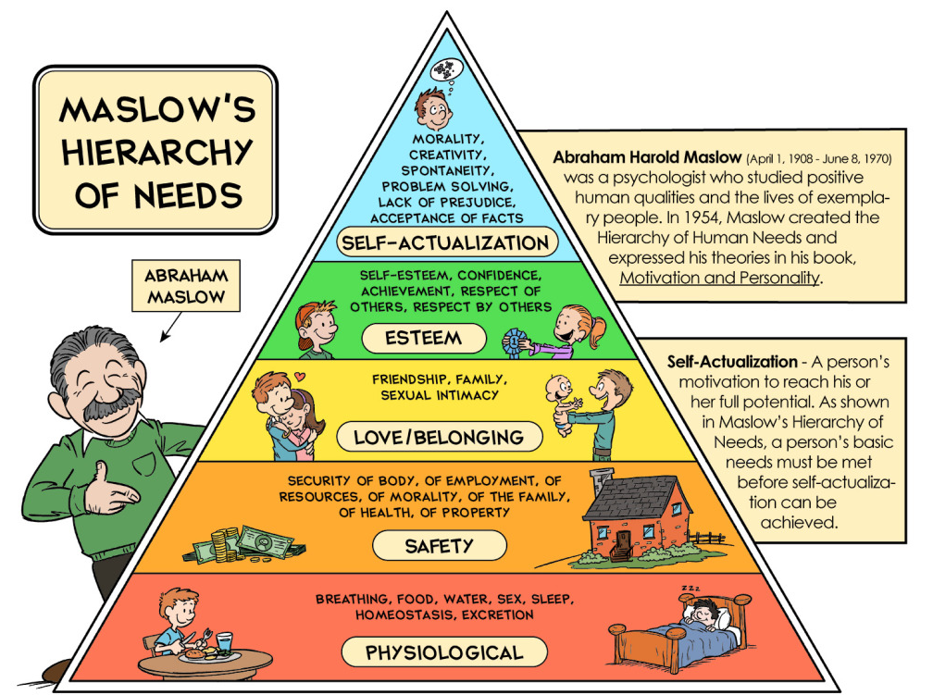

Slide 26
Assumptions About Maslow’s Hierarchy
Basic needs must be at least partially satisfied before higher-order needs can become relevant to the individual.
Individuals meet their needs in different ways.
The manner the needs are met and the extent by which these are considered needs vary according to each individual.
  Individualized nursing care

Slide 27
Homeostasis
Homeostasis is a dynamic balance achieved by effectively functioning open systems.
  Homeostasis is attained by coordinated responses of body/person systems
Individuals, as open systems, also endeavor to maintain balance between external and internal forces.
  When balance is achieved, the person is healthy or is resistant to illness.
  If no adaptation, disequilibrium may occur leading to illness or disease.
Carl Rogers (1961) On becoming a Person
  A person’s needs change as the person changes.
Adaptation = response to change in health status
E.g. person loses mobility obtains skill that

Slide 28
Fundamental Nursing Concepts
CONCEPT 2: Environment: The supra-system in which a person lives in.
  The environment can either promote or interfere with homeostasis and well-being of individuals.
  In Maslow’s hierarchy of needs, there is a dynamic interaction between a person’s needs (internal) and the satisfaction of those needs (often environmentally determined).

Slide 29
Environmental Systems
Family system
  Nuclear and extended family
  Trends in USA
Cultural systems
Social systems:
  Communities
  States
  Nations
  Supra-national
  International
Nurses’ potential impact on the environment/supra-system
  Ecological health
  Healthy work environments
  WHO training modules including mercury poisoning
  Health Care Without Harm to reduce hazardous waste
  Luminary Projec

Slide 30
Fundamental Nursing Concepts
CONCEPT 3: Health as a continuum
Definition vary
  WHO definition
Health beliefs models:
  Rosenstock’s Health Beliefs Model
    E.g. perception of vulnerability will motivate health behavior
  Bandura’s Theory of Self-efficacy
    E.g. belief that one has ability to change health acts as a motivator
Locus of control : Internal vs. external locus of control

Slide 31
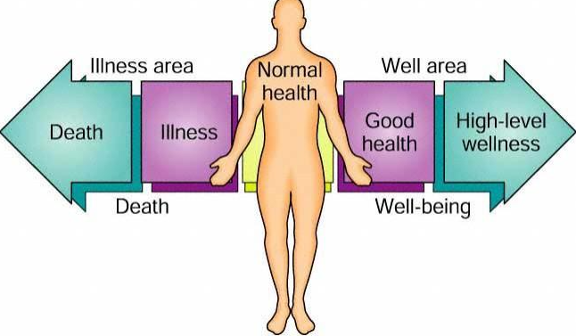
Health as a Continuum

Slide 32
Nursing: Forming the Meaningful Whole
Holistic nursing care nourishes the whole person – the body, mind, and spirit.
  Eight factors contribute to holistic approach to nursing
  Nursing is an open system
  Nursing is the provision of health care services
  Nursing involves collaborating with patients and their families
  Nursing is integrally involved with people
  Nursing care is provided regardless of diagnosis, individual differences, age, beliefs, gender, sexual orientation, or other factors.
  Nurses require advanced knowledge and skills
  Nursing requires concern, compassion, respect, and warmth, as well as comprehensive, individualized planning of care, to facilitate patients’ growth toward wellness.
  Nursing links theory and research

