Slide 1

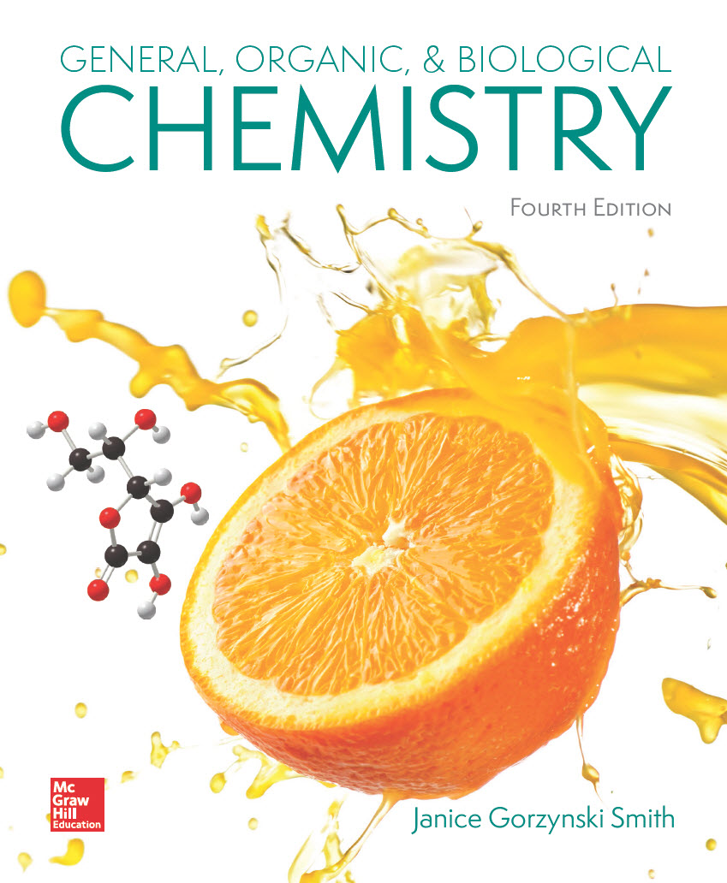
Chapter 1
Lecture Outline
Prepared by Harpreet Malhotra
Florida State College at Jacksonville

Slide 2
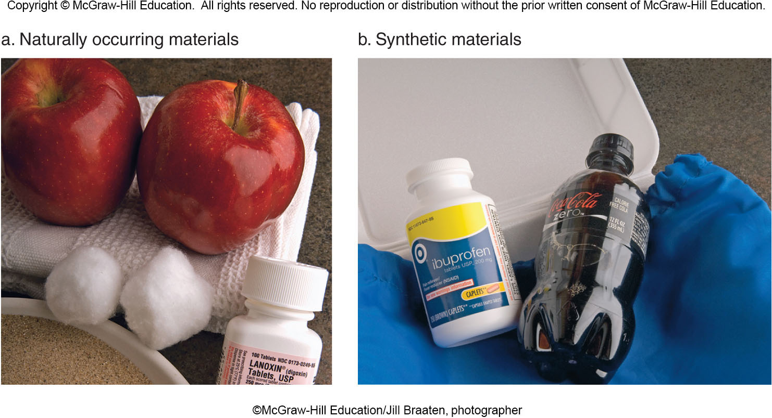
1.1 Chemistry—The Science of Everyday Experience
Chemistry is the study of matter—its composition, properties, and transformations.
Matter is anything that has mass and takes up volume.
Matter can be:
©McGraw-Hill Education/Jill Braaten, photographer

Slide 3
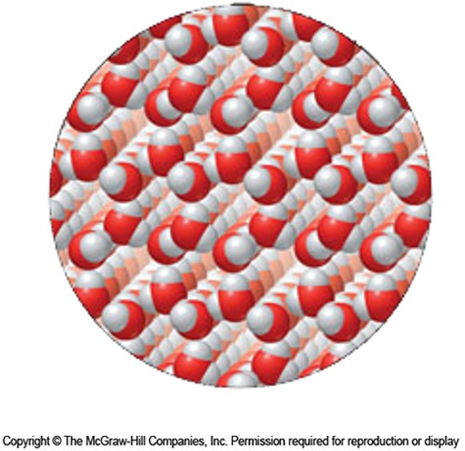
1.2 States of Matter (1)
The Solid State:
A solid has a definite volume.
It maintains its shape regardless of its container.
Solid particles lie close together in a regular pattern.

Slide 4
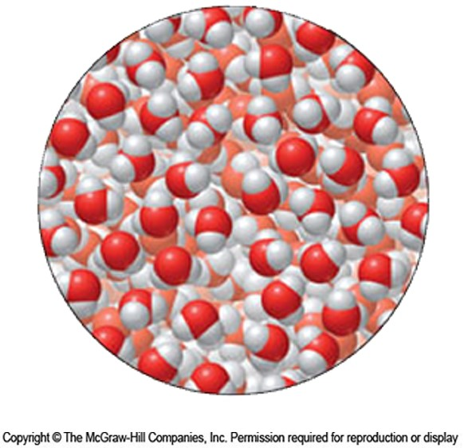
1.2 States of Matter (2)
The Liquid State:
A liquid has a definite volume.
It takes the shape of its container.
Liquid particles are close together but can move past one another.

Slide 5
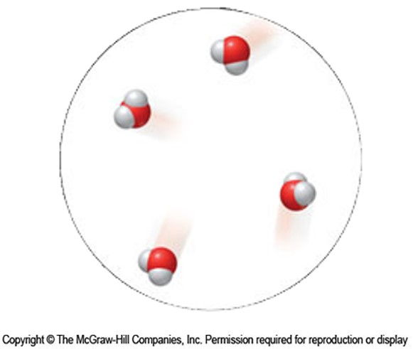
1.2 States of Matter (3)
The Gas State:
A gas has no definite shape; it assumes the shape of its container.
It has no definite volume; it assumes the volume of its container.
Gas particles are very far apart and move around randomly.

Slide 6
1.2 States of Matter (4)
Physical properties can be observed or measured
without changing the composition of the material.
boiling point
melting point
solubility
color
odor
state of matter

Slide 7
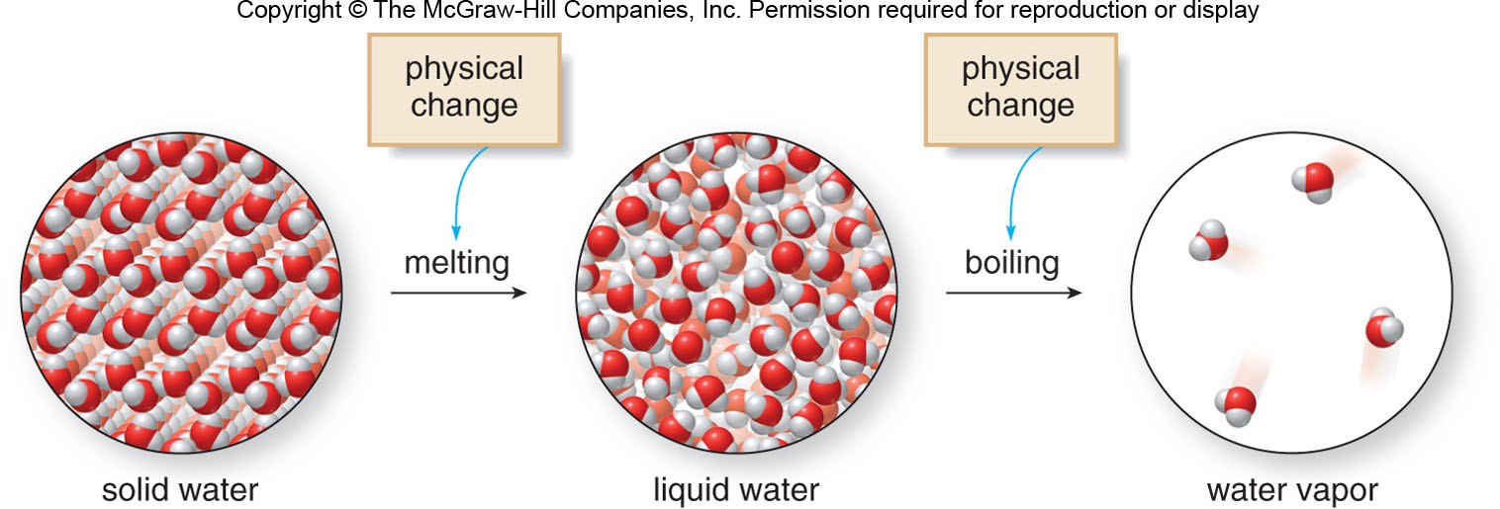
1.2 States of Matter (5)
A physical change alters the material without changing its composition.
Physical changes will be covered in more detail in Chapter 7.

Slide 8
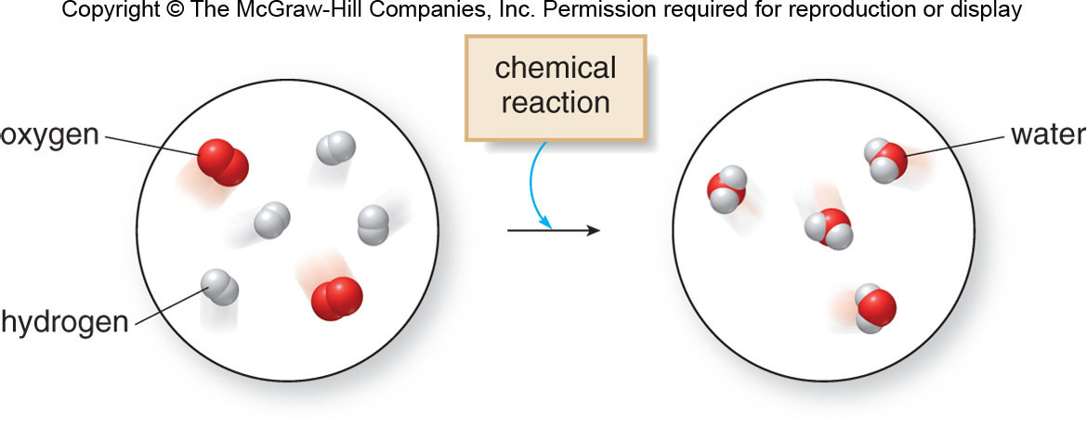
1.2 States of Matter (6)
Chemical properties determine how a substance can be converted into another substance.
Chemical change is the chemical reaction that converts one substance into another (Chapters 5 and 6).

Slide 9
1.3 Classification of Matter (1)
All matter can be classified as either a pure substance or a mixture.
Pure Substances
A pure substance is composed of only a single component (atom or molecule).
It has a constant composition, regardless of sample size or origin of sample.
It cannot be broken down to other pure substances by a physical change.

Slide 10
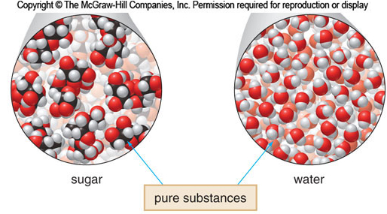
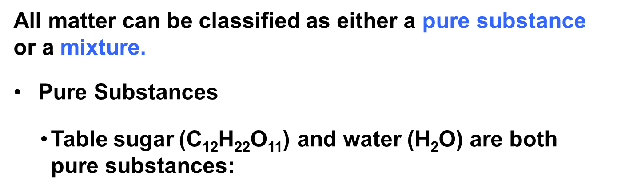
1.3 Classification of Matter (2)
All matter can be classified as either a pure substance or a mixture.
Pure Substances
Table sugar (C₁₂H₂₂O₁₁) and water (H₂O) are both pure substances:

Slide 11
1.3 Classification of Matter (3)
All matter can be classified as either a pure substance or a mixture.
Mixtures
Mixtures are composed of more than one component.
They can have varying composition (any combination of solid, liquid, and gas).
Mixtures can be separated into their components by a physical process.

Slide 12
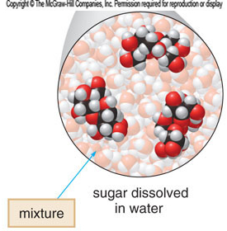
1.3 Classification of Matter (4)
All matter can be classified as either a pure substance or a mixture.
Mixtures
Sugar dissolved in water is a mixture.

Slide 13
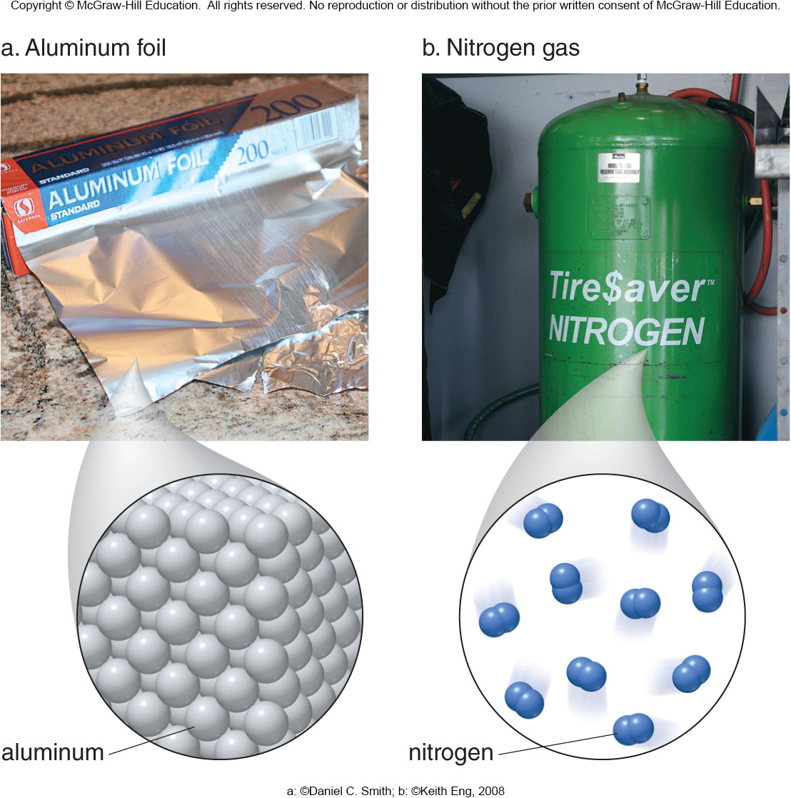
1.3 Classification of Matter (5)
A pure substance is classified as an element or a compound.
An element is a pure substance that cannot be broken down by a chemical change.
a: ©Daniel C. Smith; b: ©Keith Eng, 2008

Slide 14
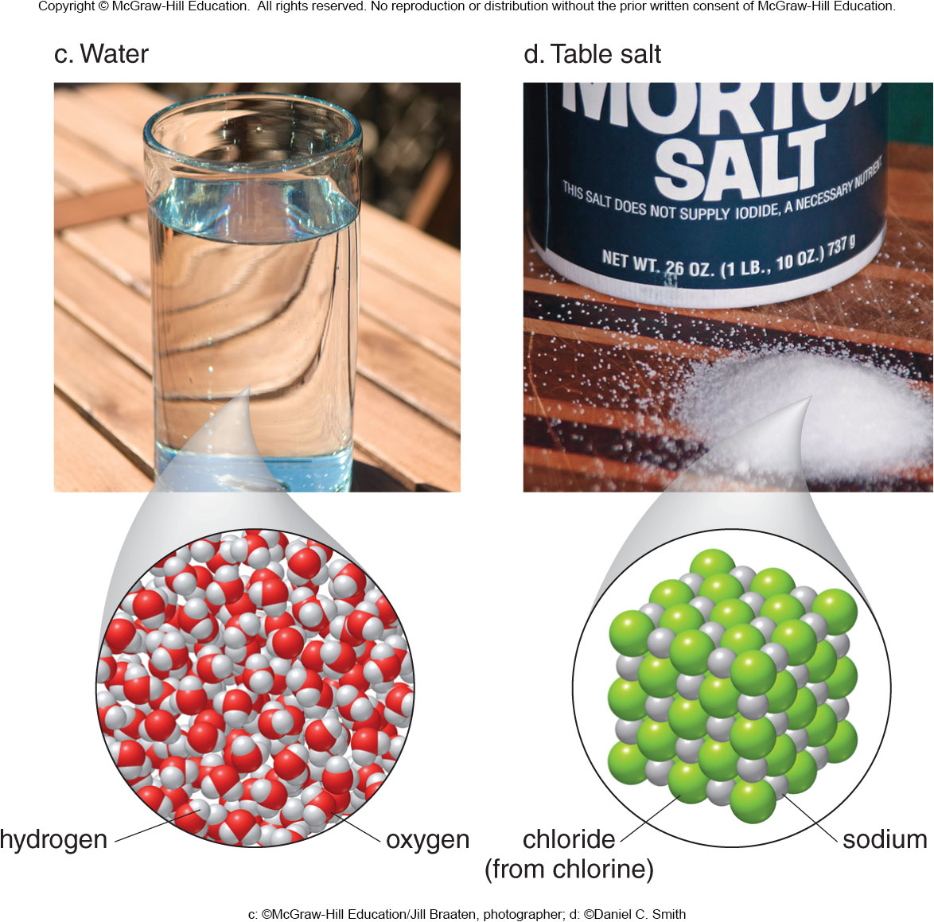
1.3 Classification of Matter (6)
A pure substance is classified as an element or a compound.
A compound is a pure substance formed by chemically joining two or more elements.
c: ©McGraw-Hill Education/Jill Braaten, photographer; d: ©Daniel C. Smith

Slide 15
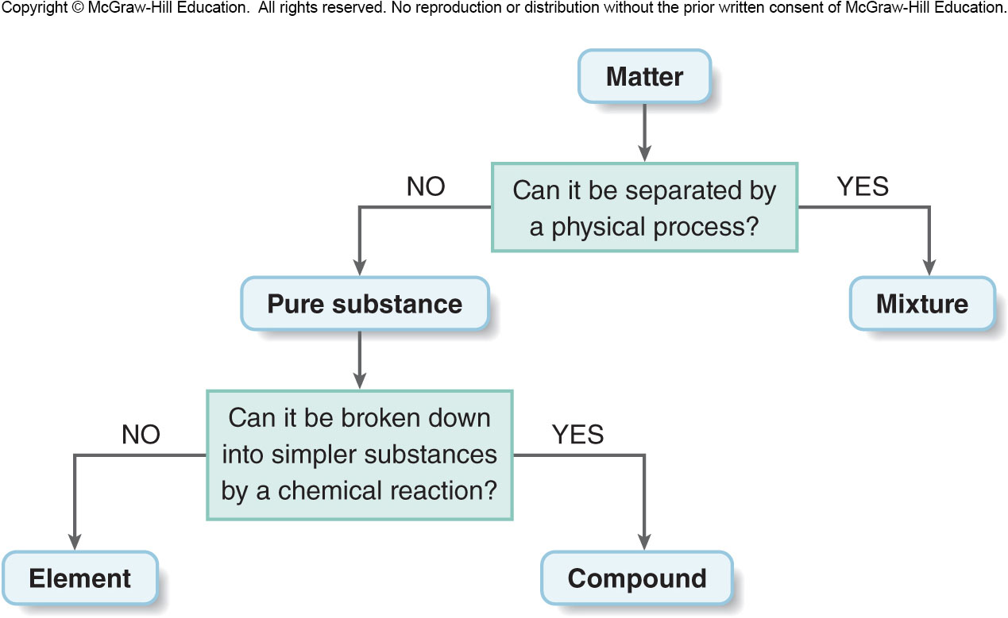
1.3 Classification of Matter (7)

Slide 16
1.4 Measurement (1)
Every measurement is composed of a number and a unit.
The number is meaningless without the unit.
Examples:
proper aspirin dosage = 325 (milligrams or pounds?)
a fast time for the 100-meter dash = 10.00 (seconds or days?)

Slide 17
1.4 Measurement (2)
The Metric System
Each type of measurement has a base unit in the metric system..
Table 1.1 The Basic Metric Units
Quantity | Metric Base Unit | Symbol
Length | Meter | m
Mass | Gram | g
Volume | Liter | L
Time | Second | s

Slide 18
1.4 Measurement (3)
The Metric System
Other units are related to the base unit by a power of 10.
The prefix of the unit name indicates if the unit is larger or smaller than the base unit.
Table 1.2 Common Prefixes Used for Metric Units
Prefix
Symbol
Meaning
Giga-
G
Billion
1,000,000,000.
Mega-
M
Million
1,000,000.
Kilo-
k
Thousand
1,000.
Deci-
d
Tenth
0.1
Centi-
c
Hundredth
0.01
Milli-
m
Thousandth
0.001
Micro-
Millionth
0.000 001
Nano-
n
Billionth
0.000 000 001
that contain five or more digits to the right of the decimal point are written with a small space
separating each group of three digits.
to express numbers in scientific notation is explained in Section 1.6.
symbol
is the lower case Greek letter mu. The prefix micro- is sometimes abbreviated as mc.

Slide 19
1.4 Measurement (4)
Measuring Length
The base unit of length is the meter (m).
1 kilometer (km) = 1,000 meters (m)
1 km = 1,000 m
1 millimeter (mm) = 0.001 meters (m)
1 mm = 0.001 m
1 centimeter (cm) = 0.01 meters (m)
1 cm = 0.01 m

Slide 20
1.4 Measurement (5)
Measuring Mass
Mass is a measure of the amount of matter in an object.
Weight is the force that matter feels due to gravity.
The base unit of mass is the gram (g).
1 kilogram (kg) = 1,000 grams (g)
1 kg = 1,000 g
1 milligram (mg) = 0.001 grams (g)
1 mg = 0.001 g

Slide 21
1.4 Measurement (6)
Measuring Volume
The base unit of volume is the liter (L).
1 kiloliter (kL) = 1,000 liters (L)
1 kL = 1,000 L
1 milliliter (mL) = 0.001 liters (L)
1 mL = 0.001 L
Volume = Length × Width × Height
= cm × cm × cm

Slide 22
1.4 Measurement (7)
Table 1.4 English Units and Their Metric Equivalents
Quantity | English Unit | Metric-English Relationship
Length | 1 ft = 12 in. | 2.54 cm = 1 in.
Length | 1 yd = 3 ft | 1 m = 39.4 in.
Length | 1 mi = 5,280 ft | 1 km = 0.621 mi
Mass | 1 lb = 16 oz | 1 kg = 2.20 lb
Mass | 1 ton = 2,000 lb | 454 g = 1 lb
Mass |  | 28.3 g = 1 oz
Volume | 1 qt = 4 cups | 946 mL = 1 qt
Volume | 1 qt = 2 pints | 1 L = 1.06 qt
Volume | 1 qt = 32 fl oz | 29.6 mL = 1 fl oz
Volume | 1 gal = 4 qt
Common abbreviations for English units: inch (in.), foot (ft), yard (yd), mile (mi), pound (lb), ounce(oz), gallon (gal), quart (qt), and fluid ounce (fl oz).

Slide 23
1.5 Significant Figures (1)
An exact number results from counting objects or is part of a definition.
10 fingers
10 toes
1 meter = 100 centimeters
An inexact number results from a measurement or observation and contains some uncertainty.
15.3 cm
1000.8 g
0.0034 mL

Slide 24
1.5 Significant Figures (2)
Determining Significant Figures
Significant figures are all the digits in a measured
number including one estimated digit.
All nonzero digits are always significant.
65.2 g
3 sig. figures
255.345 g
6 sig. figures

Slide 25
1.5 Significant Figures (3)
Determining Significant Figures
Rules for Zero:
Rule 1: A zero counts as a significant figure when
it occurs:
between two nonzero digits
29.05 g
4 sig. figures
1.0087 mL
5 sig. figures
at the end of a number with a decimal place
3.7500 cm
5 sig. figures
620. lb
3 sig. figures

Slide 26
1.5 Significant Figures (4)
Determining Significant Figures
Rules for Zero:
Rule 2: A zero does not count as a significant figure when it occurs:
at the beginning of a number
0.00245 mg
3 sig. figures
0.008 mL
1 sig. figure
at the end of a number that does not have a decimal
2570 m
3 sig. figures
1245500 m
5 sig. figures

Slide 27
1.5 Significant Figures (5)
Rules for Multiplication and Division
The answer has the same number of significant figures
as the original number with the fewest significant figures.
4 sig. figures
2 sig. figures
Answer must have
2 sig. figures.

Slide 28
1.5 Significant Figures (6)
Rules for Multiplication and Division
first digit to be dropped
2 sig. figures
Answer
If the first digit
to be dropped is:
between 0 and 4
between 5 and 9
Then:
drop it and all remaining digits
round up the last digit
to be retained by adding 1

Slide 29
1.5 Significant Figures (7)
Rules for Multiplication and Division
Table 1.5 Rounding Off Numbers
Original Number | Rounded To | The First Number to Be Dropped | Rounded Number
61.2537 | Two places | 2 | 61
61.2537 | Three places | 5 | 61.3
61.2537 | Four places | 3 | 61.25
61.2537 | Five places | 7 | 61.254
The first number to be dropped is indicated in red in each original number and again in the third column of the table. When this number is 4 or fewer, it and all other digits to its right are dropped. When this number is 5 or greater, 1 is added to the digit to its left.

Slide 30
1.5 Significant Figures (8)
Rules for Addition and Subtraction
The answer has the same number of decimal places
as the original number with the fewest decimal places.
10.11 kg | 2 decimal places
−3.6 kg | 1 decimal place
= 6.51 kg | answer must have 1 decimal place
6.5 kg | final answer 1 decimal place

Slide 31
1.6 Scientific Notation (1)
In scientific notation, a number is written as:
Exponent:
Any positive or negative
whole number.
Coefficient:
A number between
1 and 10.

Slide 32

1.6 Scientific Notation (2)
HOW TO Convert a Standard Number to Scientific Notation
Example
Convert these numbers to scientific notation.
2,500
0.036
Step [1]
Move the decimal point to give a number
between 1 and 10.
2500
0.036
Step [2]
Multiply the result by
$,$where
x = number of places the decimal was moved.
move decimal left,
x is positive
move decimal right,
x is negative

Slide 33
1.6 Scientific Notation (3)
Converting a Number in Scientific Notation
to a Standard Number
When the exponent x is positive, move the decimal point x places to the right.
When the exponent x is negative, move the decimal point x places to the left.

Slide 34
1.7 Problem Solving Using Conversion Factors (1)
Conversion Factors
Conversion factor: A term that converts a quantity in one unit to a quantity in another unit.
original
quantity
desired
quantity
×
conversion factor
=
Conversion factors are usually written as equalities.
2.20 lb = 1 kg
To use them, they must be written as fractions.
or

Slide 35
1.7 Problem Solving Using Conversion Factors (2)
Solving a Problem Using One Conversion Factor
If a unit appears in the numerator in one term and the denominator in another term, the units cancel.
The goal in setting up a problem is to make sure all unwanted units cancel.
To convert 130 lb into kilograms:
130 lb
original quantity
×
conversion factor
? kg
desired quantity
=

Slide 36
1.7 Problem Solving Using Conversion Factors (3)
Solving a Problem Using One Conversion Factor
Answer
2 sig. figures
×
or
= 59 kg
The bottom conversion factor has the original unit in the denominator.
The unwanted unit lb cancels.
The desired unit kg does not cancel.

Slide 37
1.7 Problem Solving Using Conversion Factors (4)
HOW TO Solve a Problem Using Conversion Factors
How many grams of aspirin are in a 325-mg tablet?
Example
Identify the original quantity and the desired quantity, including units.
Step [1]
original quantity
325 mg
desired quantity
? g

Slide 38
1.7 Problem Solving Using Conversion Factors (5)
HOW TO Solve a Problem Using Conversion Factors
Step [2]
Write out the conversion factor(s) needed to solve the problem.
1 g = 1000 mg
This can be written as two possible fractions:
or
Choose this factor to
cancel the unwanted
unit, mg.

Slide 39
1.7 Problem Solving Using Conversion Factors (6)
HOW TO Solve a Problem Using Conversion Factors
Step [3]
Set up and solve the problem.
Write the answer with the correct number of significant figures.
Step [4]

Slide 40
1.7 Problem Solving Using Conversion Factors (7)
Solving a Problem Using Two or More Conversion Factors
Always arrange the factors so that the denominator in
one term cancels the numerator in the preceding term.
How many liters are in 1.0 pint?
1.0 pint
original quantity
? L
desired quantity
Two conversion factors are needed:
2 pints = 1 quart
1.06 quarts = 1 liter
or
or
Choose the right side one to cancel pt.
Choose the right side one to cancel qt.

Slide 41
1.7 Problem Solving Using Conversion Factors (8)
Solving a Problem Using Two or More Conversion Factors
Set up the problem and solve:
2 sig. figures
2 sig. figures
Write the answer with the correct number of significant figures.

Slide 42
1.9 Temperature
Temperature is a measure of how hot or cold an object is.
Three temperature scales are used:
Degrees Fahrenheit
Degrees Celsius
Kelvin (K)
To convert from
to
:
To convert from
to
:
To convert from
to K
To convert from K to
:

Slide 43
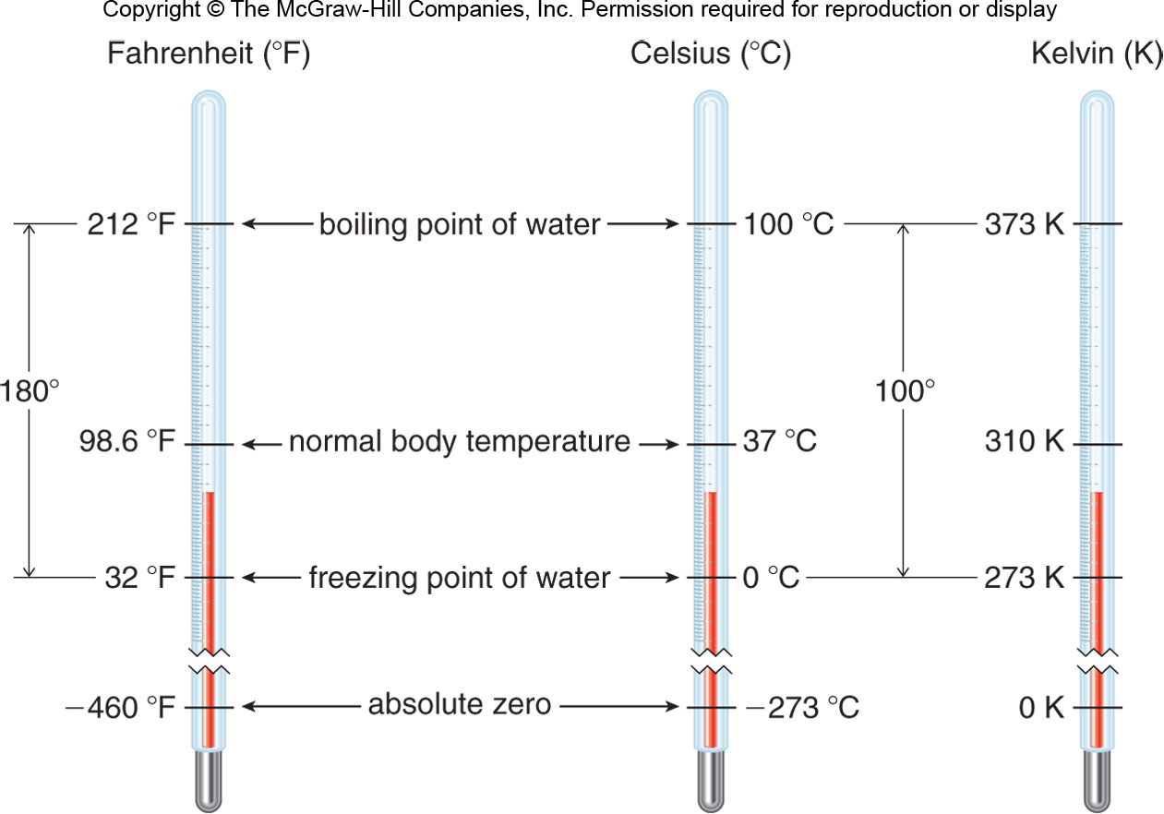
1.9 Temperature Comparing the Three Temperature Scales

Slide 44
1.10 Density and Specific Gravity (1)
Density
Density: A physical property that relates the mass of a substance to its volume.
To convert volume (mL) to mass (g):
To convert mass (g) to volume (mL):
density is g/mL
inverse of density is mL/g

Slide 45
1.10 Density and Specific Gravity (2)
Density
Example:
If the density of acetic acid is 1.05 g/mL, what is
the volume of 5.0 grams of acetic acid?
5.0 g
original quantity
? mL
desired quantity
Density is the conversion factor, and can be
written two ways:
or
Choose the right side one to cancel the unwanted unit, g.

Slide 46
1.10 Density and Specific Gravity (3)
Density
Set up and solve the problem:
2 sig. figures
cancel g
2 sig. figures
Write the final answer with the correct number of significant figures.

Slide 47
1.10 Density and Specific Gravity (4)
Specific Gravity
Specific gravity: A quantity that compares the density
of a substance with the density of water at the
same temperature.
The units of the numerator (g/ml) cancel the units of the denominator (g/ml).
The specific gravity of a substance is equal to its density, but contains no units.

