Slide 1


Chapter 2
Lecture Outline
Prepared by
Harpreet Malhotra
Florida State College at Jacksonville

Slide 2
2.1 Elements (1)
An element is a pure substance that cannot be broken down into simpler substances by a chemical reaction.
Each element is identified by a one- or two-letter symbol.
Elements are arranged in the periodic table.
The position of an element in the periodic table tells us much about its chemical properties.

Slide 3
2.1 Elements (2)
Table 2.1 Common Elements and Their Symbols
Element | Symbol
Bromine | Br
Calcium | Ca
Carbon | C
Chlorine | Cl
Chromium | Cr
Cobalt | Co
Copper | Cu
Fluorine | F
Hydrogen | H
Iodine | I
Lead | Pb
Element | Symbol
Magnesium | Mg
Manganese | Mn
Molybdenum | Mo
Nitrogen | N
Oxygen | O
Phosphorus | P
Potassium | K
Sodium | Na
Sulfur | S
Zinc | Zn

Slide 4
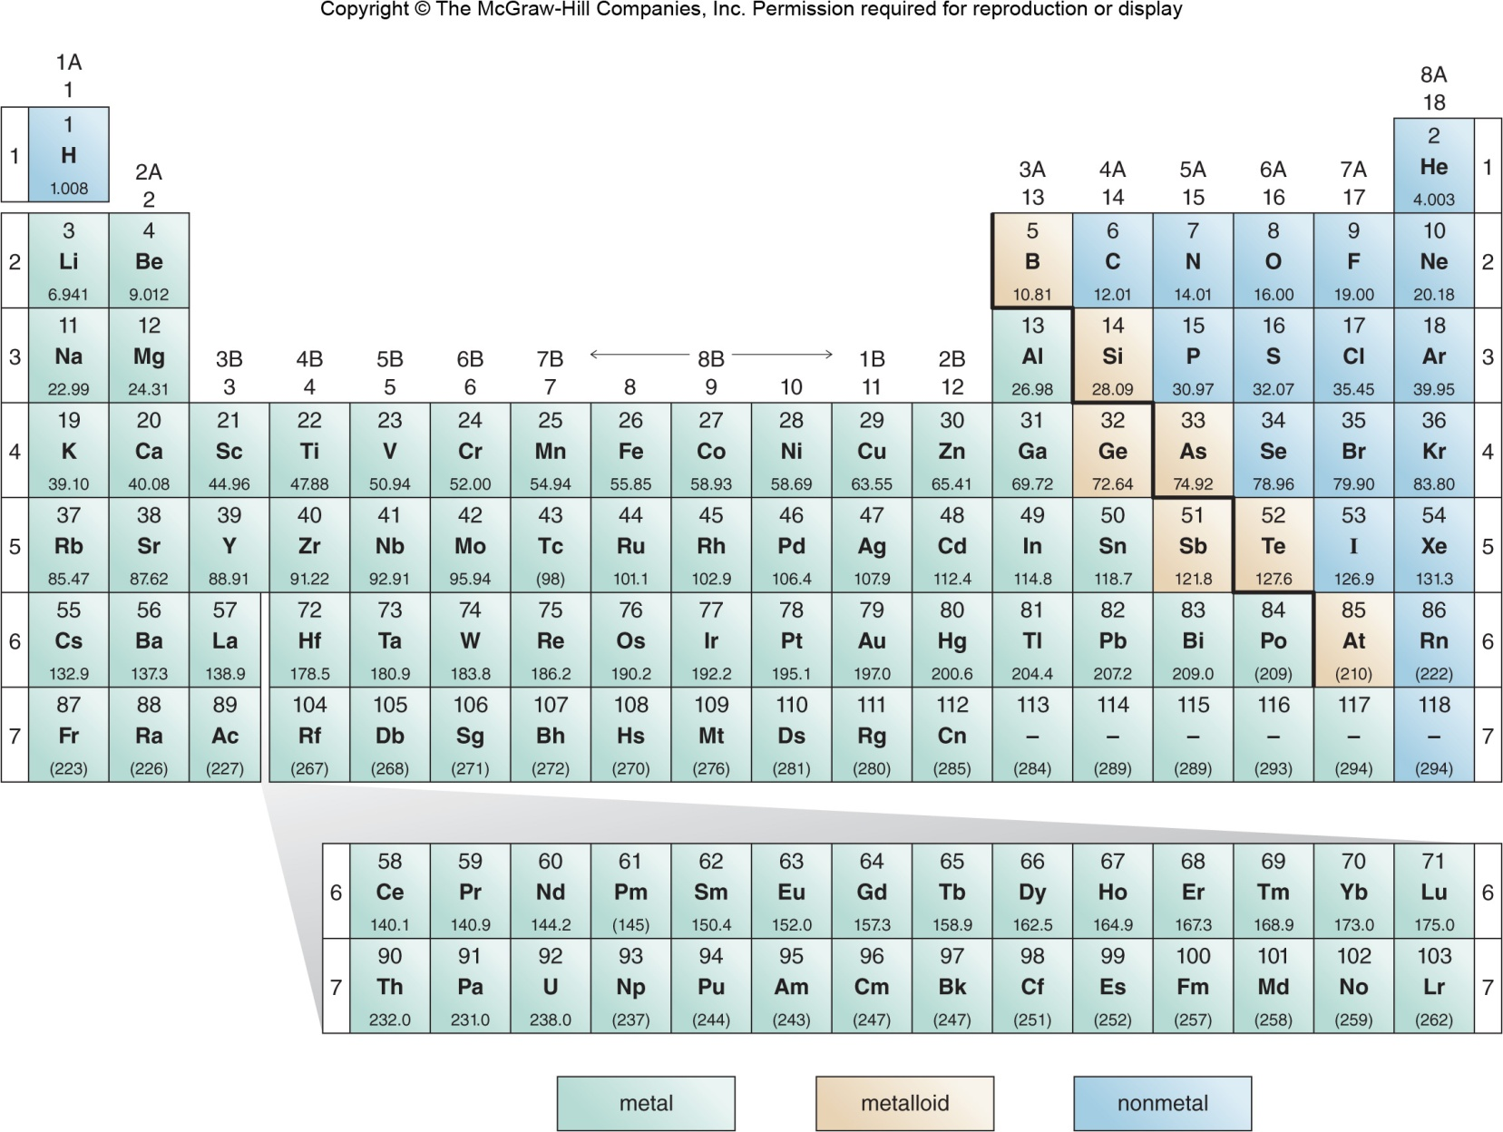
2.1 Elements (3)

Slide 5
2.1 Elements (4)
Elements and the Periodic Table
The elements in the periodic table are divided into three groups—metals, nonmetals, and metalloids.
Metals:
They are located on the left side of the periodic
table.
They are good conductors of heat and electricity.
Metals are shiny solids at room temperature, except for mercury (Hg), which is a liquid.

Slide 6
2.1 Elements (5)
Elements and the Periodic Table
Nonmetals:
They are located on the right side of the periodic table.
Nonmetals have a dull appearance
They are usually poor conductors of heat and electricity.
Nonmetals can be solids, liquids, or gases at room temperature
solid
Examples: sulfur, carbon
liquid
Examples: bromine
gas
Examples: nitrogen, oxygen

Slide 7
2.1 Elements (6)
Elements and the Periodic Table
Metalloids:
These are located on the solid line that starts at boron (B) and angles down towards astatine (At).
Metalloids have properties intermediate between metals and nonmetals
Only seven elements are Metalloids:
boron (B)
silicon (Si)
germanium (Ge)
arsenic (As)
antimony (Sb)
tellurium (Te)
astatine (At)

Slide 8
2.1 Elements (7)
Focus on the Human Body
Building-Block Elements:
The four elements that comprise 96% of the mass of the human body.
oxygen (O) carbon (C)
hydrogen (H) nitrogen (N)
Carbon, hydrogen, and oxygen are found in the four main types of biological molecules—proteins, carbohydrates, lipids, and nucleic acids. Proteins and nucleic acids contain nitrogen.
These biological molecules are discussed in Chapters 19 to 22.

Slide 9
2.1 Elements (8)
Focus on the Human Body
Major Minerals:
These elements are present in smaller amounts and at least 100 mg of each are needed in the daily diet.
Magnesium (Mg) and sulfur (S) are found in proteins.
Trace Elements:
Usually less than 15 mg of each of these elements are required in the daily diet.
Iodine (I) is needed for proper thyroid function.

Slide 10
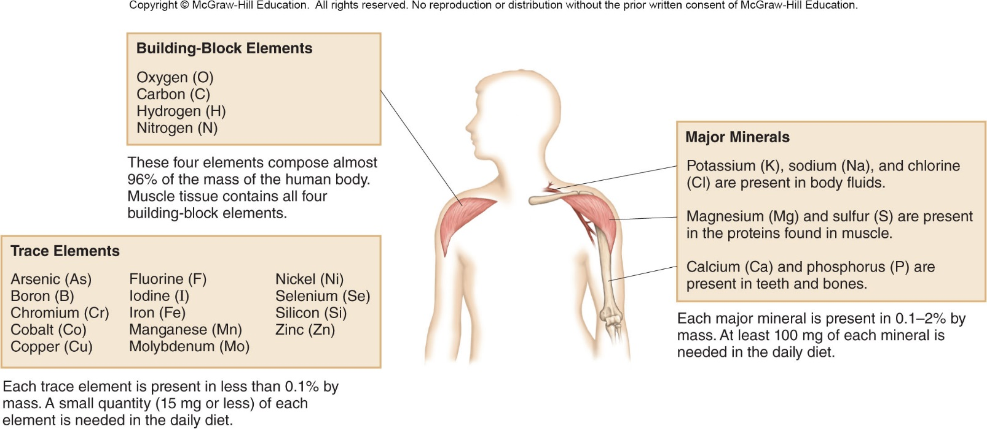
2.1 Elements (9)
Focus on the Human Body

Slide 11
2.1 Elements (10)
Compounds
Compound: a pure substance formed by chemically combining two or more elements together.
A chemical formula consists of:
Element symbols to show the identity of the elements forming a compound.
Subscripts to show the ratio of atoms in the compound.
H₂O
C₃H₈
2 H atoms
1 O atom
3 C atoms
8 H atoms

Slide 12
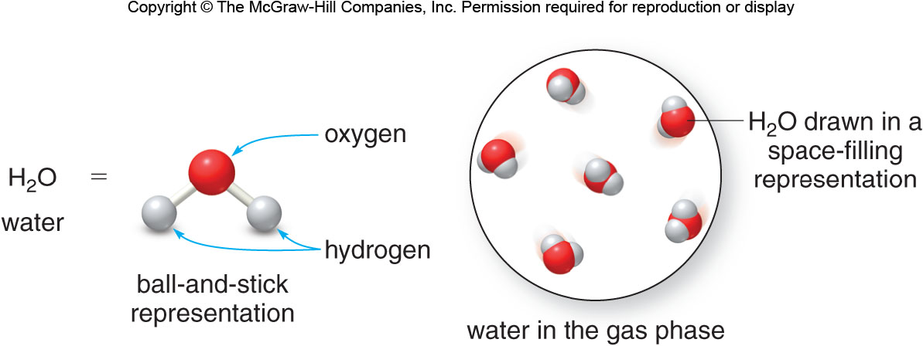
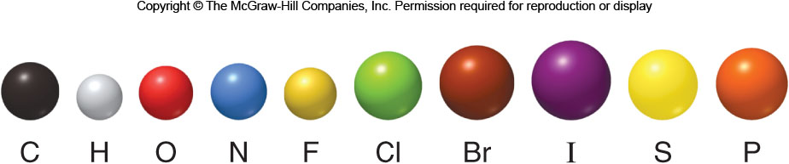
2.1 Elements (11)
Compounds
Compounds can be drawn many ways:
Different elements are represented by different colors:

Slide 13
2.2 Structure of the Atom (1)
All matter is composed of the same basic building blocks called atoms.
Atoms are composed of three subatomic particles:
Table 2.3 Summary: The Properties of the Three Subatomic Particles
Subatomic Particle
Charge
Mass (g)
Mass (amu)
Proton
+1
1
Neutron
0
1
Electron
−1
Negligible

Slide 14
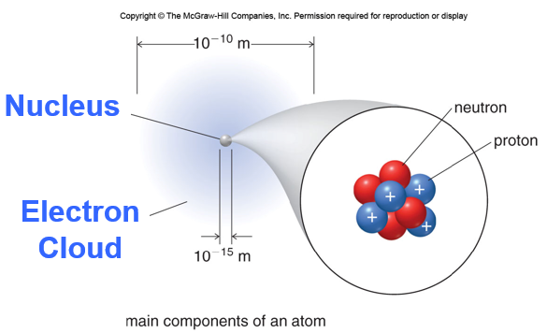
2.2 Structure of the Atom (2)
Nucleus:
location of protons and neutrons
dense core of the atom
location of most of the atom’s mass
Electron cloud:
location of electrons
comprises most of the atom’s volume
mostly empty space

Slide 15
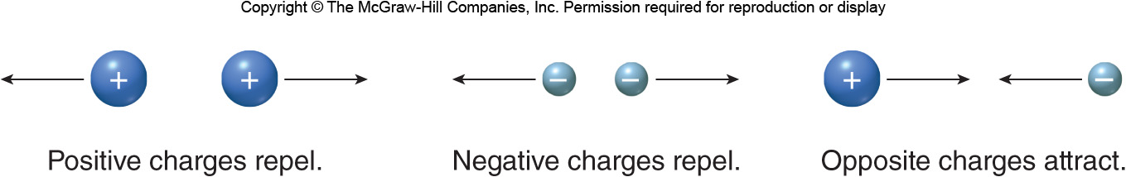
2.2 Structure of the Atom (3)
Opposite charges attract while like charges repel each other.
Protons and electrons attract each other, but two electrons repel each other.

Slide 16
2.2 Structure of the Atom (4)
From the periodic table:
3 Li
Atomic number (Z) is the number of protons in the nucleus.
Every atom of a given element has the same number of protons in the nucleus.
Different elements have different atomic numbers.
A neutral atom has no net overall charge, so
Z=number of protons = number of electrons

Slide 17
2.3 Isotopes (1)
Isotopes, Atomic Number, and Mass Number
Isotopes are atoms of the same element that have a different number of neutrons.
the number of protons (Z)
+
the number of neutrons
Mass number (A) =
Mass number (A)
Mass number (A)
Atomic number (Z)
Atomic number (Z)
# of protons = 17
# of protons = 17
# of electrons = 17
# of electrons = 17
# of neutrons = 35 − 17 = 18
# of neutrons = 37 − 17 = 20

Slide 18
2.3 Isotopes (2)
Atomic Weight
The atomic weight is the weighted average of the masses of the naturally occurring isotopes of a particular element reported in atomic mass units.
From the periodic table:
6
atomic number
C
element symbol
12.01
atomic weight (amu)

Slide 19
2.3 Isotopes (3)
Atomic Weight
HOW TO Determine the Atomic Weight of an Element
Example
What is the atomic weight of chlorine?
Step [1]
List each isotope, its mass in atomic mass units, and its abundance in nature.
Isotope | Mass (amu) | Isotopic Abundance
Cl-35 | 34.97 | 75.78% = 0.7578
Cl-37 | 36.97 | 24.22% = 0.2422

Slide 20
2.3 Isotopes (4)
Atomic Weight
HOW TO Determine the Atomic Weight of an Element
Multiply the isotopic abundance by the mass of each isotope, and add up the products.
The sum is the atomic weight of the element.
Step [2]
34.97 × 0.7578 = 26.5003 amu
36.97 × 0.2422 = 8.9541 amu
4 sig. figs.
35.4544 amu
=
35.45 amu
Answer 4 sig. figs.

Slide 21
2.4 The Periodic Table (1)
Basic Features of the Periodic Table
A row in the periodic table is called a period, and a column in the periodic table is called a group.
Main group elements:
They consist of the tall columns on the right and left of the Periodic Table.
The groups are numbered 1A to 8A.
Transition metal elements:
These are in the 10 short columns in the middle.
The groups are numbered 1B to 8B.
Inner transition elements:
They consist of the lanthanides and actinides.
There are no group numbers assigned.

Slide 22
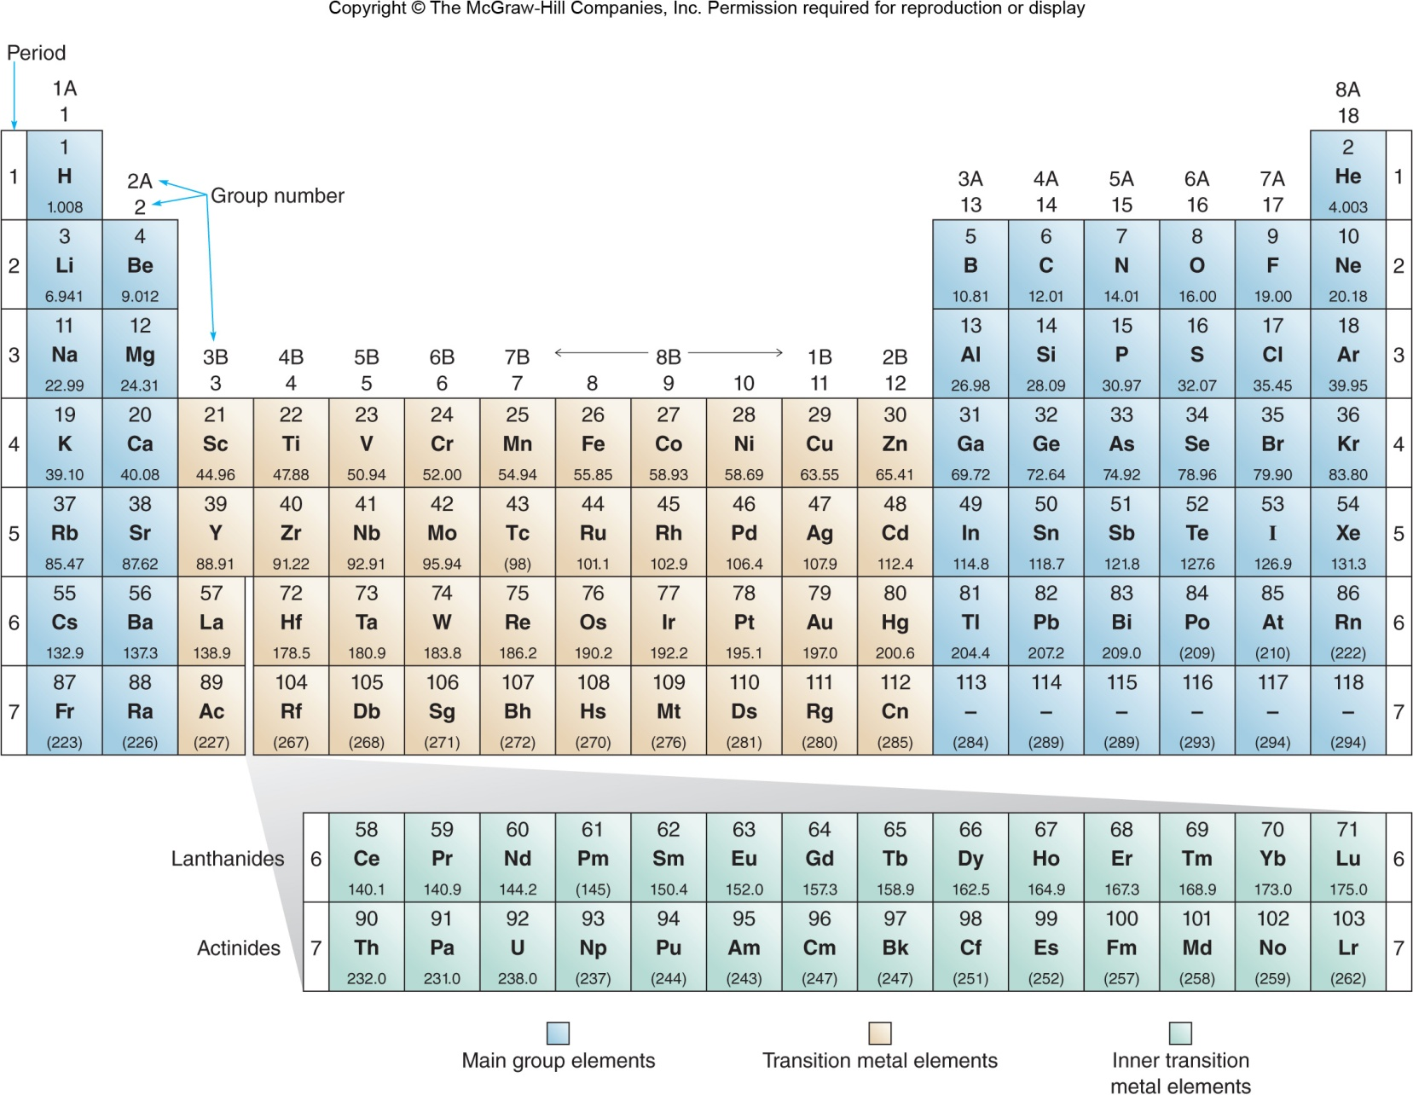
2.4 The Periodic Table (2)
Basic Features of the Periodic Table

Slide 23
2.4 The Periodic Table (3)
B-1 Characteristics of Groups 1A and 2A
Elements that comprise a particular group have similar chemical properties.
Properties of Both Groups
soft and shiny metals
low melting points
good conductors of heat and electricity
react with water to form basic solutions
Group Number | Group Name
1A | Alkali metals
2A | Alkaline earth elements

Slide 24
2.4 The Periodic Table (4)
B-2 Characteristics of Groups 7A and 8A
Group Number | Group Name | Properties
7A | Halogens | exist as two atoms joined together very reactive
8A | Noble gases | very stable rarely combine with any other elements

Slide 25

2.4 The Periodic Table (5)
The Unusual Nature of Carbon
Carbon’s ability to join with itself and other elements gives it a versatility not seen with any other element in the periodic table.
Elemental forms of carbon include the following carbon-only structures:
(a): ©Charles O’Rear/Corbis; (b): ©Lester V. Bergman/Corbis; (c): ©McGraw-Hill Education/Jill Braaten, photoghapher

Slide 26
2.5 Electronic Structure (1)
An electron is confined to a specific region around the nucleus, giving it a particular energy.
The regions occupied by electrons are called principal energy levels or shells (n).
The shells are numbered n = 1,2,3,4 etc.
Electrons in lower numbered shells are closer to the nucleus and are lower in energy.
Electrons in higher numbered shells are further from the nucleus and are higher in energy.

Slide 27

2.5 Electronic Structure (2)
Shells with larger numbers (n) are farther from the nucleus and can hold more electrons.
The maximum number of electrons in each shell is given by the formula
, where n = shell number.
The distribution of electrons in the first four shells:
Shell (n) | Number of Electrons in a Shell
4 | 32
3 | 18
2 | 8
1 | 2
increasing energy
increasing number of electrons

Slide 28

2.5 Electronic Structure (3)
Shells are divided into subshells, identified by the letters s, p, d, and f.
The subshells consist of orbitals.
An orbital is a region of space where the probability of finding an electron is high.
Each orbital can hold two electrons.
Subshell | Number of Orbitals
s | 1
p | 3
d | 5
f | 7
increasing energy

Slide 29
2.5 Electronic Structure (4)
Table 2.4 Orbitals and Electrons Contained in the Principal Energy Levels (n = 1 − 4)
Shell | Orbitals | Electrons in Each Subshell | Maximum Number of Electrons
1 | 1s | 2 | 2
2 | 2s 2p 2p 2p | 2 3 × 2 = 6 | 8
3 | 3s 3p 3p 3p 3d 3d 3d 3d 3d | 2 3 × 2 = 6 5 × 2 = 10 | 18
4 | 4s 4p 4p 4p 4d 4d 4d 4d 4d 4f 4f 4f 4f 4f 4f 4f | 2 3 × 2 = 6 5 × 2 = 10 7 × 2 = 14 | 32

Slide 30
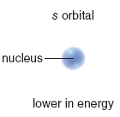
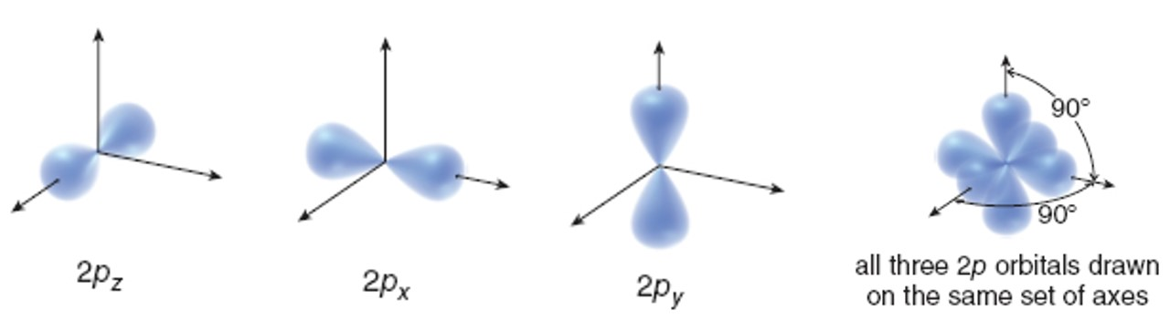
2.5 Electronic Structure (5)
The s orbital has a spherical shape. The orbital gets larger in size as the shell number increases.
The p orbital has a dumbbell shape.

Slide 31
2.6 Electron Configuration (1)
The electron configuration shows how the electrons are arranged in an atom’s orbitals.
The ground state is the lowest energy arrangement.
Rules to Determine the Ground State Electronic Configuration of an Atom
Rule [1]
Electrons are placed in the lowest energy orbital beginning with the 1s orbital.
Orbitals are then filled in order of increasing energy.

Slide 32
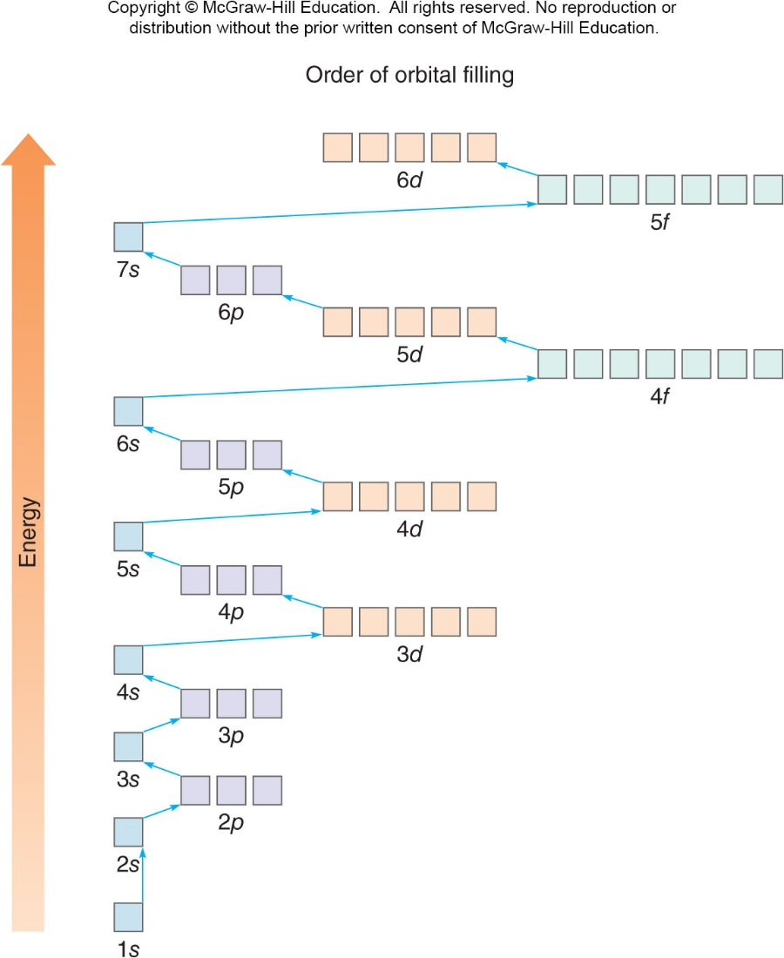
2.6 Electron Configuration (2)
Rules to Determine the Ground State Electronic Configuration of an Atom

Slide 33
Electron Configuration
Rules to Determine the Ground State Electronic Configuration of an Atom
Rule [2]
Each orbital holds a maximum of 2 electrons.
Rule [3]
When orbitals are equal in energy:
1 electron is added to each orbital until all of the orbitals are half-filled.
Then, the orbitals can be completely filled.

Slide 34

2.6 Electron Configuration (3)
Orbital Diagrams
An orbital diagram uses a box to represent each orbital and arrows to represent electrons.
an orbital
a single, unpaired electron
an electron pair
Two electrons must have paired spins (opposite directions) to fit into the same orbital.

Slide 35
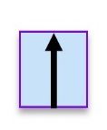

2.6 Electron Configuration (4)
First-Row Elements (Period 1)
Orbital Notation
Electron Configuration
Element
H (Z = 1) 1 electron
1s
He (Z = 2)
2 electrons
1s

Slide 36
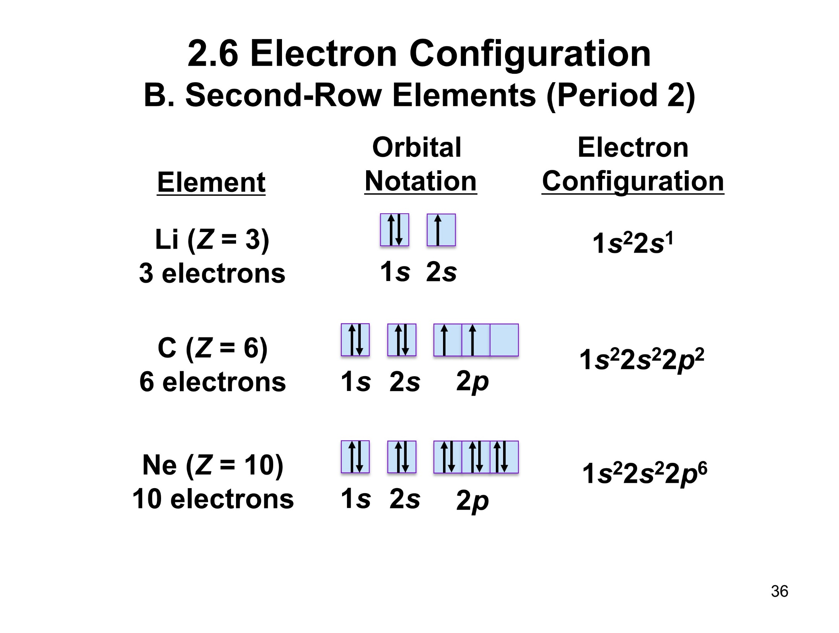





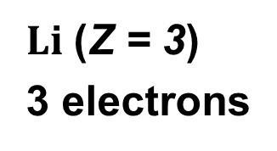
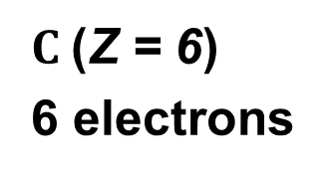
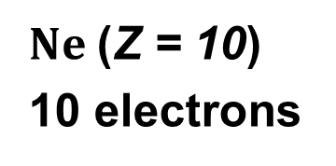
2.6 Electron Configuration (5)
Second-Row Elements (Period 2)
Orbital Notation
Electron Configuration
Element
$Li$(Z = 3)
3 electrons
1s
2s
$C$(Z = 6)
6 electrons
1s
2s
2p
$Ne$(Z = 10)
10 electrons
1s
2s
2p

Slide 37
2.6 Electron Configuration (6)
The electron configuration can be shortened by
using Noble Gas Notation.
Write the Symbol of the previous Noble Gas, then add the electronic configuration of the additional electrons.
Electron Configuration
Noble Gas Notation
element:
C
[He]
nearest noble gas:
He

Slide 38
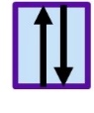
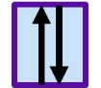



2.6 Electron Configuration (7)
Other Elements
Orbital Notation
Element
Ca
20 electrons
1s
2s
2p
3s
3p
4s
4s is lower in energy; it is filled before 3d.
Electron Configuration
Noble Gas Notation
[Ar]

Slide 39
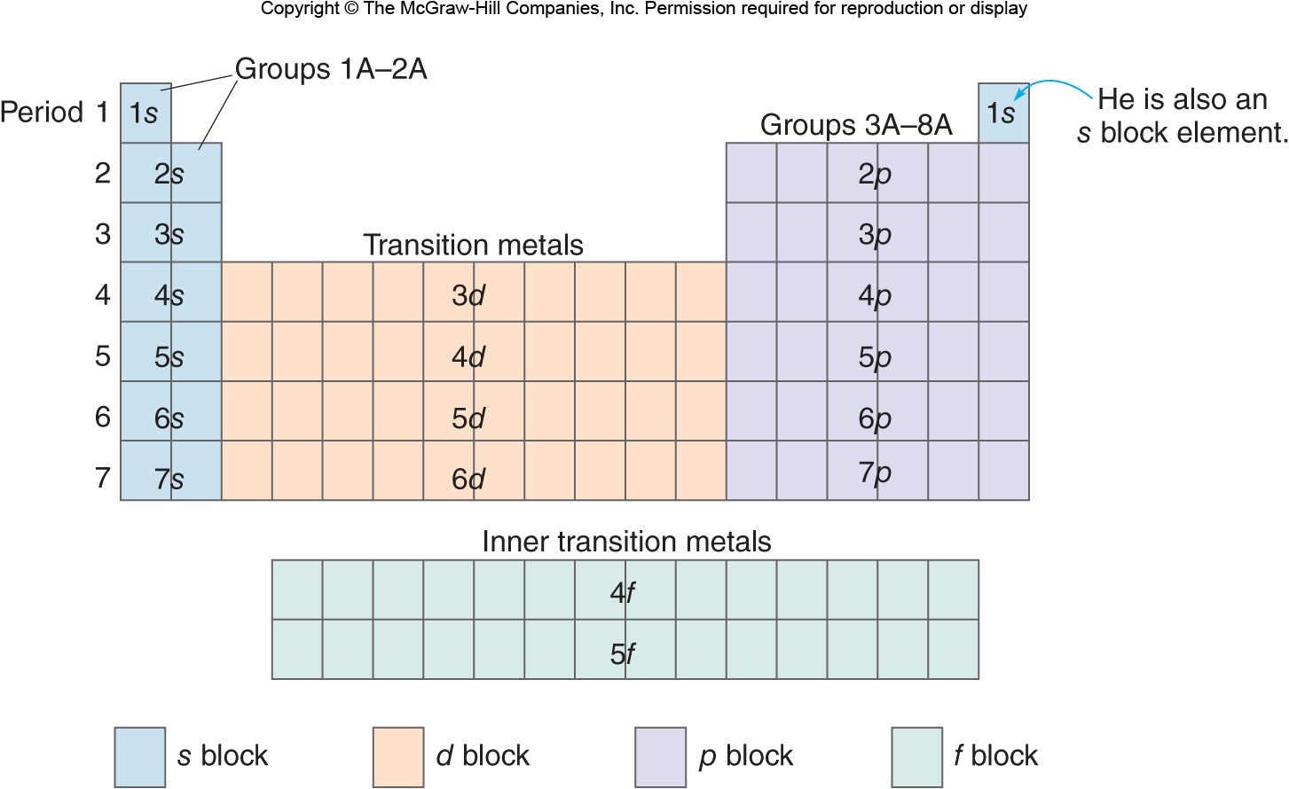
Electron Configurations and the Periodic Table

Slide 40
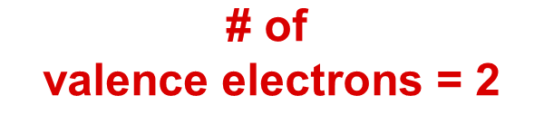
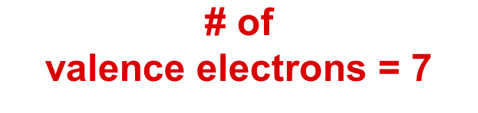
2.7 Valence Electrons (1)
The chemical properties of an element depend on the number of electrons in the valence shell.
The valence shell is the outermost shell (the highest value of n).
The electrons in the valence shell are called valence electrons.
Be
Cl
valence shell: n = 2
valence shell: n = 3
$$\text{\# }\text{of}$$
valence electrons = 2
$$\text{\# }\text{of}$$
valence electrons = 7

Slide 41
2.7 Valence Electrons (2)
Relating Valence Electrons to Group Number
Elements in the same group have similar electron configurations.
Elements in the same group have the same number of valence electrons.
The group number, 1A to 8A, equals the number of valence electrons for the main group elements.
The exception is He, which has only 2 valence electrons.
The chemical properties of a group are therefore very similar.

Slide 42





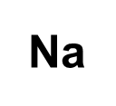
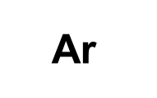


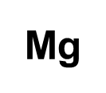
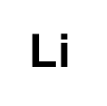
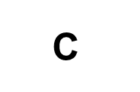


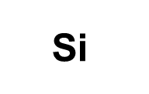
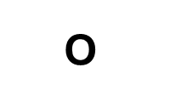
2.7 Valence Electrons (3)
Relating Valence Electrons to Group Number
Group number:
1A
2A
3A
4A
5A
6A
7A
8A
Period 1:
H
He
Period 2:
Li
Be
B
C
N
O
F
Ne
Period 3:
Na
Mg
Al
Si
P
S
Cl
Ar

Slide 43

2.7 Valence Electrons (4)
Electron-Dot Symbol
Dots representing valence electrons are placed on the four sides of an element symbol.
Each dot represents one valence electron.
For 1 to 4 valence electrons, single dots are used. With more than 4 valence electrons, the dots are paired.
Element:
H
C
O
Cl
# of Valence electrons:
1
4
6
7
Electron-dot symbol:

Slide 44
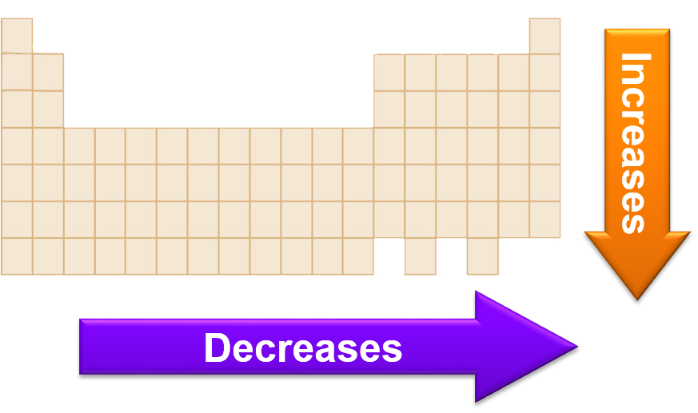
2.8 Periodic Trends (1)
Atomic Size
The size of atoms increases down a column, as the valence e⁻ are farther from the nucleus.
The size of atoms decreases across a row, as the number of protons in the nucleus increases, pulling the valence electrons in closer.

Slide 45
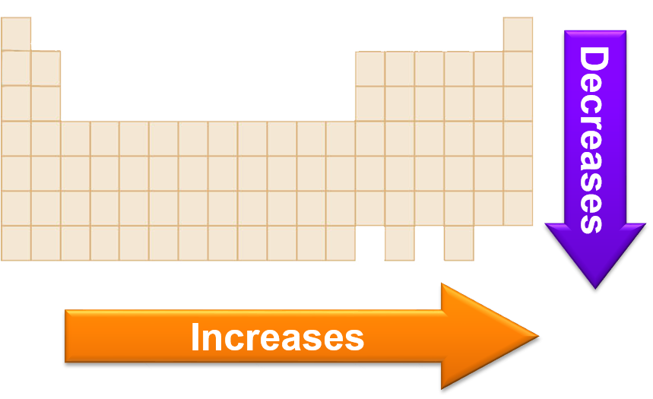
2.8 Periodic Trends (2)
Ionization Energy
The ionization energy is the energy needed to remove an electron from a neutral atom.
Ionization energies decrease down a column as the valence e⁻ get farther away from the positively charged nucleus.
Ionization energies increase across a row as the number of protons in the nucleus increases.

