Slide 1


Chapter 3
Lecture
Outline
Prepared by
Harpreet Malhotra
Florida State College at Jacksonville

Slide 2
3.1 Introduction to Bonding (1)
Bonding is the joining of two atoms in a stable arrangement.
Elements will gain, lose, or share electrons to reach the electron configuration of the noble gas closest to them in the periodic table.
There are two different kinds of bonding:
Ionic bonds result from the transfer of electrons from one element to another.
Covalent bonds result from the sharing of electrons between two atoms.

Slide 3
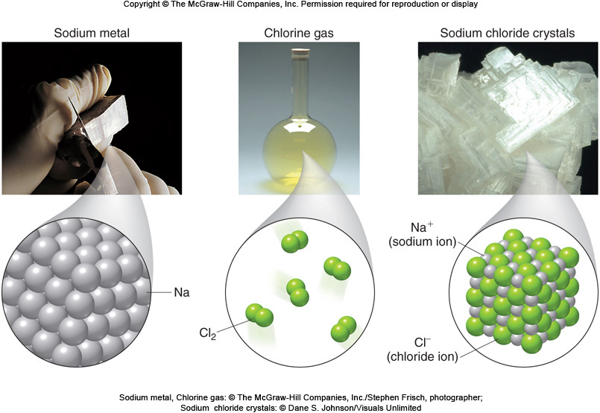
3.1 Introduction to Bonding (2)
Ionic bonds form between:
A metal on the left side of the periodic table.
A nonmetal on the right side of the periodic table.
Sodium metal, Chlorine gas: © The McGraw-Hill Companies, Inc./Stephen Frisch, photographer; Sodium chloride crystals: © Dane S. Johnson/Visuals Unlimited

Slide 4
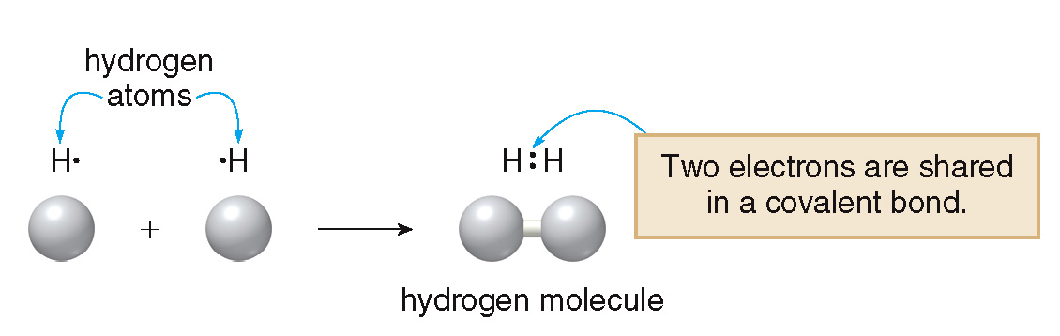
3.1 Introduction to Bonding (3)
Covalent bonds are formed when two nonmetals combine, or when a metalloid bonds to a nonmetal.
A molecule is a compound or element containing two or more atoms joined together with covalent bonds.
Covalent bonds and molecules will be discussed in more detail in Chapter 4.

Slide 5
3.2 Ions (1)
Cations and Anions
Ions are charged species in which the number of protons and electrons in an atom is unequal.
Ionic compounds consist of oppositely charged ions that have a strong electrostatic attraction for each other.
There are two types of ions—cations and anions.

Slide 6
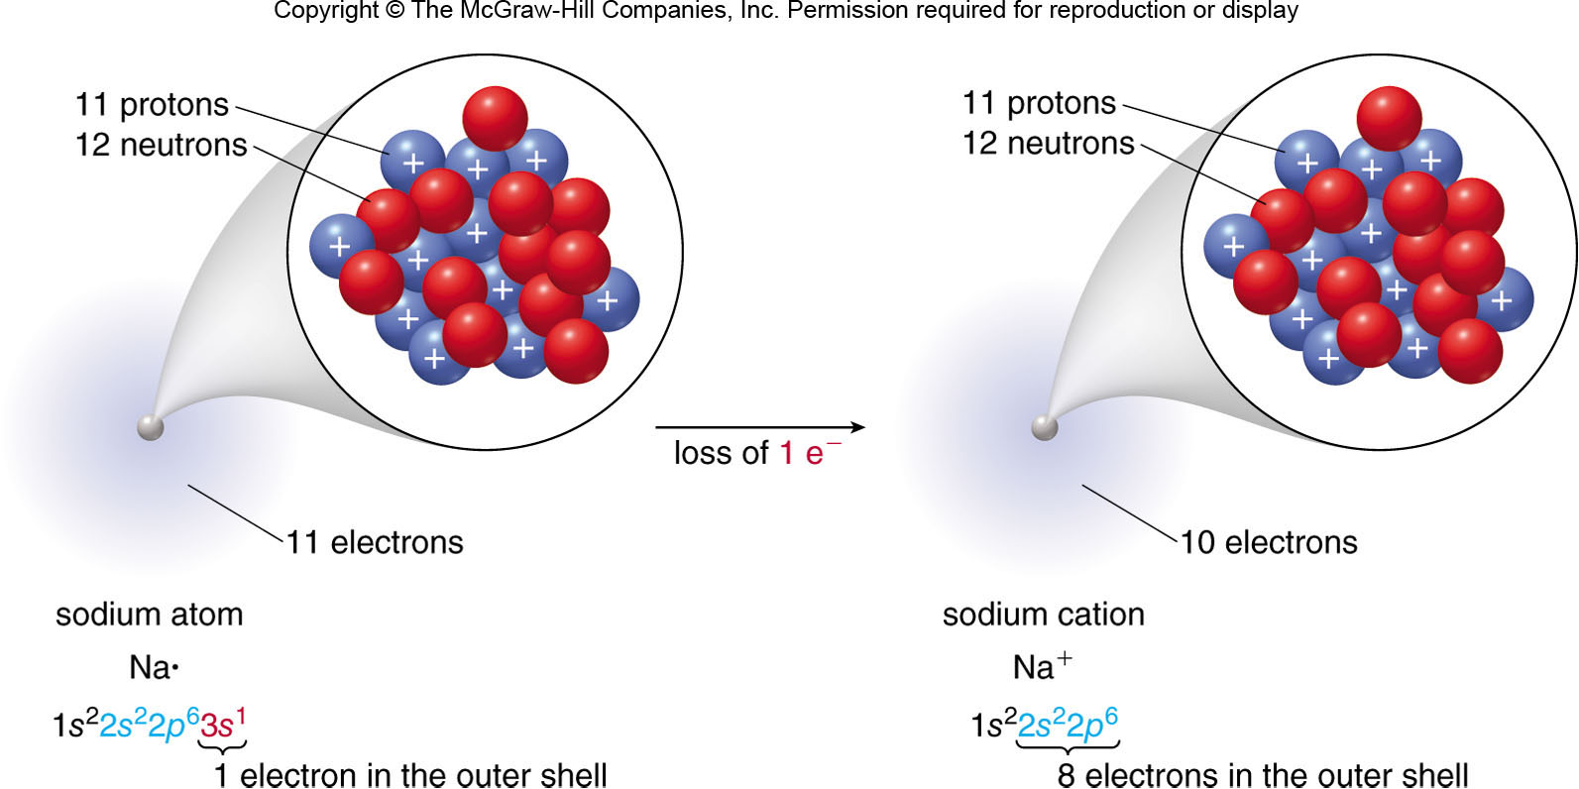
3.2 Ions (2)
Cations and Anions
Cations are positively charged ions. A cation has
fewer electrons (e⁻) than protons.
the sodium atom
the sodium ion

Slide 7
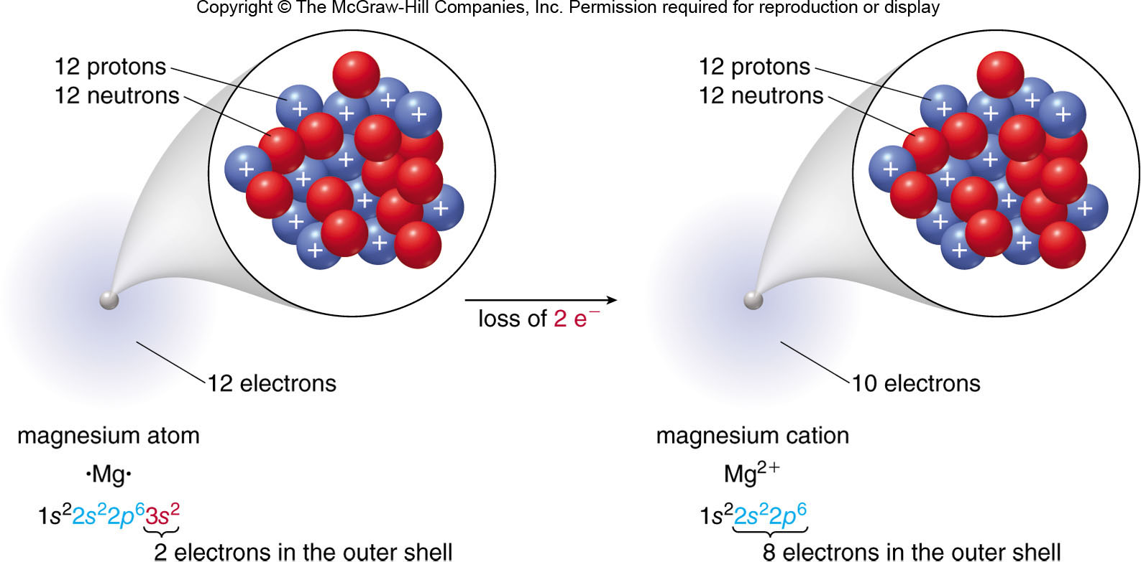
3.2 Ions (3)
Cations and Anions
By losing one, two, or three e⁻, an atom forms a cation with a completely filled outer shell of e⁻.
the magnesium atom
the magnesium ion

Slide 8
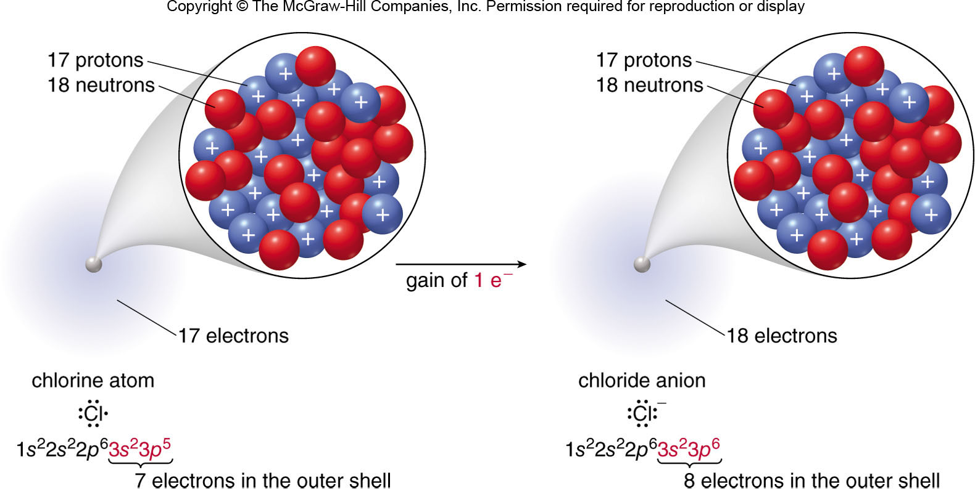
3.2 Ions (4)
Cations and Anions
Anions are negatively charged ions. An anion has
more e⁻ than protons.
the chlorine atom
the chloride ion

Slide 9
3.2 Ions (5)
Cations and Anions
Metals, like sodium (Na) and magnesium (Mg), form cations.
By losing one, two, or three electrons, an atom forms a cation with a completely filled outer shell of electrons.
Nonmetals, like chlorine (Cl), form anions.
By gaining one, two, or three electrons, an atom forms an anion with a completely filled outer shell of e⁻.
The octet rule: a main group element is especially stable when it possesses an octet of e⁻ in its outer shell.
octet = 8 valence e⁻

Slide 10
3.2 Ions (6)
Relating Group Number to Ionic Charge for Main Group Elements
Elements in the same group form ions of similar charge.
For metals in groups 1A, 2A, and 3A, the group number = the charge on the cation.
For nonmetals in Groups 6A and 7A, the anion charge = 8 − the group number.

Slide 11
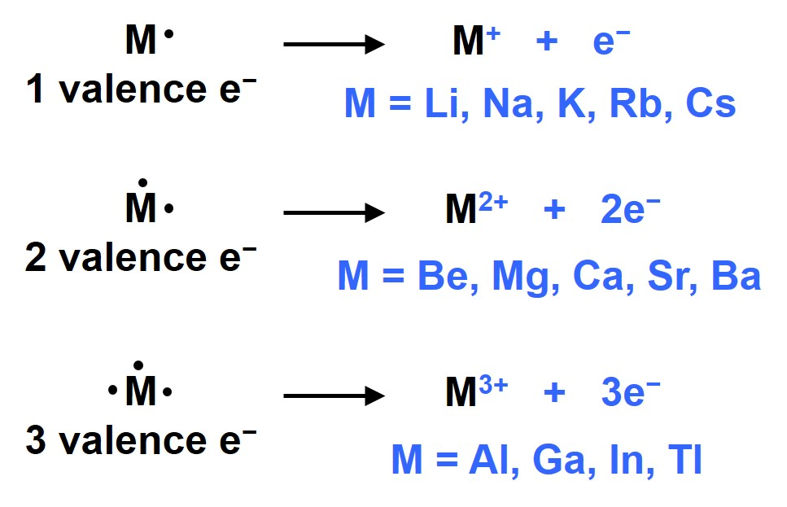
3.2 Ions (7)
B-1 Relating Group Number to Ionic Charge for Groups 1A–3A
the cation charge = the group number
group 1A:
group 2A:
group 3A:

Slide 12
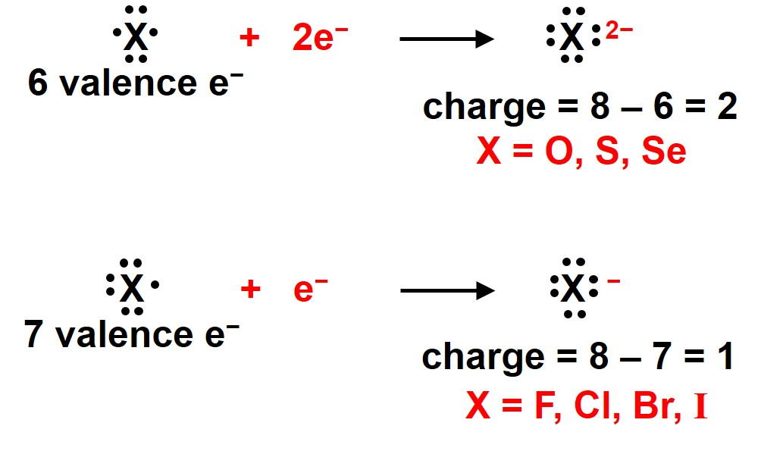
3.2 Ions (8)
B-2 Relating Group Number to Ionic Charge for Groups 6A and 7A
the anion charge = 8 − group number
group 6A:
group 7A:

Slide 13
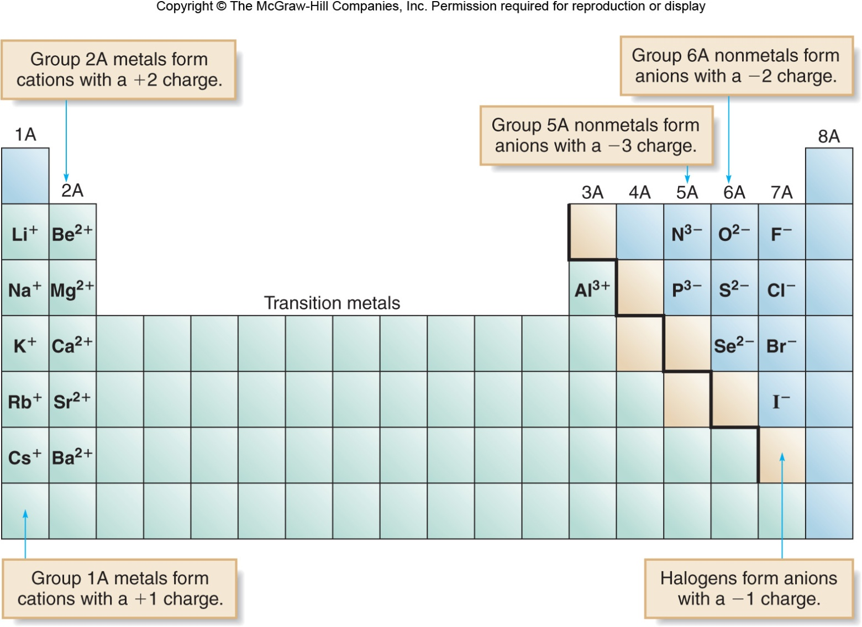
3.2 Ions (9)

Slide 14
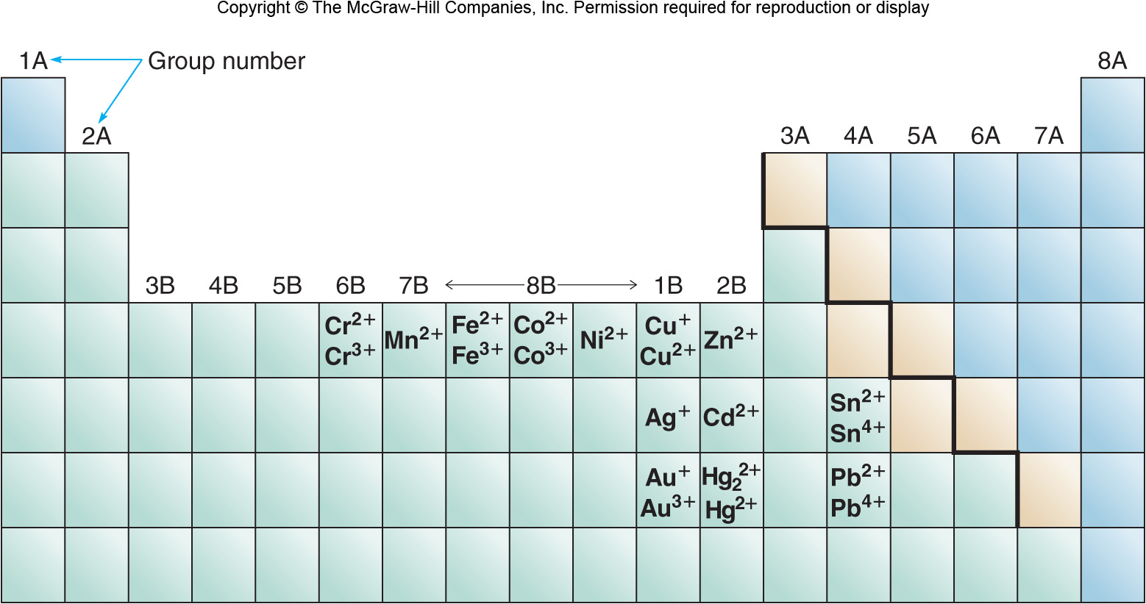
3.2 Ions (10)
Metals with Variable Charge

Slide 15
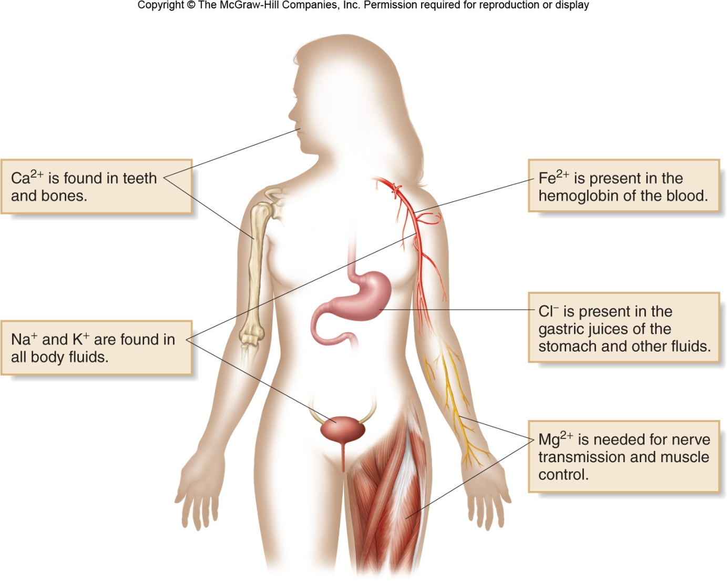
3.2 Ions (11)
Common Ions in the Human Body

Slide 16
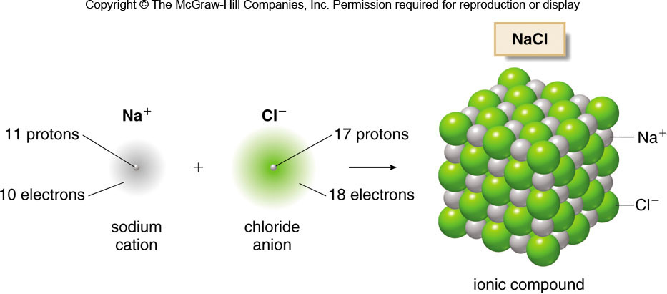
3.3 Ionic Compounds (1)
An ionic bond is formed when a metal transfers one or more electrons to a nonmetal.
The sum of the charges in an ionic compound must be zero overall.

Slide 17
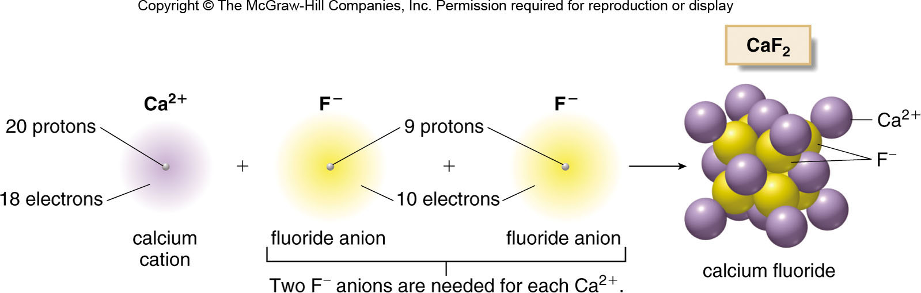
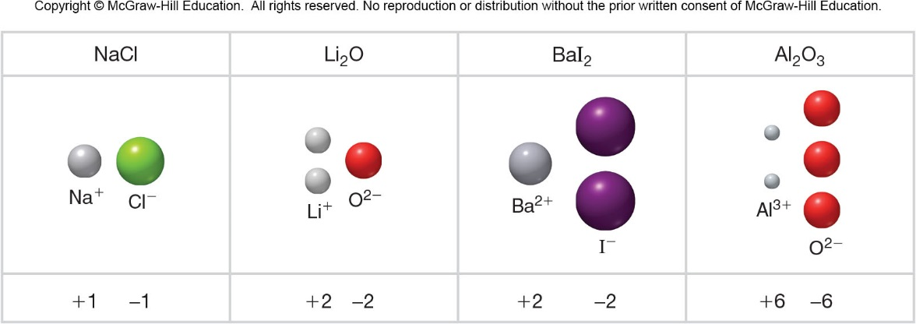
3.3 Ionic Compounds (2)

Slide 18
3.3 Ionic Compounds (3)
HOW TO Write a Formula for an Ionic Compound
Identify which element is the cation
and which is the anion.
Step [1]
Metals form cations and nonmetals form anions.
Use the group number of a main group element
to determine the charge.
metal
group 1A
nonmetal
group 7A
metal
group 2A
nonmetal
group 6A

Slide 19
3.3 Ionic Compounds (4)
HOW TO Write a Formula for an Ionic Compound
Step [2]
Determine how many of each ion type is
needed for an overall charge of zero.
When the cation and anion have the same
charge, only one of each is needed.
zero charge
zero charge
One of each ion is needed to balance charge.

Slide 20
3.3 Ionic Compounds (5)
HOW TO Write a Formula for an Ionic Compound
When the cation and anion have different charges,
use the ion charges to determine the number of
ions of each needed.
A +2 charge means
A −1 charge means
anions are
cation is
needed.
needed.
for each

Slide 21
3.3 Ionic Compounds (6)
HOW TO Write a Formula for an Ionic Compound
Step [3]
To write the formula, place the cation
first and then the anion, and omit charges.
Examples:
KCl
CaO
CaCl₂
Use subscripts to show the number of
each ion needed to have a zero overall
charge.
When no subscript is written, it is assumed to be “1.”

Slide 22
3.4 Naming Ionic Compounds (1)
Naming Cations
Main group cations (groups 1—3A) are named for the element from which they are formed.
sodium
potassium
calcium
magnesium

Slide 23
3.4 Naming Ionic Compounds (2)
Naming Cations
When a metal is able to form two different cations, two naming systems are used:
Systematic name: Follow the name of the cation
by a Roman numeral in parentheses to indicate its charge.
iron(II)
iron(III)
Common name: Use suffix “-ous” for the cation
with a smaller charge and suffix “-ic” for the
cation with a higher charge.
ferrous
ferric

Slide 24
3.4 Naming Ionic Compounds (3)
Naming Cations
Table 3.3 Systematic and Common Names for Some Metal Ions
Element
Ion Symbol
Systematic Name
Common Name
Chromium
Chromium(II)
Chromous
Chromium
Chromium(III)
Chromic
Copper
Copper(I)
Cuprous
Copper
Copper(II)
Cupric
Iron
Iron(II)
Ferrous
Iron
Iron(III)
Ferric
Mercury
Mercurous
Mercury
Mercury(II)
Mercuric
Tin
Tin(II)
Stannous
Tin
Tin(IV)
Stannic
exists as
, containing two atoms of mercury, each with a +1 charge.

Slide 25
3.4 Naming Ionic Compounds (4)
Naming Anions
Anions are named by replacing the ending of the
element name by the suffix “-ide.”
Table 3.4 Names of Common Anions
Element
Ion Symbol
Name
Bromine
Bromide
Chlorine
Chloride
Fluorine
Fluoride
Iodine
Iodide
Nitrogen
Nitride
Oxygen
Oxide
Phosphorus
Phosphide
Sulfur
Sulfide

Slide 26
3.4 Naming Ionic Compounds (5)
Compounds of Main Group Metals
Name the cation and then the anion.
Do not specify the charge on the ion.
Do not specify how many ions of each type are needed to balance charge.

Slide 27
3.4 Naming Ionic Compounds (6)
Compounds of Metals with a Variable Charge
HOW TO Name an Ionic Compound That Contains
a Metal with Variable Charge
Example
Give the name for CuCl₂.
Step [1]
Determine the charge on the cation.
CuCl₂
Cu cation must have a +2 charge to make the overall charge zero

Slide 28
3.4 Naming Ionic Compounds (7)
Compounds of Metals with a Variable Charge
HOW TO Name an Ionic Compound That Contains
a Metal with Variable Charge
Step [2]
Name the cation and the anion.
The cation is named one of two possible ways:
Systematic
Common
copper(II)
cupric
The anion changes ending of element name to “-ide”
chloride

Slide 29
3.4 Naming Ionic Compounds (8)
Compounds of Metals with a Variable Charge
HOW TO Name an Ionic Compound That Contains
a Metal with Variable Charge
Write the name of the cation first, then
the anion.
Step [3]
copper(II) chloride
or
cupric chloride
Answer =

Slide 30
3.4 Naming Ionic Compounds (9)
Writing a Formula from the Name
HOW TO Derive a Formula from the Name of an Ionic
Compound
Example
Write the formula for tin(IV) oxide.
Step [1]
Identify the cation and anion and
determine their charges. For metals with variable charges, the Roman numeral gives the charge on the cation.
tin(IV)
oxide

Slide 31
3.4 Naming Ionic Compounds (10)
Writing a Formula from the Name
HOW TO Derive a Formula from the Name of an Ionic
Compound
Step [2]
Balance charges.
Two −2 anions
are needed for
each +4 cation.
Step [3]
Write the formula with the cation first, and
use subscripts to show how many of each
ion is needed to have zero overall charge.

Slide 32
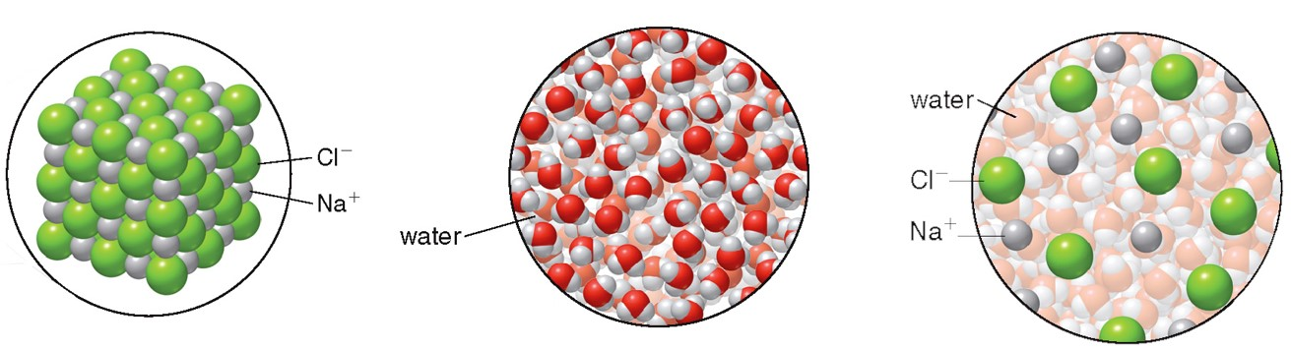
3.5 Physical Properties of Ionic Compounds
Ionic compounds are crystalline solids with very high melting and boiling points.
When ionic compounds dissolve in water, they separate into cations and anions, increasing the conductivity of the solution.
NaCl
water
solution

Slide 33
3.6 Polyatomic Ions (1)
A polyatomic ion is a cation or anion that contains more than one atom.
Table 3.5 Names of Common Polyatomic Anions
Nonmetal
Formula
Name
Carbon
Carbonate
Hydrogen carbonate or bicarbonate
Acetate
Cyanide
Nitrogen
Nitrate
Nitrite
Oxygen
Hydroxide
Phosphorus
Phosphate
Hydrogen phosphate
Dihydrogen phosphate
Sulfur
Sulfate
Hydrogen sulfate or bisulfate
Sulfite
Hydrogen sulfite or bisulfite

Slide 34
3.6 Polyatomic Ions (2)
Writing Formulas for Ionic Compounds with Polyatomic Ions
Writing formulas for ionic compounds with polyatomic ions is the same as writing formulas for ions with single charged atoms. (Section 3.3A)
When a cation and anion of equal charge combine, only one of each ion is needed.
zero overall charge
zero overall charge

Slide 35
3.6 Polyatomic Ions (3)
Writing Formulas for Ionic Compounds with Polyatomic Ions
When a cation and anion of unequal charge combine, use the ionic charges to determine the relative number of each ion that is needed.
+2 charge means
−1 charge means
zero overall charge
anions are
anion is
needed.
needed.

Slide 36
3.6 Polyatomic Ions (4)
Naming Ionic Compounds with Polyatomic Ions
The same rules are followed for naming standard
ionic compounds:
Name the cation and then the anion.
Do not specify the charge on the ions.
Do not specify how many ions of each type are needed to balance charge.
NaHCO₃
Al₂(SO₄)₃
sodium bicarbonate
aluminum sulfate

