Slide 1

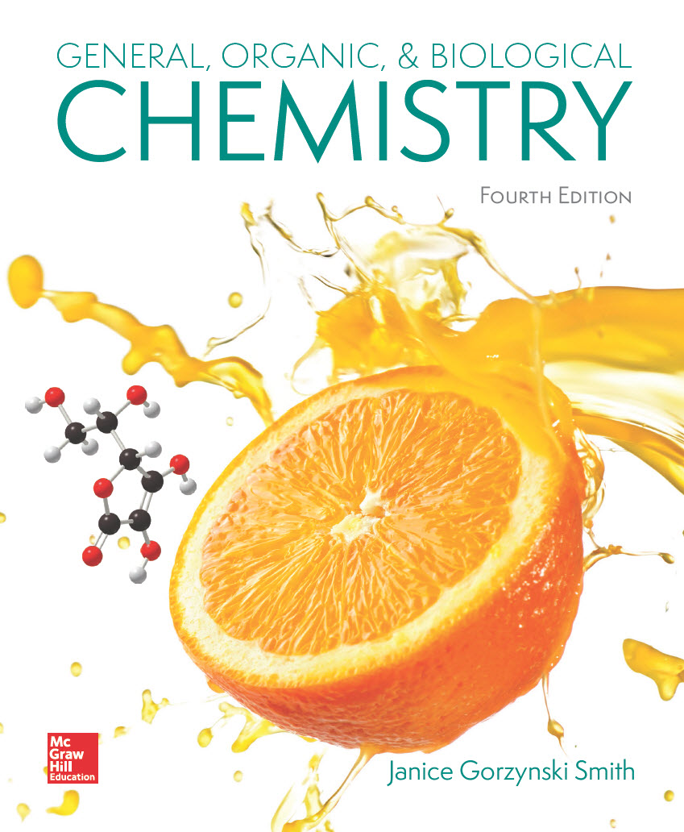
Chapter 5
Lecture Outline
Prepared by
Harpreet Malhotra
Florida State College at Jacksonville

Slide 2
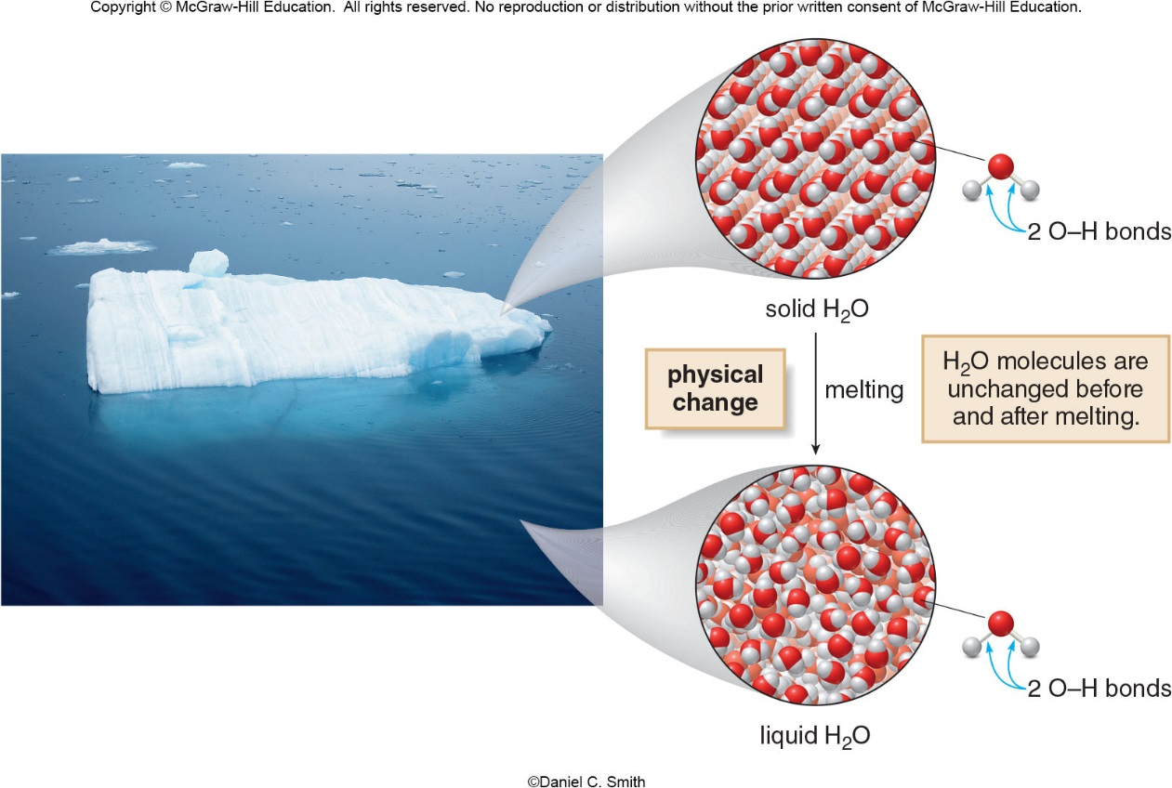
5.1 Introduction to Chemical Reactions (1)
General Features of Physical and Chemical Changes
A physical change alters the physical state of a substance without changing its composition.
©Daniel C. Smith

Slide 3
5.1 Introduction to Chemical Reactions (2)
General Features of Physical and Chemical Changes
A chemical change (a chemical reaction) converts one substance into another.
Chemical reactions involve:
Breaking bonds in the reactants (starting materials)
Forming new bonds in the products

Slide 4
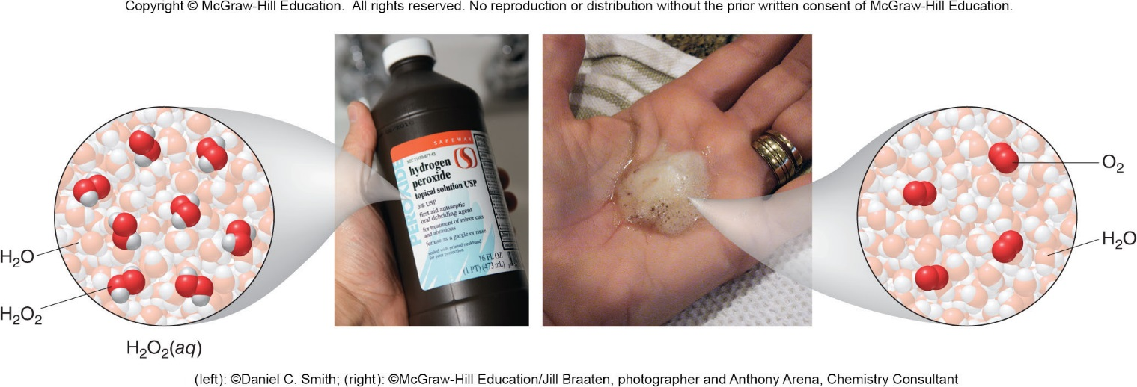
5.1 Introduction to Chemical Reactions (3)
General Features of Physical and Chemical Changes
(left): ©Daniel C. Smith; (right): ©McGraw-Hill Education/Jill Braaten, photographer and Anthony Arena, Chemistry Consultant

Slide 5
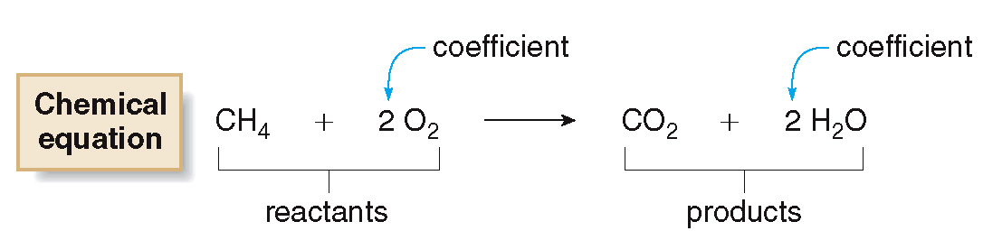
5.1 Introduction to Chemical Reactions (4)
Writing Chemical Equations
A chemical equation uses chemical formulas and other symbols showing what reactants are the starting materials in a reaction and what products are formed.
The reactants are written on the left.
The products are written on the right.
Coefficients show the number of molecules of a given element or compound that react or are formed.

Slide 6
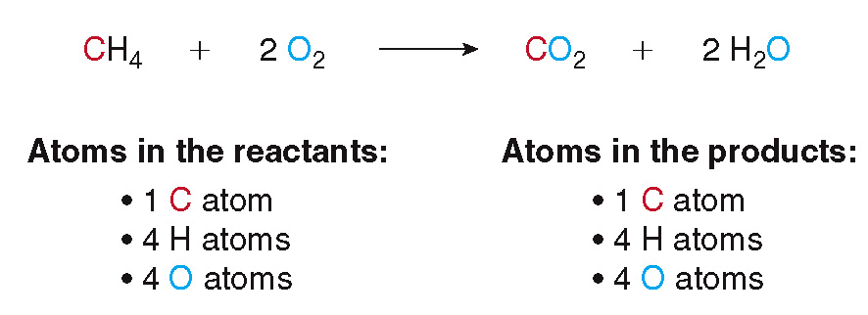
5.1 Introduction to Chemical Reactions (5)
Writing Chemical Equations
The law of conservation of mass states that atoms cannot be created or destroyed in a chemical reaction.
Coefficients are used to balance an equation.
A balanced equation has the same number of atoms of each element on both sides of the equation.

Slide 7
5.1 Introduction to Chemical Reactions (6)
Writing Chemical Equations
Table 5.1
Symbols Used in Chemical Equations
Symbol | Meaning
→ | Reaction arrow
Δ | Heat
(s) | Solid
(I) | Liquid
(g) | Gas
(aq) | Aqueous solution

Slide 8
5.2 Balancing Chemical Equations (1)
HOW TO Balance a Chemical Equation
Example
Write a balanced chemical equation for
the reaction of propane (C₃H₈) with
oxygen (O₂) to form carbon dioxide (CO₂)
and water (H₂O).
Step [1]
Write the equation with the correct formulas.
The subscripts in a formula can never be changed to balance an equation, because changing a subscript changes the identity of a compound.

Slide 9
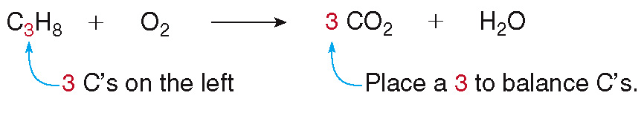
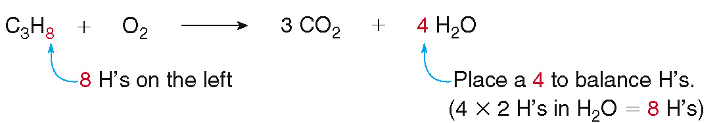
5.2 Balancing Chemical Equations (2)
HOW TO Balance a Chemical Equation
Step [2]
Balance the equation with coefficients one
element at a time.
Balance the C’s first:
Balance the H’s next:

Slide 10
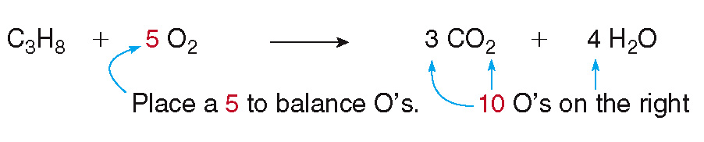
5.2 Balancing Chemical Equations (3)
HOW TO Balance a Chemical Equation
Step [2]
Balance the equation with coefficients one
element at a time.
Finally, balance the O’s:

Slide 11
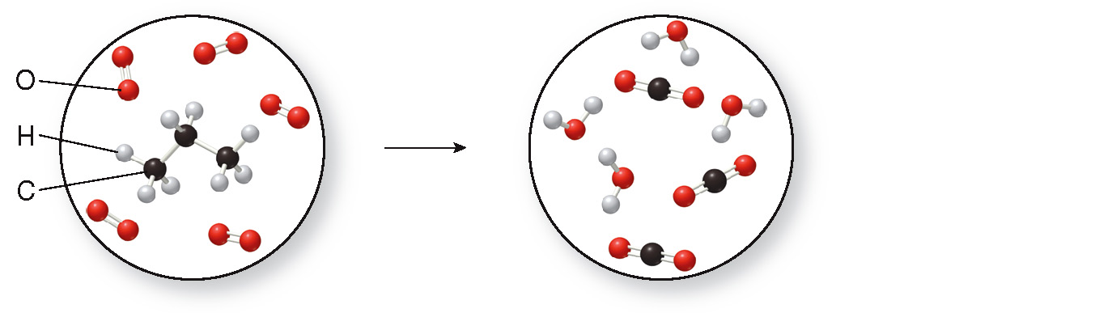
5.2 Balancing Chemical Equations (4)
HOW TO Balance a Chemical Equation
Step [3]
Check to make sure that the smallest set of whole numbers is used.
Atoms in the reactants:
3 C’s 8 H’s 10 O’s (5 × 2 O’s)
Atoms in the products:
3 C’s 8 H’s 10 O’s [(3 × 2 O’s) + (4 × 10)]

Slide 12
5.3 Types of Reactions (1)
The majority of chemical reactions fall into 6 categories:
combination
decomposition
single replacement
double replacement
oxidation and reduction (Section 5.4)
acid-base (Chapter 9)

Slide 13
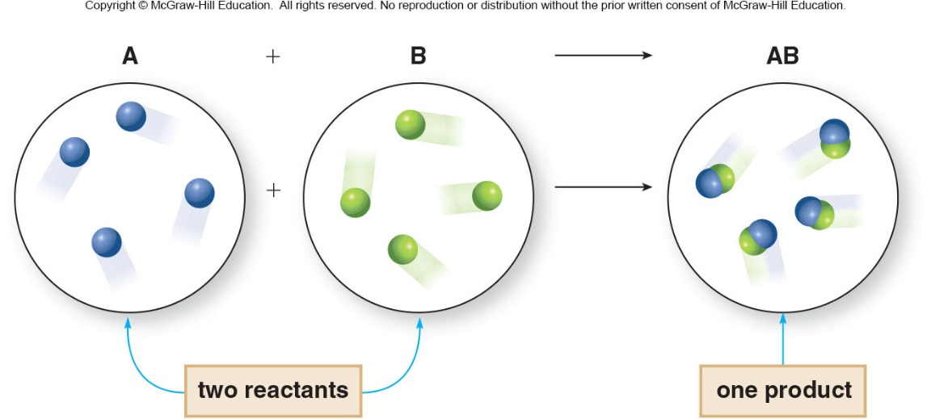
5.3 Types of Reactions (2)
Combination and Decomposition
A combination reaction is the joining of two or more reactants to form a single product.
Table 5.2 Examples of Combination Reactions

Slide 14
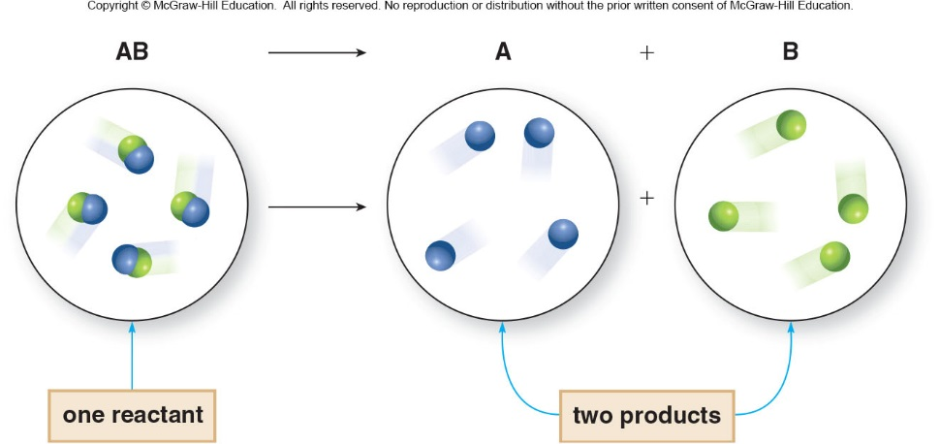
5.3 Types of Reactions (3)
Combination and Decomposition
A decomposition reaction is the conversion of a single reactant to two or more products.
Table 5.3 Examples of Combination Reactions

Slide 15
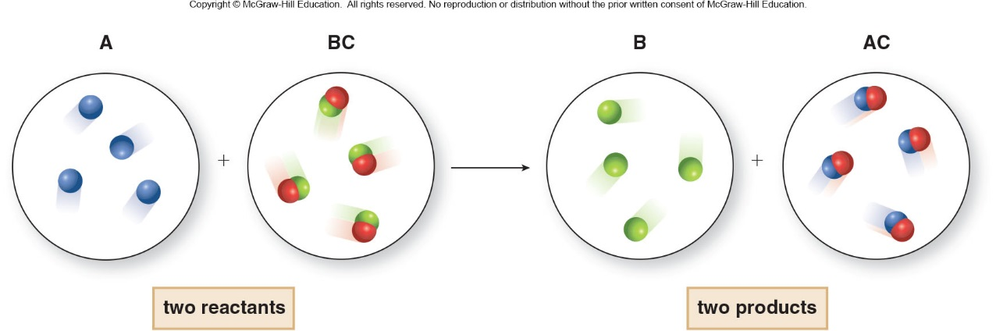
5.3 Types of Reactions (4)
Replacement Reactions
A single replacement reaction is a reaction in which one element replaces another element in a compound to form a different compound and element as products.

Slide 16
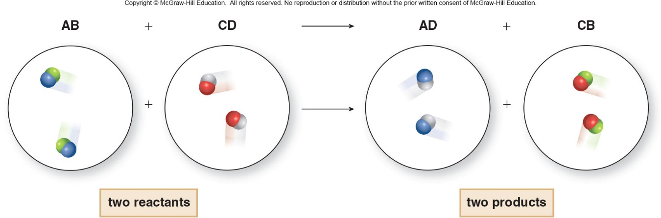
5.3 Types of Reactions (5)
Replacement Reactions
A double replacement reaction is a reaction in which two compounds exchange “parts”–atoms or ions—to form two new compounds.
Table 5.4 Examples of Single and Double Replacement Reactions
Type of Reaction
Examples
Comment
Single replacement
The element Br replaces CI in the compound NaCI.
Single replacement
The element Fe replaces Cu in the compound CuSO₄.
Double replacement
The ions
and
exchange.
Double replacement
The species H and
exchange.

Slide 17
5.4 Oxidation and Reduction (1)
General Features
Oxidation is the loss of electrons from an atom.
Reduction is the gain of electrons by an atom.
Both processes occur together in a single reaction called an oxidation−reduction or redox reaction.
A redox reaction always has two components, one that is oxidized and one that is reduced.
A redox reaction involves the transfer of electrons from one element to another.

Slide 18
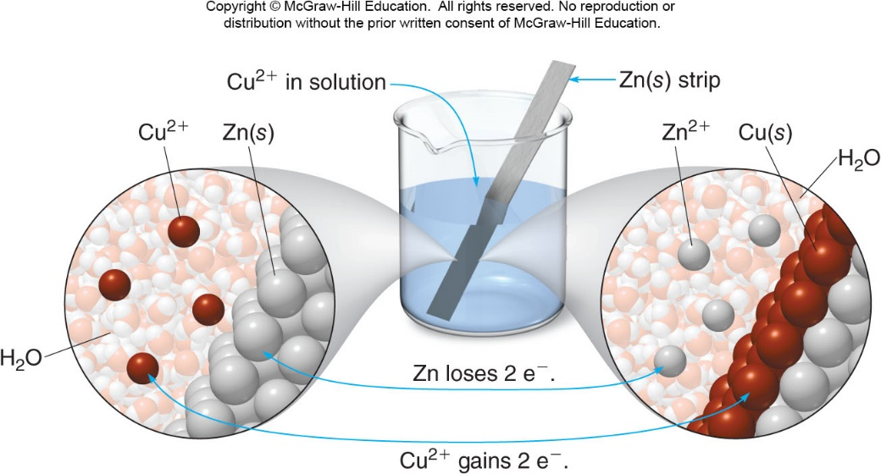
5.4 Oxidation and Reduction (2)
General Features
Zn loses 2 e⁻ to form
, so Zn is oxidized.
gains 2 e⁻ to form Cu, so
is reduced.

Slide 19
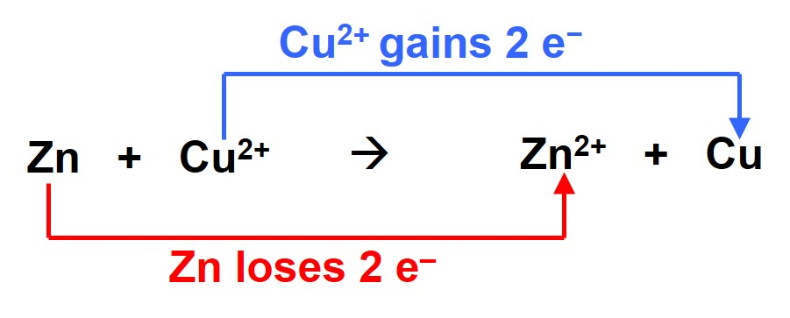
5.4 Oxidation and Reduction (3)
General Features
Each of these processes can be written as an
individual half reaction:
          Oxidation half reaction:
loss of e⁻
Reduction half reaction:
gain of e⁻

Slide 20
5.4 Oxidation and Reduction (4)
General Features
Zn
oxidized
reduced
A compound that is oxidized while causing another
compound to be reduced is called a reducing agent.
Zn acts as a reducing agent because it causes
to gain electrons and become reduced.

Slide 21
5.4 Oxidation and Reduction (5)
General Features
Zn
oxidized
reduced
A compound that is reduced while causing another
compound to be oxidized is called an oxidizing agent.
acts as an oxidizing agent because it causes
Zn to lose electrons and become oxidized.

Slide 22
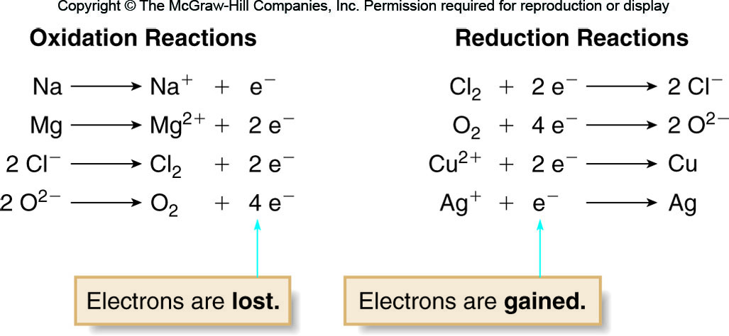
5.4 Oxidation and Reduction (6)
General Features

Slide 23
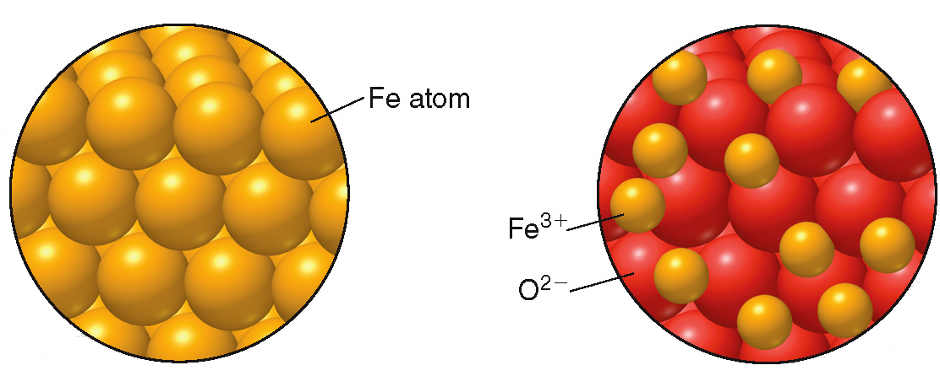
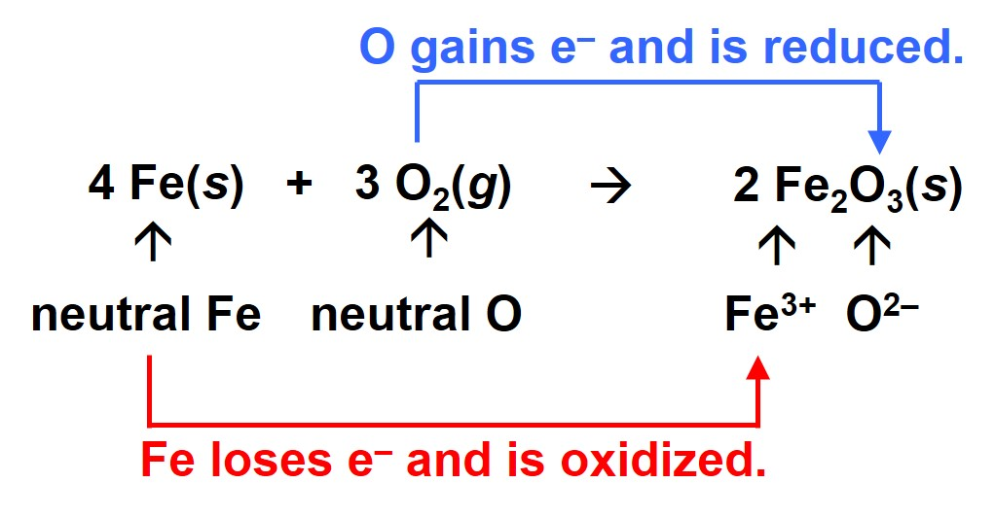
5.4 Oxidation and Reduction (7)
Examples of Oxidation–Reduction Reactions
Iron Rusting

Slide 24
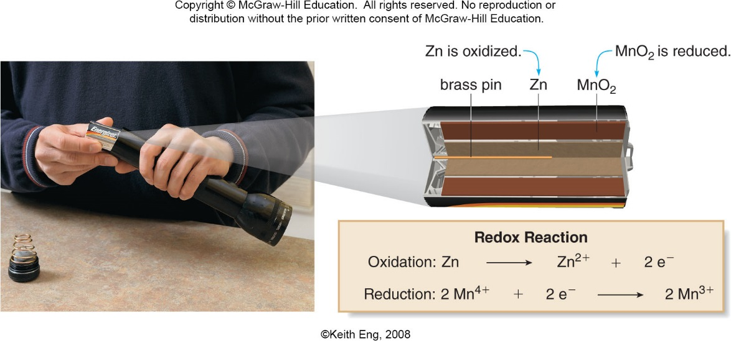
5.4 Oxidation and Reduction (8)
Examples of Oxidation–Reduction Reactions
©Keith Eng, 2008

Slide 25
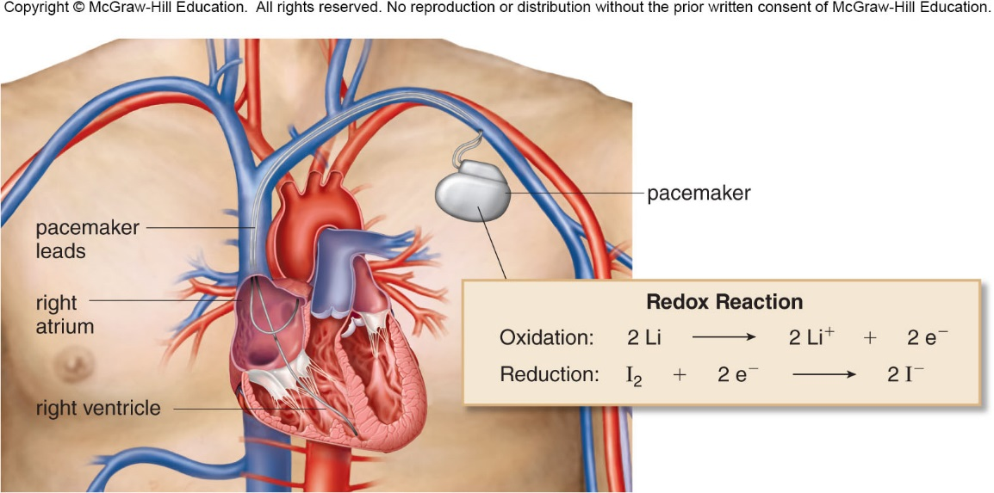
5.4 Oxidation and Reduction (9)
Pacemakers

Slide 26
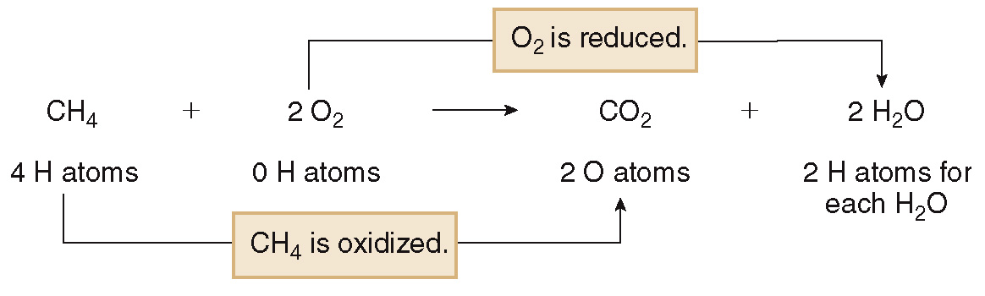
5.4 Oxidation and Reduction (10)
Examples of Oxidation–Reduction Reactions
Oxidation results in the:
Reduction results in the:
Gain of oxygen atoms
Loss of hydrogen atoms
Loss of oxygen atoms
Gain of hydrogen atoms

Slide 27
5.5 The Mole and Avogadro’s Number (1)
A mole is a quantity that contains
items.
The number
is Avogadro’s number.

Slide 28
5.5 The Mole and Avogadro’s Number (2)
It can be used as a conversion factor to relate the
number of moles of a substance to the number of
atoms or molecules:
or
or

Slide 29
5.5 The Mole and Avogadro’s Number (3)
Sample Problem 5.5
How many molecules are contained in 5.0 moles of carbon dioxide (CO₂)?
Step [1]
Identify the original quantity and the desired quantity.
5.0 mol of CO₂ original quantity
? number of molecules of CO₂ desired quantity

Slide 30
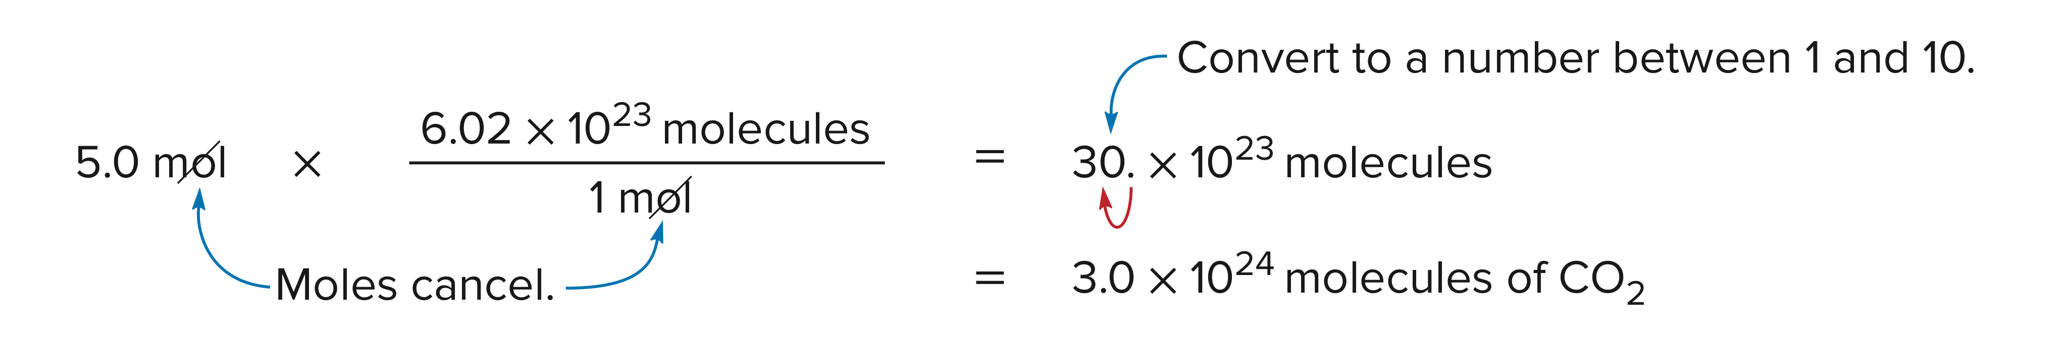
5.5 The Mole and Avogadro’s Number (4)
Step [2]
Write out the conversion factors.
or
Choose the right side to cancel mol.
Step [3]
Set up and solve the problem.
Unwanted unit cancels.

Slide 31
5.6 Mass to Mole Conversions (1)
The formula weight is the sum of the atomic weights of all the atoms in a compound, reported in atomic mass units (amu).
HOW TO Calculate the Formula Weight of a Compound
Example
Calculate the formula weight for FeSO₄.
Step [1]
Write the correct formula and determine the number of atoms of each element from the subscripts.
FeSO₄ contains 1 Fe atom, 1 S atom, and 4 O atoms.

Slide 32
5.6 Mass to Mole Conversions (2)
HOW TO Calculate the Formula Weight of a Compound
Step [2]
Multiply the number of atoms of each
element by the atomic weight and add
the results.
1 Fe atom × 55.85 amu = 55.85 amu
1 S atom × 32.07 amu = 32.07 amu
4 O atoms ×16.00 amu = 64.00 amu
Formula weight of FeSO₄ = 151.92 amu

Slide 33
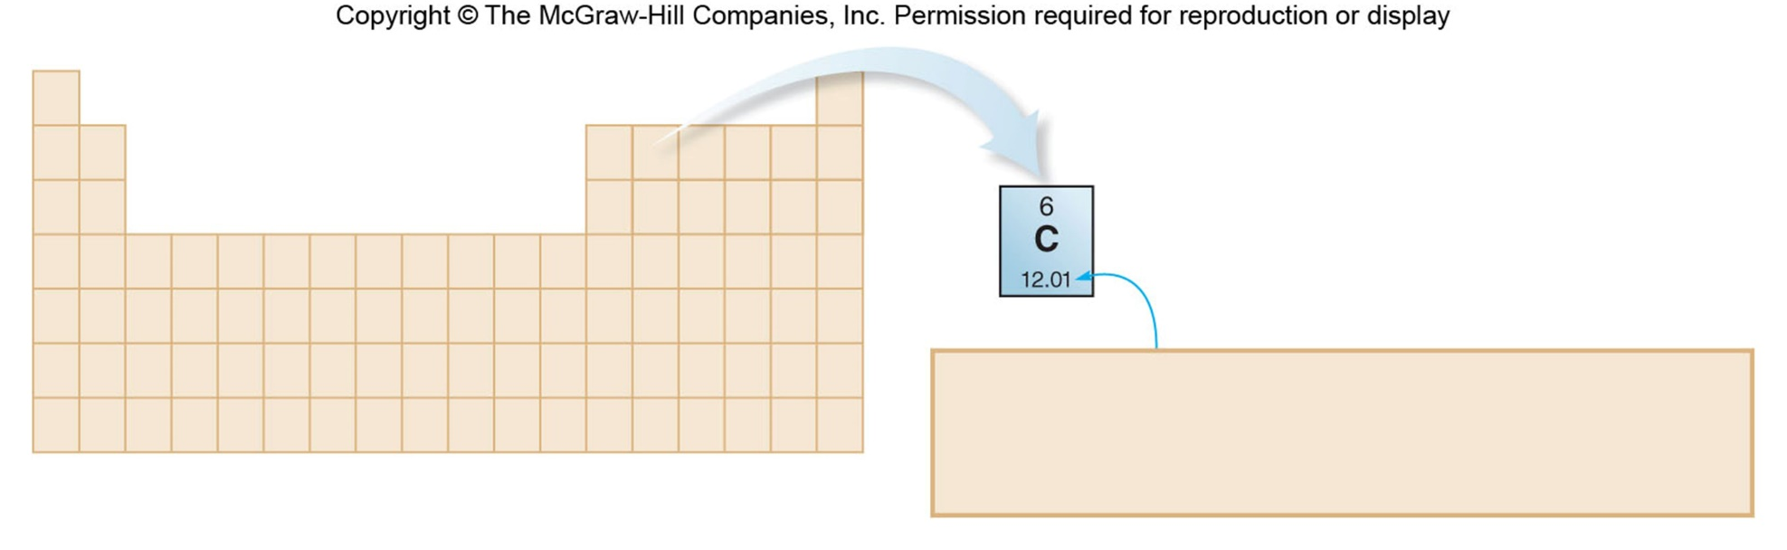
5.6 Mass to Mole Conversions (3)
Molar Mass
The molar mass is the mass of one mole of any substance, reported in grams per mole (g/mol).
Carbon’s atomic weight is 12.01 amu.
Carbon’s molar mass is 12.01 g/mol.
One mole of carbon atoms weights 12.01 g.
The value of the molar mass of a compound in grams equals the value of its formula weight in amu.

Slide 34
5.6 Mass to Mole Conversions (4)
Relating Grams to Moles
The molar mass relates the number of moles to the number of grams of a substance.
In this way, molar mass can be used as a conversion factor.
The molar mass of H₂O is 18.02 g/mol, the conversion factor can be written:
or

Slide 35
5.6 Mass to Mole Conversions (5)
Relating Grams to Moles
Sample Problem 5.9
How many moles are present in 100. g of aspirin
(C₉H₈O₄, molar mass 180.2 g/mol)?
Step [1]
Identify the original quantity and the
desired quantity.
100. g of aspirin original quantity
? mol of aspirin desired quantity

Slide 36
5.6 Mass to Mole Conversions (6)
Relating Grams to Moles
Step [2]
Write out the conversion factors.
The conversion factor is the molar mass, and it can be written in two ways.
Choose the one that places the unwanted unit, grams, in the denominator so that the units cancel:
or
Choose the right one to
cancel g aspirin.

Slide 37
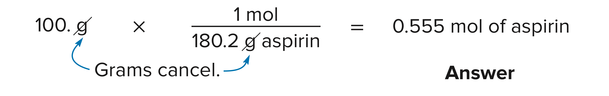
5.6 Mass to Mole Conversions (7)
Relating Grams to Moles
Step [3]
Set up and solve the problem.
Unwanted unit cancels.

Slide 38
5.6 Mass to Mole Conversions (8)
Relating Grams to Number of Atoms or Molecules
We can also use the molar mass to show the relationship between grams and number of
molecules (or atoms).
=

Slide 39
5.6 Mass to Mole Conversions (9)
Relating Grams to Number of Atoms or Molecules
Sample Problem 5.10
How many molecules are in a 325-mg tablet of
aspirin (C₉H₈O₄, molar mass 180.2 g/mol)?
Step [1]
Identify the original and desired quantities.
325 mg aspirin original quantity
? molecules aspirin desired quantity

Slide 40
5.6 Mass to Mole Conversions (10)
Relating Grams to Number of Atoms or Molecules
Step [2]
Write out the conversion factors.
To convert mg to g:
or
Choose the right one to cancel mg.
Then, to convert g to number of moles:
or
Choose the right one to cancel g aspirin.

Slide 41

5.6 Mass to Mole Conversions (11)
Relating Grams to Number of Atoms or Molecules
Step [3]
Set up and solve the problem.

Slide 42
5.7 Mole Calculations in Chemical Equations (1)
A balanced chemical equation also tell us:
The number of moles of each reactant that combine
The number of moles of each product formed
1 mole of N₂ 1 molecule N₂
1 mole of O₂
1 molecule O₂
2 moles of NO 2 molecules NO
(The coefficient “1” has been written for emphasis.)

Slide 43
5.7 Mole Calculations in Chemical Equations (2)
Coefficients are used to form mole ratios, which can
serve as conversion factors.
Mole ratios:

Slide 44
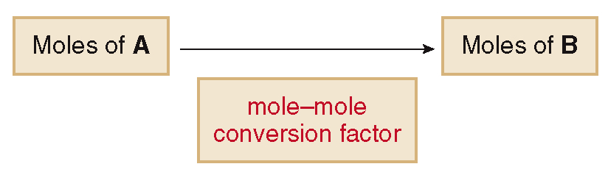
5.7 Mole Calculations in Chemical Equations (3)
Use the mole ratios from the coefficients in the
balanced equation to convert moles of one
compound (A) into moles of another compound (B).

Slide 45
5.7 Mole Calculations in Chemical Equations (4)
Sample Problem 5.11
Using the balanced chemical equation, how many moles of CO are produced from 3.5 moles
of C₂H₆?
Step [1]
Identify the original and desired quantities.
3.5 mol C₆H₆ original quantity
? mol CO desired quantity

Slide 46
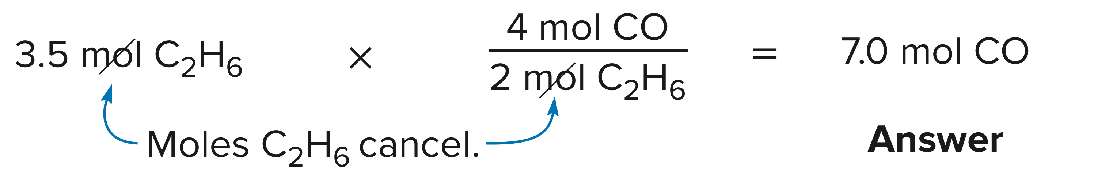
5.7 Mole Calculations in Chemical Equations (5)
Step [2]
Write out the conversion factors.
or
Choose the right one to
cancel mol C₂H₆.
Step [3]
Set up and solve the problem.

Slide 47
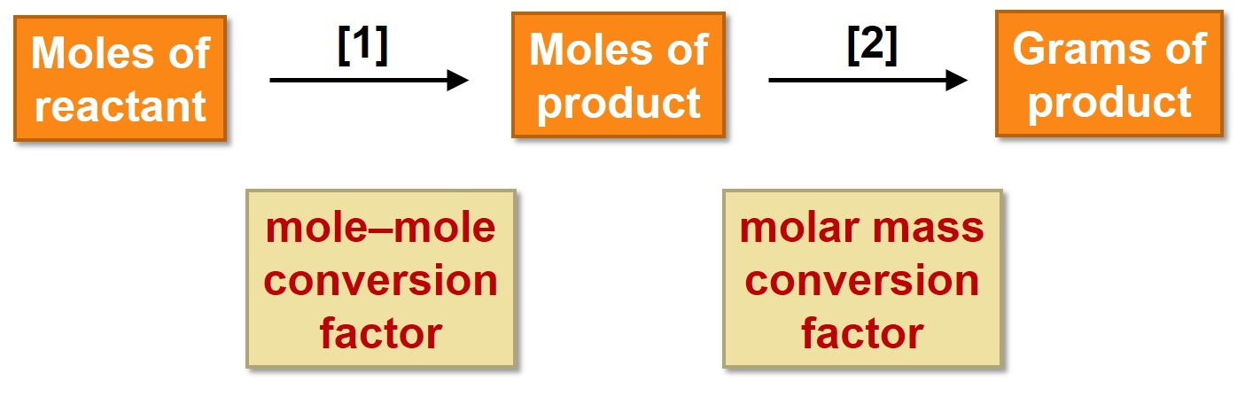
5.8 Mass Calculations in Chemical Equations (1)
HOW TO Convert Moles of Reactant to Grams of Product
Using the balanced equation, how many grams of O₃ are formed from 9.0 mol of O₂.
Example

Slide 48
5.8 Mass Calculations in Chemical Equations (2)
HOW TO Convert Moles of Reactant to Grams of Product
Step [1]
Convert the number of moles of reactant
to the number of moles of product using
a mole–mole conversion factor.
mole–mole
conversion
factor
or
Choose the right one to cancel mol O₂ in Step [1].

Slide 49
5.8 Mass Calculations in Chemical Equations (3)
HOW TO Convert Moles of Reactant to Grams of Product
Step [2]
Convert the number of moles of product
to the number of grams of product using
the product’s molar mass.
molar mass
conversion
factor
or
Choose the right one to cancel mol O₃ in Step [2].

Slide 50
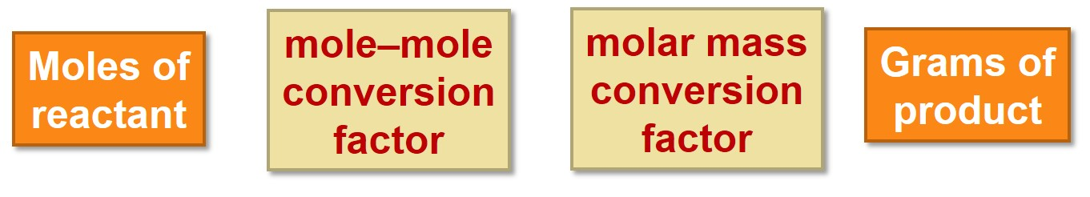
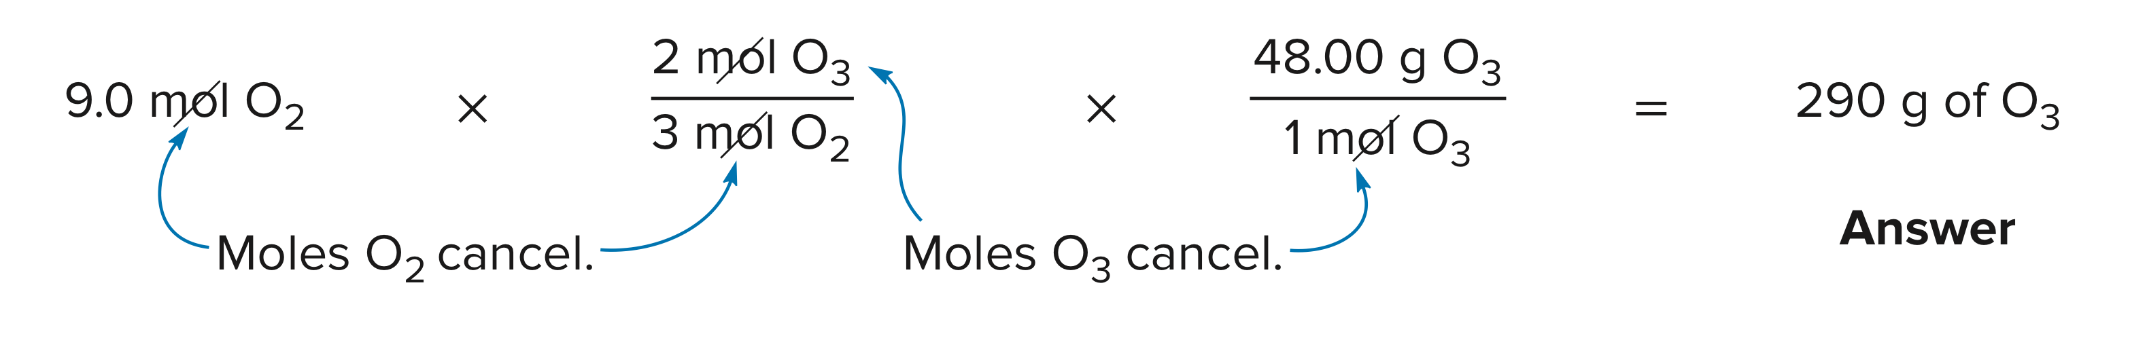
5.8 Mass Calculations in Chemical Equations (4)
HOW TO Convert Moles of Reactant to Grams of Product
Set up and solve the conversion.

Slide 51
5.8 Mass Calculations in Chemical Equations (5)
HOW TO Convert Grams of Reactant to Grams of Product
Ethanol (C₂H₆O, molar mass 46.1 g/mol) is synthesized by reacting ethylene (C₂H₄, molar mass 28.1 g/mol) with water.
How many grams of ethanol are formed from 14 g of ethylene?
Example

Slide 52
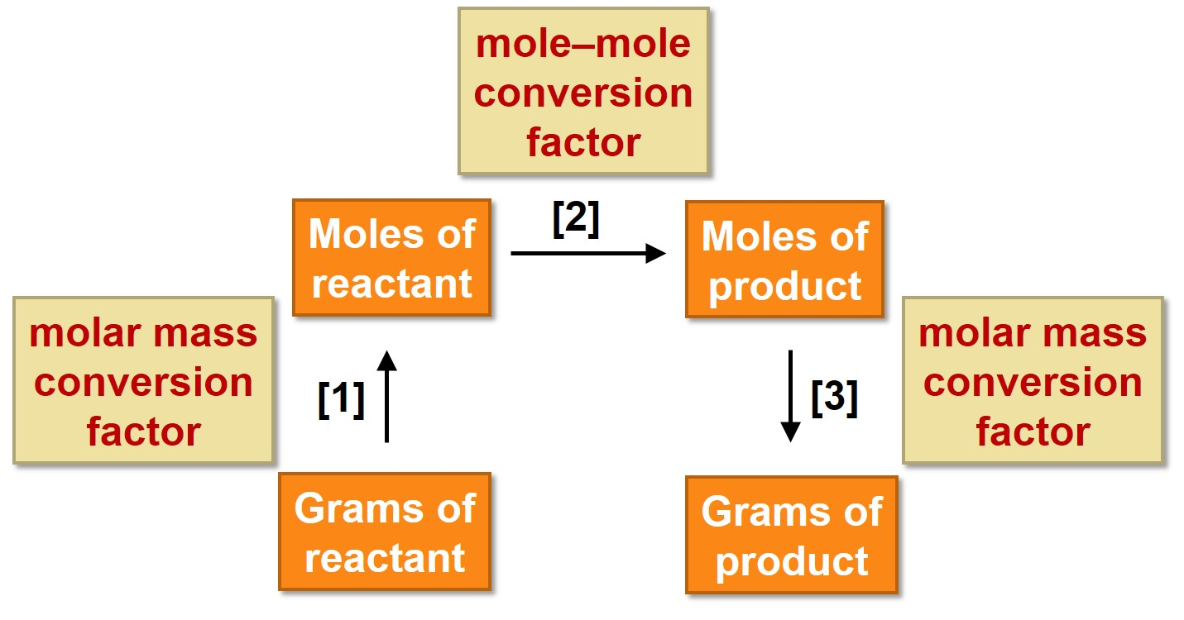
5.8 Mass Calculations in Chemical Equations (6)
HOW TO Convert Grams of Reactant to Grams of Product

Slide 53
5.8 Mass Calculations in Chemical Equations (7)
HOW TO Convert Grams of Reactant to Grams of Product
molar mass conversion factor
mole–mole conversion factor
molar mass conversion factor
Grams of reactant

Slide 54
5.9 Percent Yield (1)
The theoretical yield is the amount of product expected from a given amount of reactant based on the coefficients in the balanced chemical equation.
Usually, however, the amount of product formed is less than the maximum amount of product predicted.
The actual yield is the amount of product isolated from a reaction.

Slide 55
5.9 Percent Yield (2)
Sample Problem 5.14
If the reaction of ethylene with water to form
ethanol has a calculated theoretical yield of 23 g
of ethanol, what is the percent yield if only 15 g
of ethanol are actually formed?

Slide 56
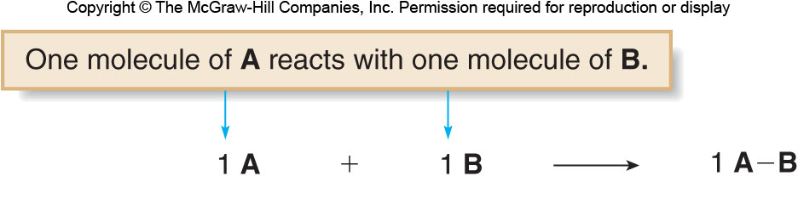
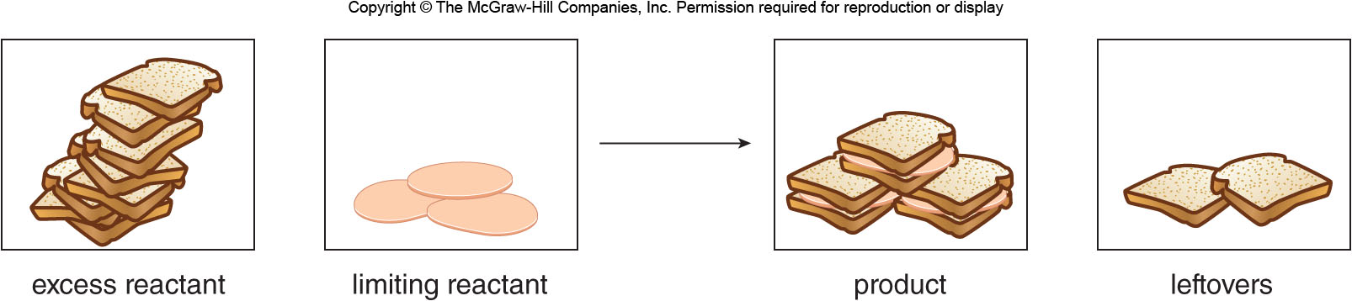
5.10 Limiting Reactants (1)
The limiting reactant is the reactant that is completely used up in a reaction.
One mole of each reactant is needed.

Slide 57
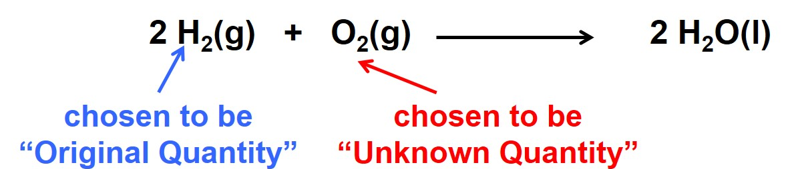
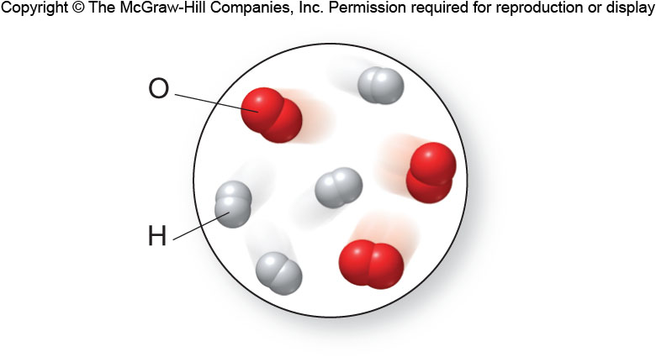
5.10 Limiting Reactant (2)
Determining the Limiting Reactant
Sample Problem 5.18
Determine how much of one reactant is needed to react with a second reactant.
There are 4 molecules of H₂ in the picture.

Slide 58
5.10 Limiting Reactant (3)
Determining the Limiting Reactant
Sample Problem 5.18
Write out the conversion factors that relate the
numbers of moles (or molecules) of reactants
Choose the right side conversion factor to cancel molecules H₂

Slide 59
5.10 Limiting Reactant (4)
Determining the Limiting Reactant
Sample Problem 5.18
Calculate the number of moles (molecules) of
the second reactant needed for complete reaction.

Slide 60
5.10 Limiting Reactant (5)
Determining the Limiting Reactant
Sample Problem 5.18
Analyze the two possible outcomes:
If the amount present of the second reactant
is less than what is needed, the second
reactant is the limiting reagent.
If the amount present of the second reactant is
greater than what is needed, the second
reactant is in excess.

Slide 61
5.10 Limiting Reactant (6)
Determining the Limiting Reactant
Sample Problem 5.18
Summary | Reactants | Product
Equation | 2 H₂ + O₂ → | 2 H₂O
Initial quantities | 4 molecules 3 molecules | 0 molecules
Used or formed | −4 molecules −2 molecules | +4 molecules
Molecules remaining | 0 molecules 1 molecule | 4 molecules
 | Limiting reactant Excess reactant

Slide 62
5.10 Limiting Reactant (7)
Determining the Limiting Reactant Using the Number of Grams
Sample Problem 5.20
Using the balanced equation, determine the limiting
reactant when 10.0 g of N₂ (MM = 28.02 g/mol) react
with 10.0 g of O₂ (MM = 32.00 g/mol).

Slide 63
5.10 Limiting Reactant (8)
Determining the Limiting Reactant Using the Number of Grams
Sample Problem 5.20
Convert the number of grams of each reactant
into moles using the molar masses.
Moles of N₂:
Moles of O₂:

Slide 64
5.10 Limiting Reactant (9)
Determining the Limiting Reactant Using the Number of Grams
Sample Problem 5.20
Determine the limiting reactant by choosing N₂
as the original quantity and converting to mol O_{2.}
mole–mole
Conversion factor
The amount of O₂ we started with (0.313 mol) is
less than the amount we would need (0.357 mol) so
O₂ is the limiting reagent.

