Slide 1


FOOTHILL DEANZA COMMUNITY COLLEGE DISTRICT Energy Master Plan Update
May 25, 2021

Slide 2
FHDA ENERGY MASTER PLAN
■ Sustainability has always in the forefront at FHDA.
■ Sustainability components
▪ Measure C Projects
▪ Prop. 39 Energy Efficiency Grant
■ No formal planning for Sustainability
■ Passage of Measure G Bond – Board sees opportunity
to have formal an Energy Master Plan.

Slide 3
FHDA ENERGY MASTER PLAN
■ Energy and Sustainability Advisory Committee (ESAC)
created.
■ Committee Representation:
▪ Foothill & DeAnza Administration Representative
▪ Foothill & DeAnza Faculty Representative
▪ DeAnza Student Representative
▪ Foothill Student Representative (Vacant)
▪ Foothill & DeAnza Classified Representative
▪ Central Services Classified Representative
▪ Director of Capital Construction Program
▪ Executive Director of Facilities and Maintenance.

Slide 4
FHDA ENERGY MASTER PLAN
■ Committee met informally at the end of 2020, and in
March 2021, enlisted the help of Matt Sullivan
Consulting, the District’s Energy Plan Consultant.
■ Biweekly meetings started in April 2021.
■ ESAC was formalized through each member’s
contribution in creating the Mission Statement.
“The Mission of the Energy and Sustainability Advisory Committee (ESAC)
is to encourage energy efficiency, reduce greenhouse gas (GHG) emissions, and collaboratively advance sustainability across the
Foothill-De Anza Community College District (FHDA-CCD), with a commitment for educational opportunities and inclusion of students,
staff, and faculty in our solutions for environmental, economic, and social
sustainability.

Slide 5
FHDA ENERGY MASTER PLAN
■ ESAC Goals:
▪ Develop an Energy and Sustainability Master Plan to identify measures to
improve energy performance, facilitate a path to reduce greenhouse gas
(GHG) emissions, and strengthen campus resilience employing all
appropriate funding sources and integrating projects from the Measure G Bond
program.
▪ Establish an inclusionary process where students, faculty, and staff play a
meaningful role in District sustainability efforts and understand the
environmental, societal, and economic impacts of energy use while integrating
these activities as learning opportunities to fulfill our responsibility as a Higher
Education institution.
▪ Establish objectives, criteria, and implementation plans to achieve Carbon
Neutrality and monitor progress over time to ensure they are achieved.
▪ Support state and federal energy policies and greenhouse gas (GHG) reduction
goals, including the 2019 CCC Board of Governors Climate Change and
Sustainability Policy.
▪ Establish the Foothill-De Anza Community College District as a Model of
Sustainability to face the challenges of the 21st century.

Slide 6
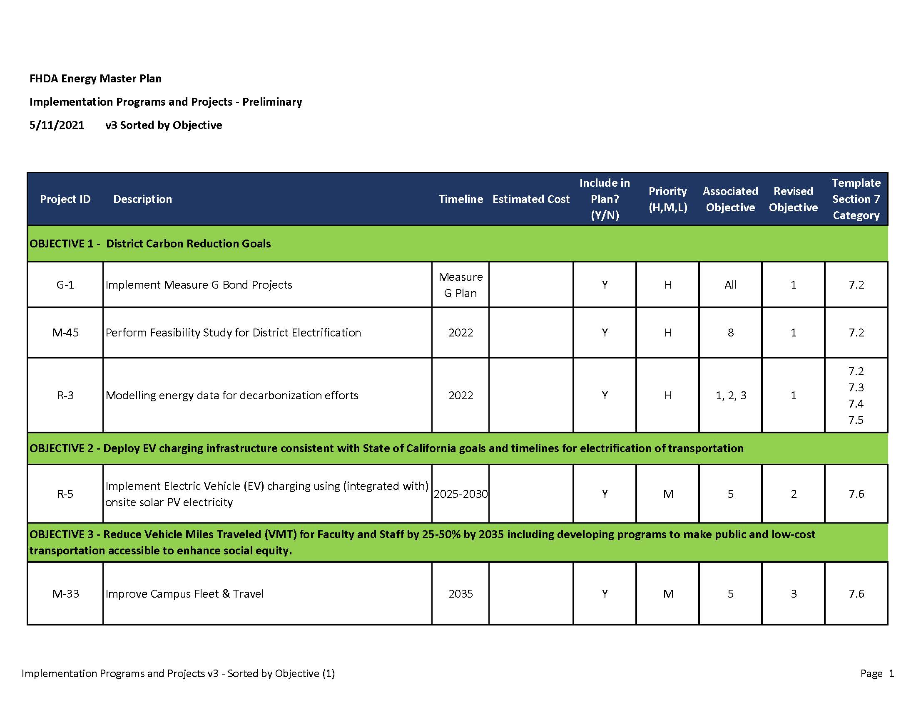
FHDA ENERGY MASTER PLAN
■ Objectives:

Slide 7
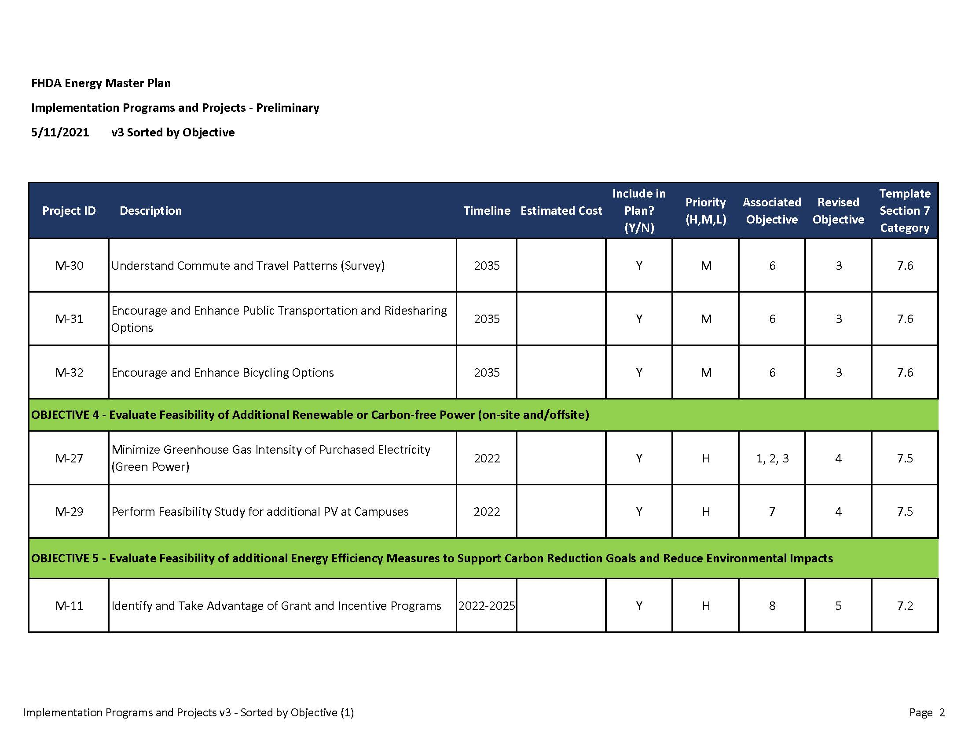
FHDA ENERGY MASTER PLAN
■ Objectives:

Slide 8
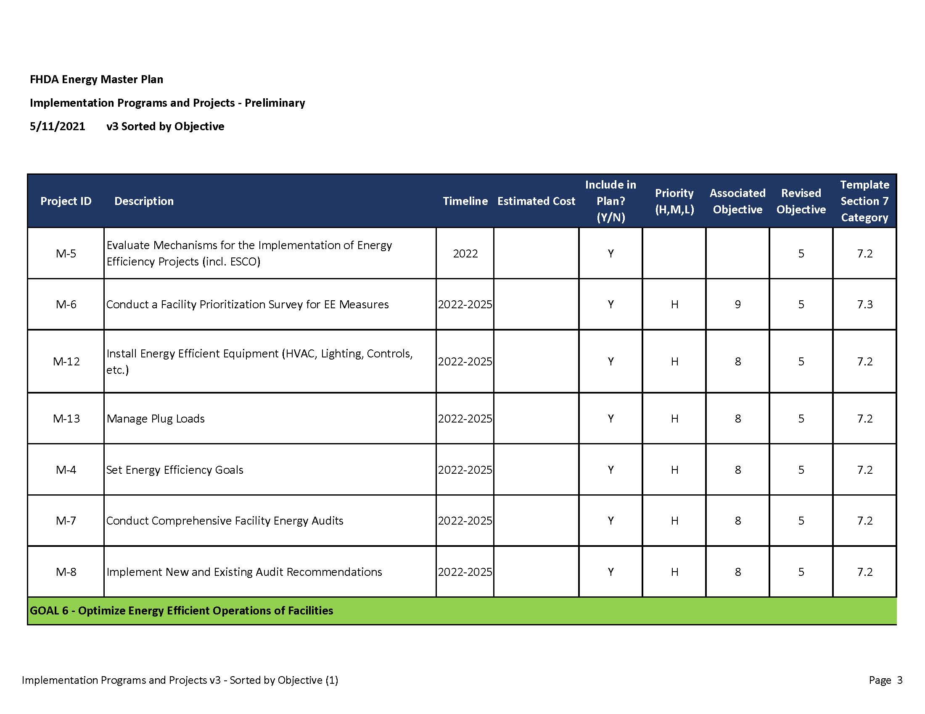
FHDA ENERGY MASTER PLAN
■ Objectives:

Slide 9
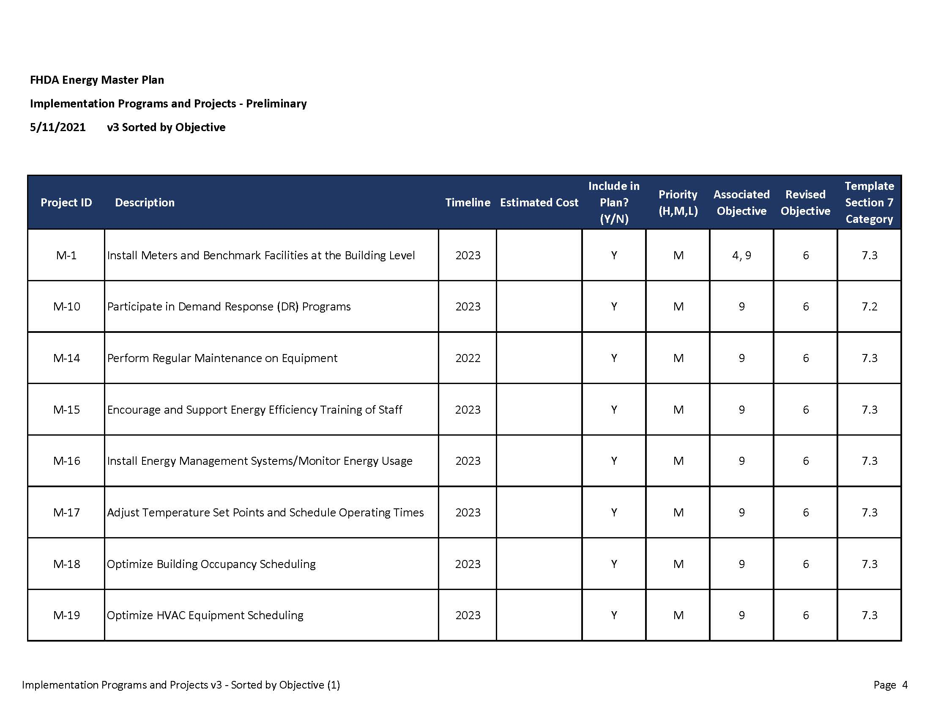
FHDA ENERGY MASTER PLAN
■ Objectives:

Slide 10
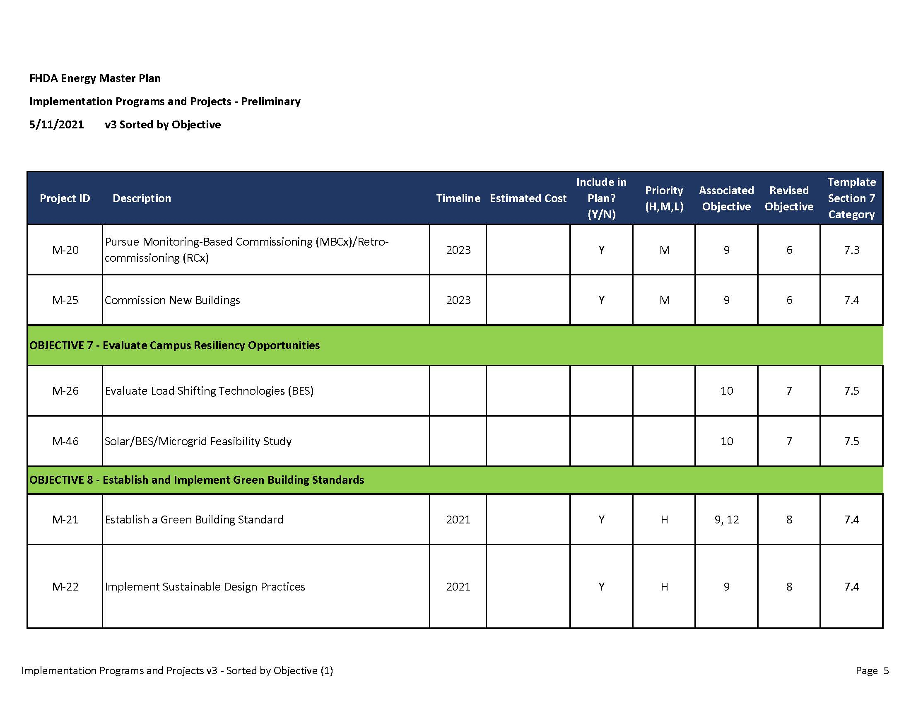
FHDA ENERGY MASTER PLAN
■ Objectives:

Slide 11
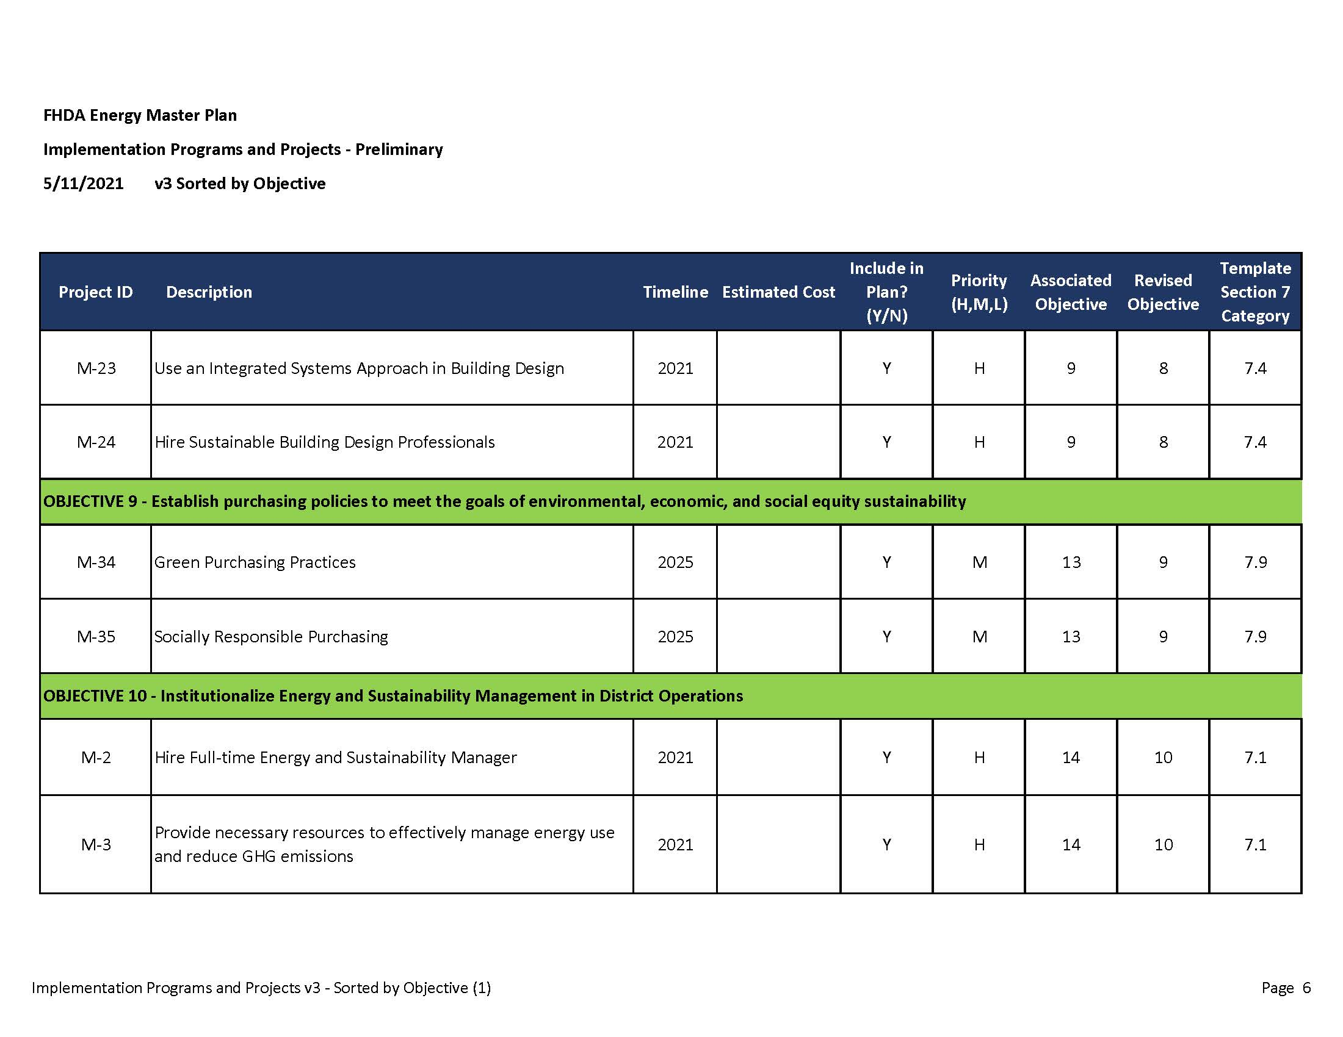
FHDA ENERGY MASTER PLAN
■ Objectives:

Slide 12
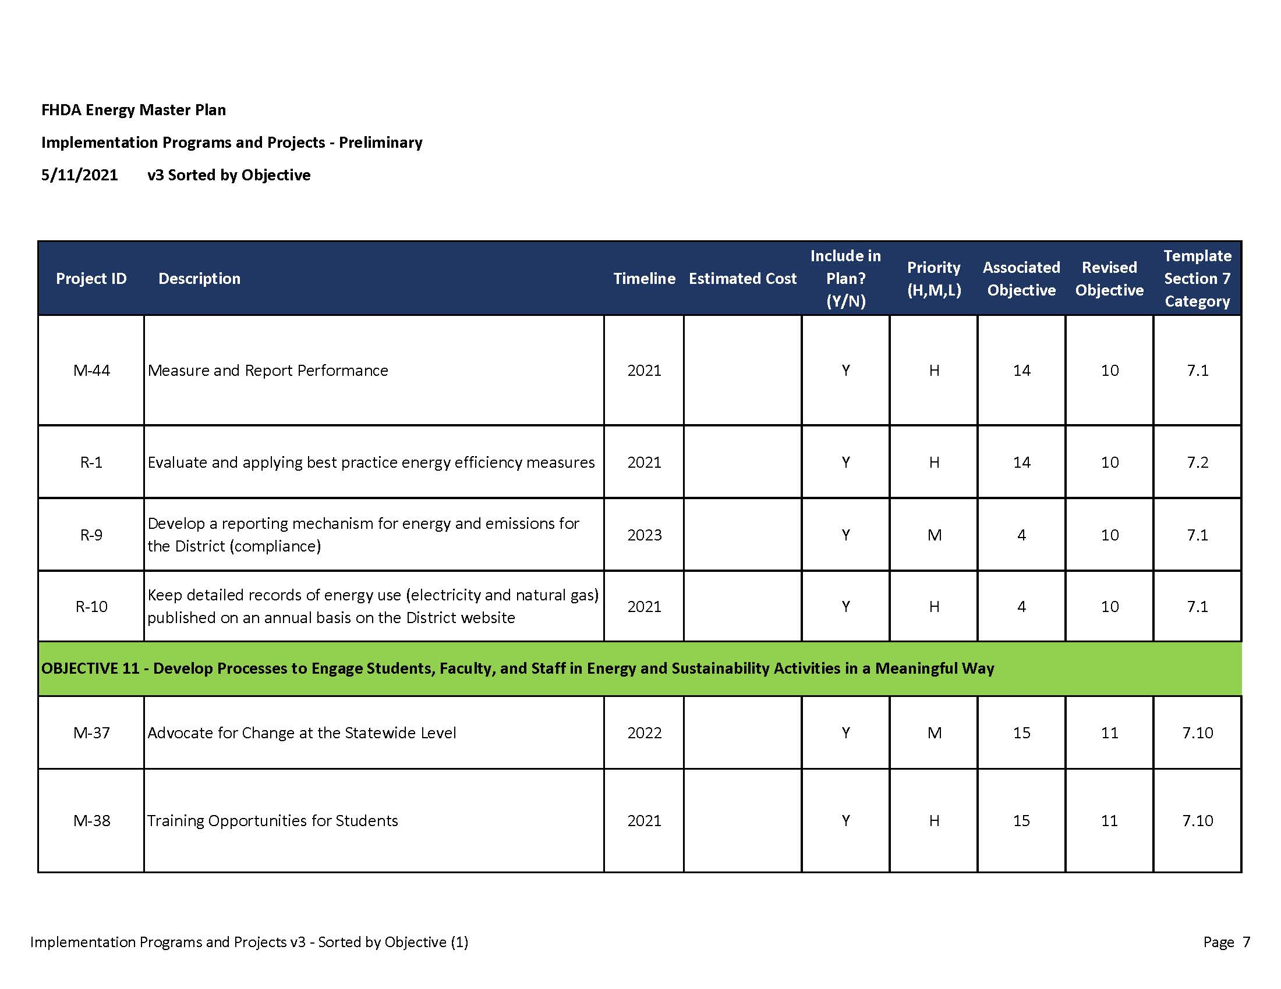
FHDA ENERGY MASTER PLAN
■ Objectives:

Slide 13
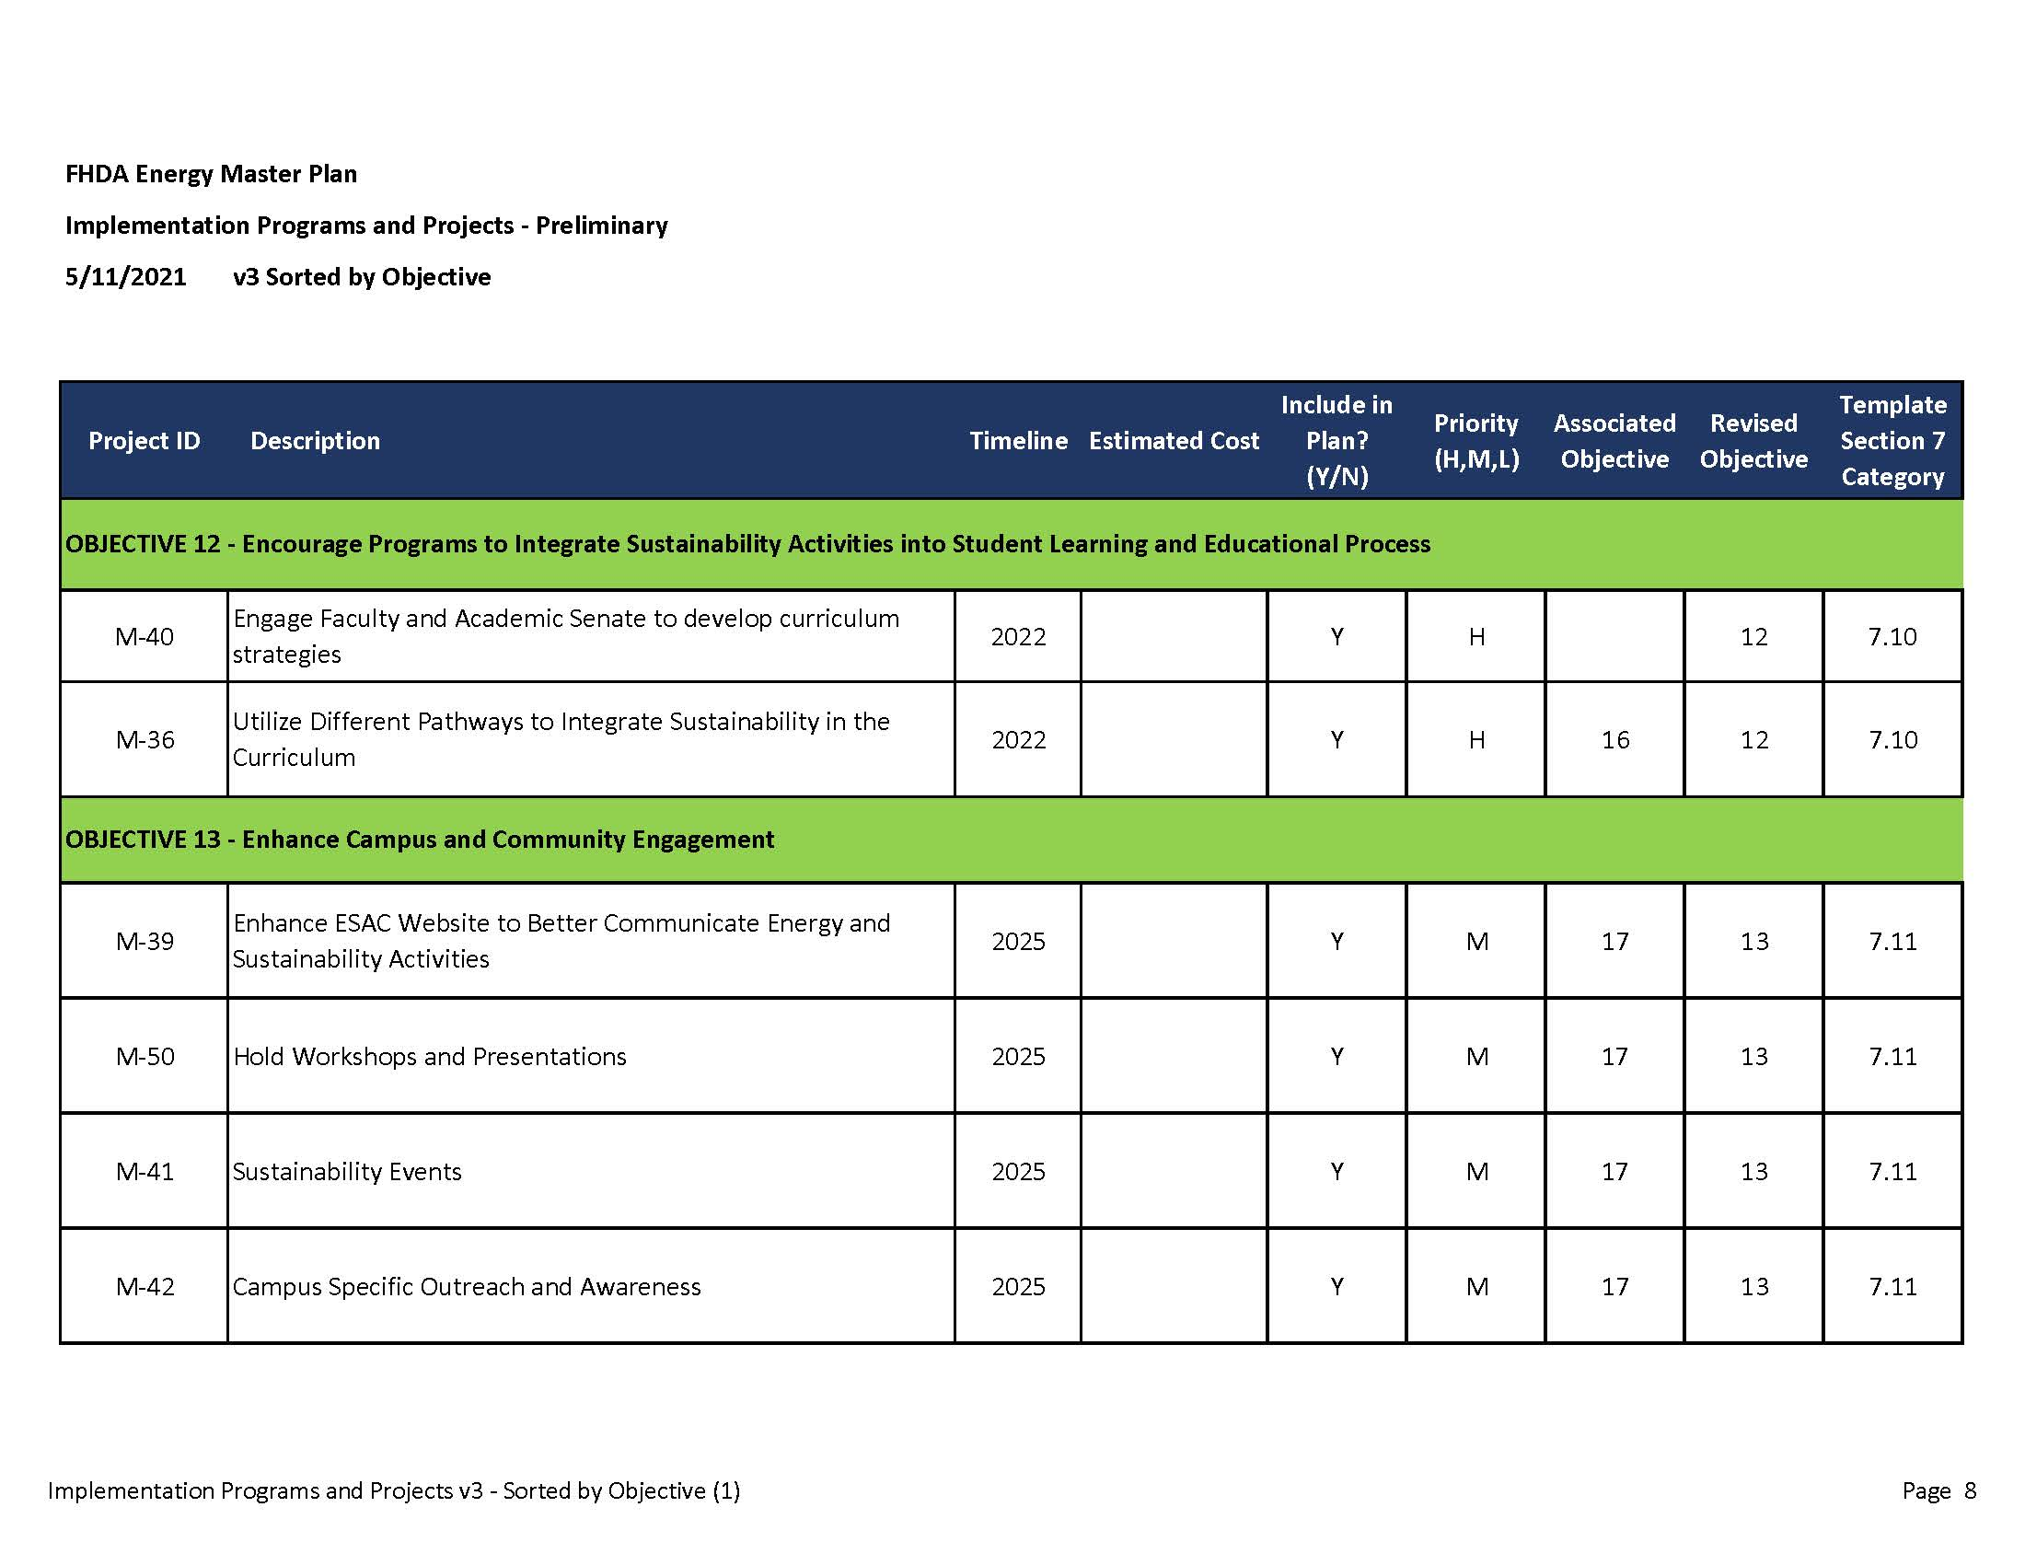
FHDA ENERGY MASTER PLAN
■ Objectives:

Slide 14
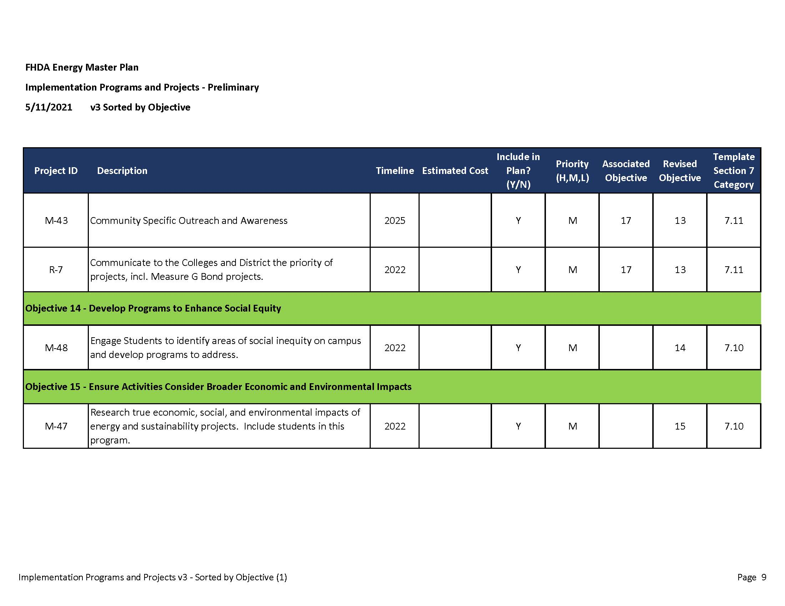
FHDA ENERGY MASTER PLAN
■ Objectives:

Slide 15
FHDA ENERGY MASTER PLAN
Questions/Comments
ESAC Website:
https://www.fhda.edu/_about-us/_participatorygovernance/D-Energy-and-Sustainability-Advisory-Committee.html

