Slide 1

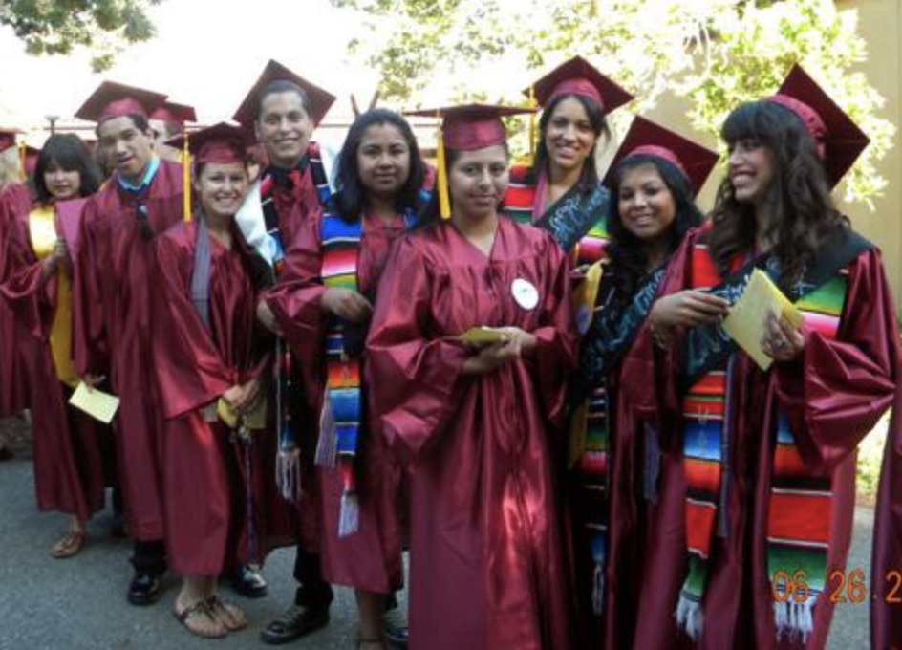

New Shared Governance Proposal
Presented by the Shared Governance Task Force
November 8, 2021

Slide 2
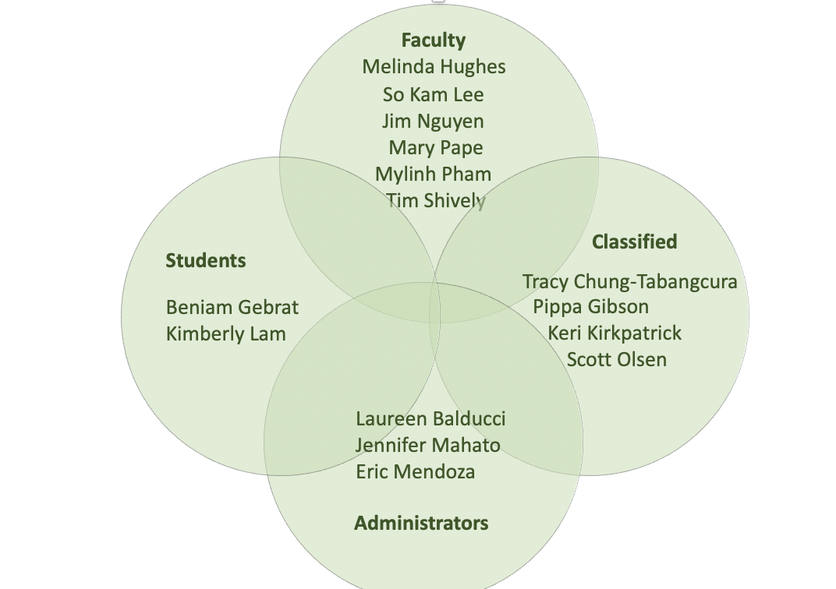
Your Dedicated Shared Governance Task Force (SGTF) Members:

Slide 3

The SGTF will:
Attend each of the Shared Governance groups to share the SGTF proposal
Develop a Q&A platform on the SGTF website
Collect feedback and new ideas regarding the proposal
Update proposal based on collective feedback
Update implementation timeline accordingly
Give updates on progress of proposal at College Council meetings
The Shared Governance Task Force is seeking your feedback on the SG proposal.

Slide 4

Shared Governance
“Colleges that share information and consult broadly with diverse constituencies have been able to respond more effectively (to crisis such as the pandemic) than those that rely on top-down decision making.”
- Marjorie Hass, Inside HigherEd, 4/20
“For shared governance to be effective, it needs to have a well-established foundation of transparency, trust, equity, and inclusion that is consistent and collaborative.”
- De Anza Shared Governance Task Force 4/21

Slide 5
The Shared Governance Task Force (SGTF)
Charge and Purpose
Charge: Current shared governance (SG) structure in place for 20+ years. Events of 2020 highlighted racial and social inequities within the college community and was a call to action. College Council requested partnership & collaboration between Academic & Classified Senates, Affinity Groups & current PBTs to form a Shared Government Task Force (SGTF).
Purpose: To review present structure & research & recommend a more equitable & holistic process. Focus on inclusion & providing funds for services that support the equity & student success goals of college & district.

Slide 6

Communication to De Anza College Community
Communication via the Shared Governance Review website: https://www.deanza.edu/gov/review
Updates to College Council, President, Senior Staff, Academic Senate as to SGTF progress
Members from each represented constituency group have shared updates and information with their groups.
New Shared Governance proposal to College Council - Oct. 28, 2021

Slide 7
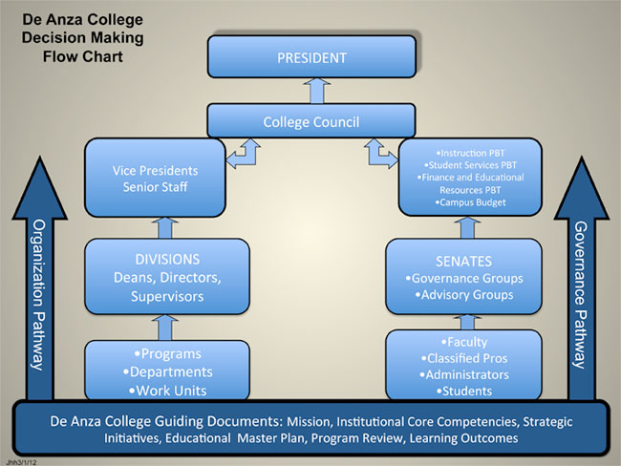
The Historic Shared Governance Structure

Slide 8
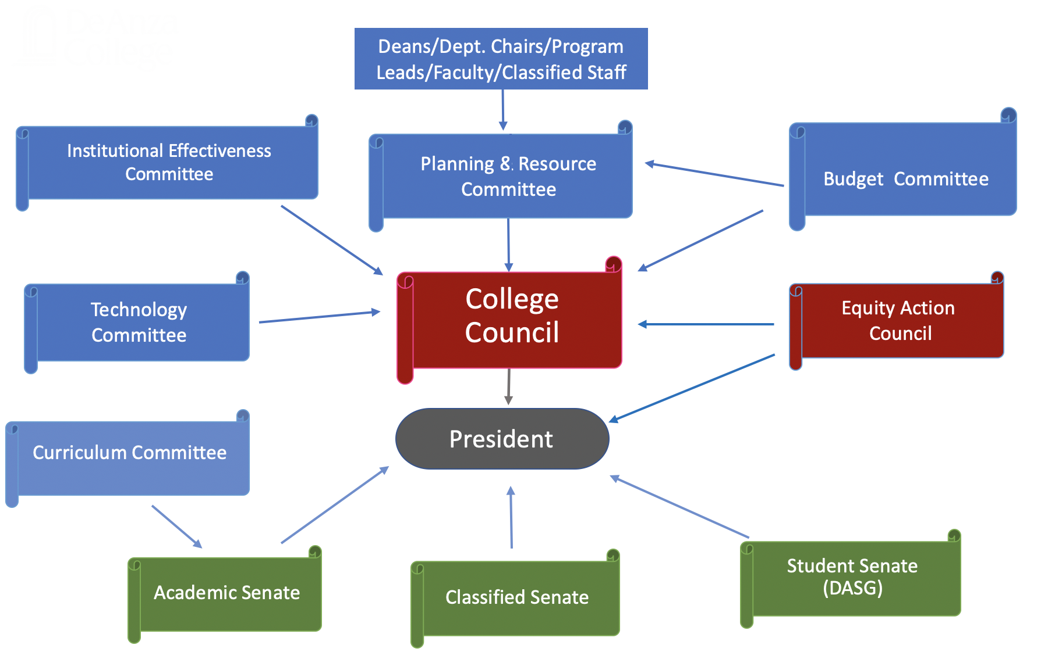
The Newly Proposed Shared Governance Model

Slide 9
The Planning & Resource Committee (PRC)
  Equity Action Council (1)
  Asian Pacific American Staff Association (1)
  Black Faculty, Staff and Administrators (1)
  De Anza Latinx Association Affinity Group (1)
  Future Affinity Groups (+1)
Affinity & Equity
Senates
  Academic Senate (2) 1 is a tri-chair
  Classified Senate (2) 1 is a tri-chair
  De Anza Student Government (2)
Planning & Resource Committee
Unions
Administrators
  Association of Classified
  Employees (1)
  California School Employees Association (1)
  Faculty Association (1)
  Teamsters (1)
  Deans/Managers (3)
  1 is a tri-chair. Rotates between areas each year
  1 Administrative Services
  1 Instruction
  1 Student Services

Slide 10
The Planning & Resource Committee
    Equity Action Council (1)
    Asian Pacific American Staff Association (1)
    Black Faculty, Staff and Administrators (1)
    De Anza Latinx Association Affinity Group (1)
    Future Affinity Groups (+1)
Affinity & Equity

Slide 11
The Planning & Resource Committee
Unions
    Association of Classified
    Employees (1)
    California School Employees Association (1)
    Faculty Association (1)
    Teamsters (1)

Slide 12
The Planning & Resource Committee
Administrators
  Deans/Managers (3)
  [1 serves as a tri-chair – this role rotates between areas below annually]
  1 Administrative Services
  1 Instruction
  1 Student Services

Slide 13
The Planning & Resource Committee
Senates
    Academic Senate (2)
      1 is a tri-chair
    Classified Senate (2)
      1 is a tri-chair
    De Anza Student Government (2)

Slide 14
The Proposed SG Model Steps
Deans, Dept. Chairs, program leads, faculty, and classified staff assess their division program areas: gather data, discuss program challenges, address opportunities for growth, and guide program area improvements.
  Division teams evaluate each programs’ needs through Program Reviews or CAS Standards to collectively prioritize positions and funding requests.
Divisions present prioritized division wide funding request to Planning & Resource Committee.
PRC formulates subcommittees known as Program Evaluation Teams (PETs) to review each division’s programs/areas/dept.’s Program Reviews/CAS Standards.
PETs use a consistent rubric to rate and/or rank each program need in a fair and equitable manner.
PRC then generates a structured report to College Council and College President based on the prioritization list.

Slide 15
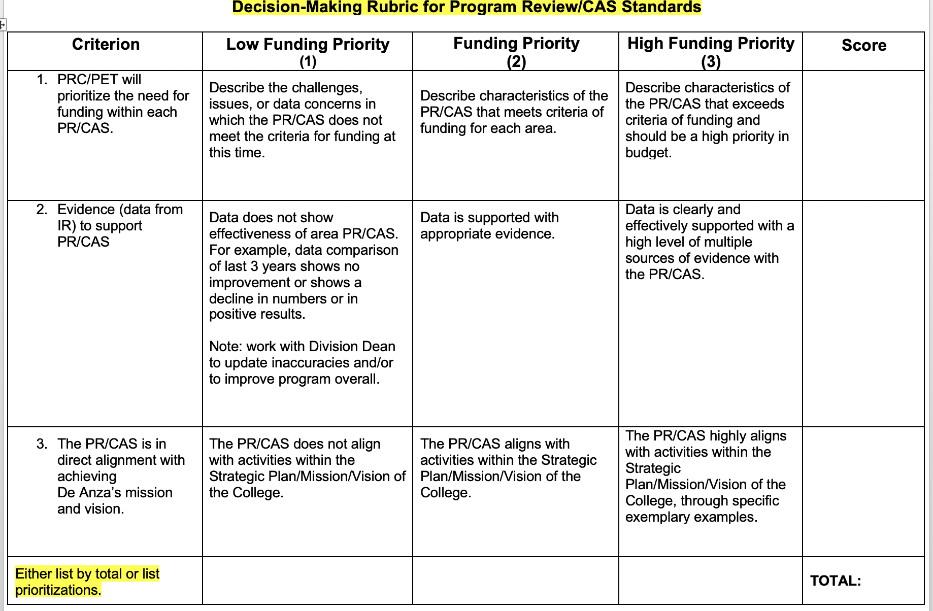
Proposed Decision-Making Rubric (sample)

Slide 16

The Proposed SG Model
The reorg structure of the new proposed model does the following:
  Dissolves present decision-making siloed teams (APBT, IPBT, SSPBT & Facilities Committee) and moves to a model of one campus wide Planning and Resource Committee (PRC)
  Allows for greater collaboration between deans and their teams to meet and confer regarding the needs of their division programs
  Simplifies structure
  Improves transparency
  Reduces meeting fatigue
  Increases opportunity for participation
  Shifts allocating resources based on holistic campus wide funding for student success
  Aligns the college goal of equity and inclusion in the decision-making process

Slide 17

The Budget Committee
Charge (Draft):
Educate – its members
Disseminate – information from various sources to constituents
Communicate – transparent budget proposals to stakeholders
Initiate – change to the process
Advocate – for appropriate funding
Navigate - the complicated internal and external systems
Purpose (How the SGTF envisions this Budget Committee based on what we know currently):
Budget information to the Deans/Divisions, and PRC
Educate/train college community on budget

Slide 18
The College Council
Recommended changes:
President is now an ex-officio member
Agendas with time allocation
Charge:
Proposes & recommends annual college objectives to carry out goals that are clearly defined, easy to understand and realistic
Provides shared governance leadership for district strategic planning/goals/objectives
Oversees collegewide strategic planning processes, achievement of outcomes, efficiency standards, budget policies, and procedures
Recommends college proposals for funding or reductions
Advises President, Senates, DASG and other college groups on policy development matters pertaining to planning, budgeting and accountability
Advises enrollment, facilities, and curriculum
Makes recommendations to the College President

Slide 19
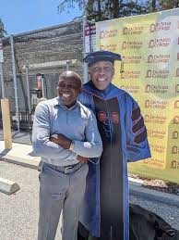
The College President
After receiving recommendations and advice from the pathways of the Deans/Divisions/Departments, Planning and Resource Council, Budget Committee, and the College Council, the president makes the final decisions.

Slide 20
Next Steps
Introduces SG proposed model to college community:
  Q&A
  Special SGTF Quick News Edition
  Continued updates on SG website
Generated feedback of model from each Shared Governance group, College Council, Senior Staff, and college community
Finalizes proposal
Invites IEPI/PRT to assist in implementing new SG model, communication structure, and assessment/technology needs
Works with Institution Research to update changes into the Governance Handbook
Evaluates SG model after one year to understand effectiveness of model & make collaborative improvements as necessary

Slide 21

Any Questions/Comments?

