Slide 1

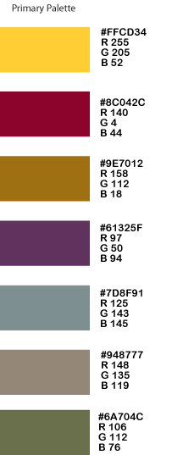
DMT Additive Manufacturing
Lab Expansion Proposal
Feb 6, 2020
Design & Manufacturing Technologies

Slide 2
The Ask
Provide funding for the Design and Manufacturing Technologies (DMT) Additive Manufacturing E35 remodel project.
Funding source is Strong Workforce Program (SWP)
Funding amount is $800,000. (estimated)
This project is in program review.

Slide 3
Support
This project is supported by President Holmes, VPI Christina Espinosa-Pieb, VPF Pam Grey, and the rest of senior staff.
This project is supported by local industry and the DMT Advisory Committee.
No other program has a proposal that SWP can fund.
  Building Maintenance has an infrastructure project ($60,000)

Slide 4
Jobs
Over 400 jobs (2018-2023) in manufacturing.

Slide 5
Why use SWP funds
This project is allowed to use SWP funding.
We need to spend SWP funding
By using SWP funds we free up funding for general college use.

Slide 6
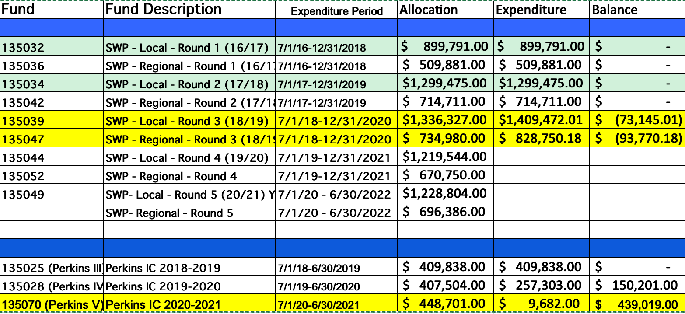
Available funds

Slide 7
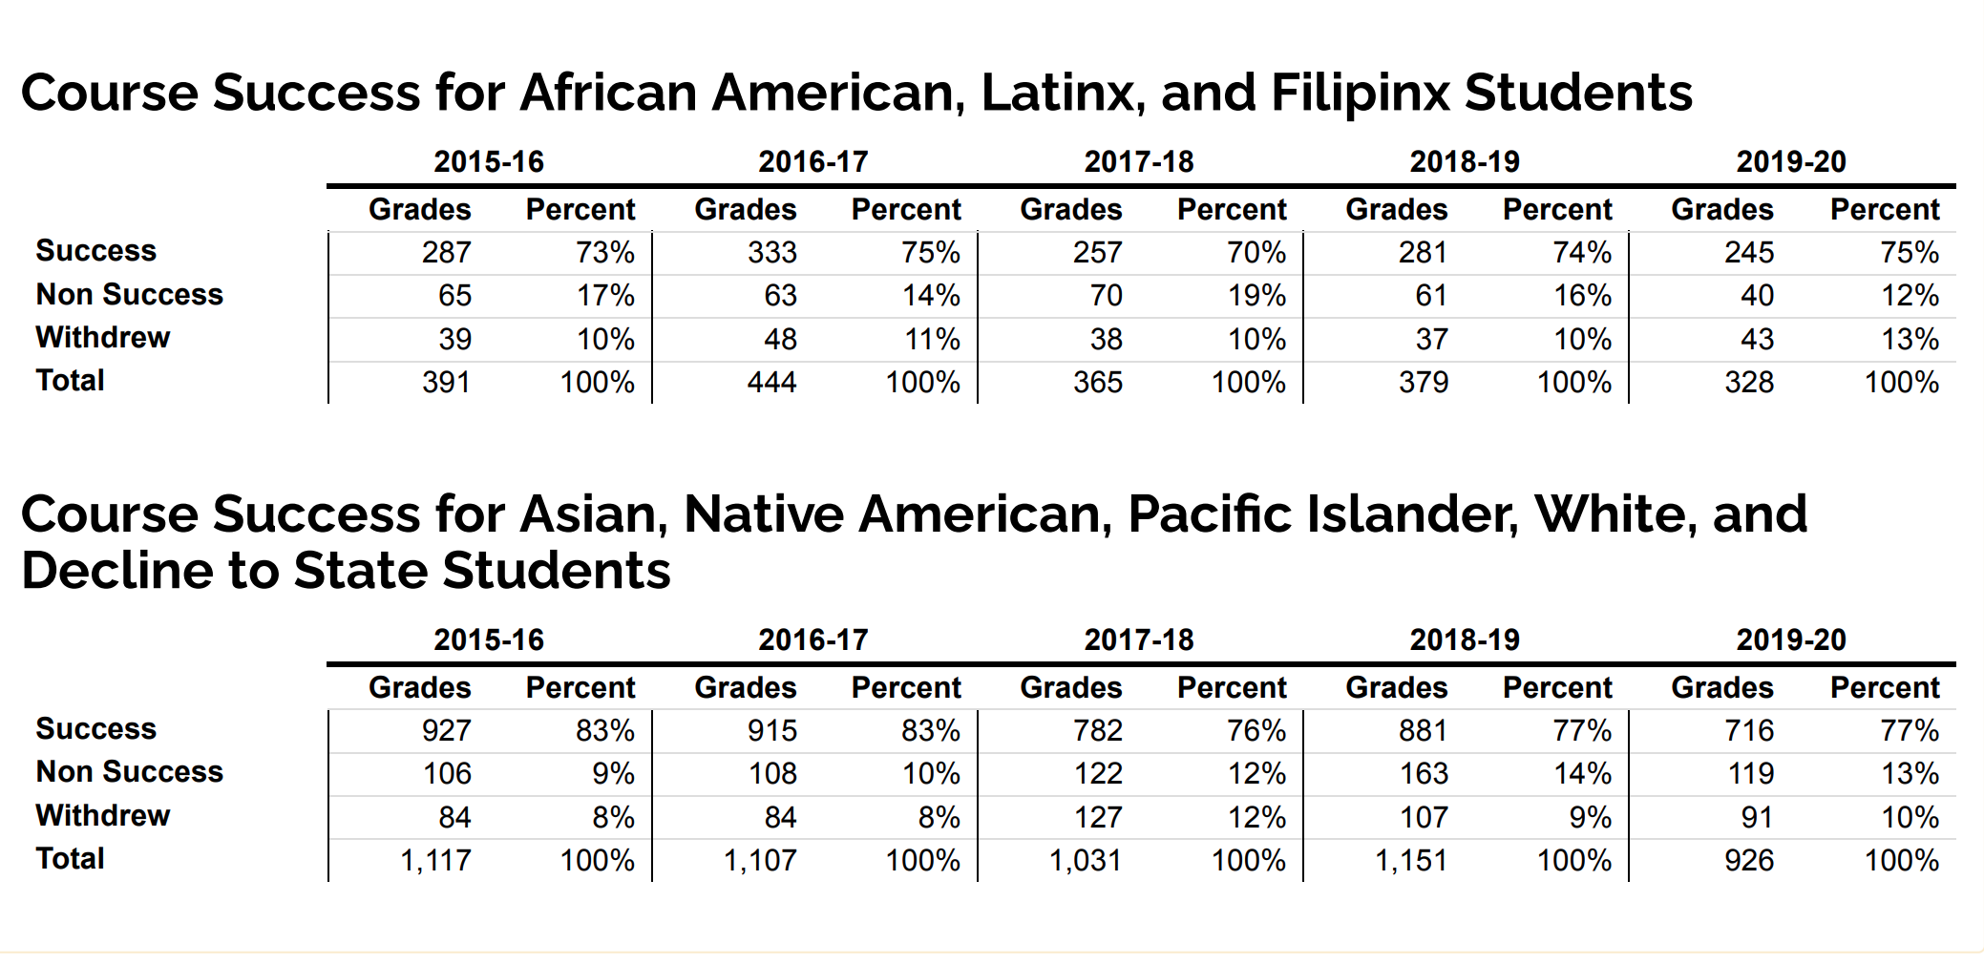
Program Equity Statistics

Slide 8
SWP Information
https://sites.google.com/a/baccc.net/baccc/Home
Strong Workforce Program Overview
Strong Workforce Program - Chancellor's Office website
Strong Workforce Program Guidance - Chancellor's Office FAQs
Bay Region Strong Workforce Program Allocations
Ed Code
  https://leginfo.legislature.ca.gov/faces/codes_displayText.xhtml?lawCode=EDC&division=7.&title=3.&part=54.5.&chapter=&article=

Slide 9
Presentation contents
Layouts: E35, E34, E36, E36a
Capital Cost & Proposed Timeframe

Slide 10
LAYOUTS

Slide 11

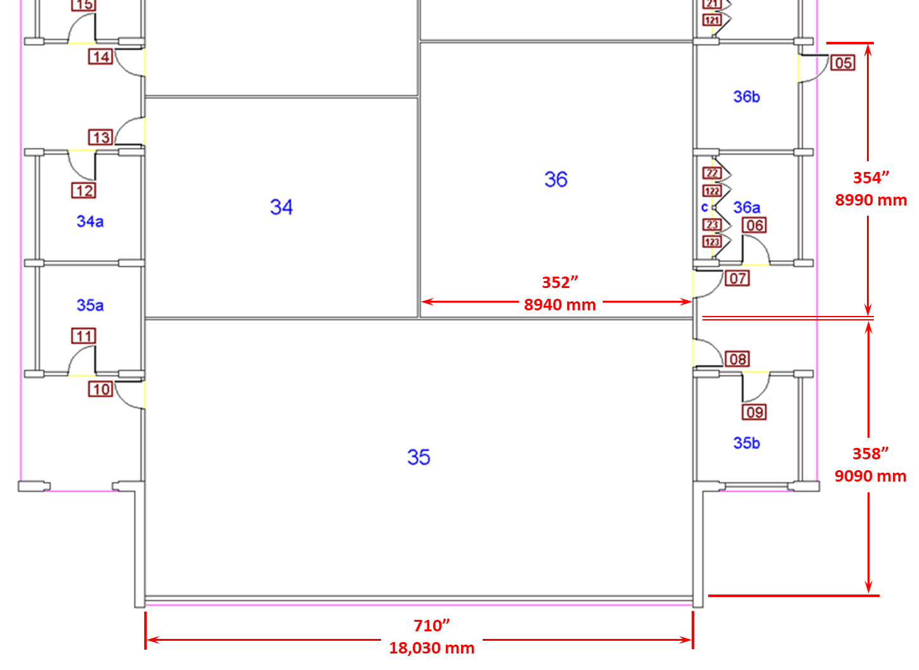
Bldg E3 overview
Current use:
Math classroom
Current use:
Math classroom
Currently empty
Current uses:
CAD classroom and lab
AM classroom and lab

Slide 12
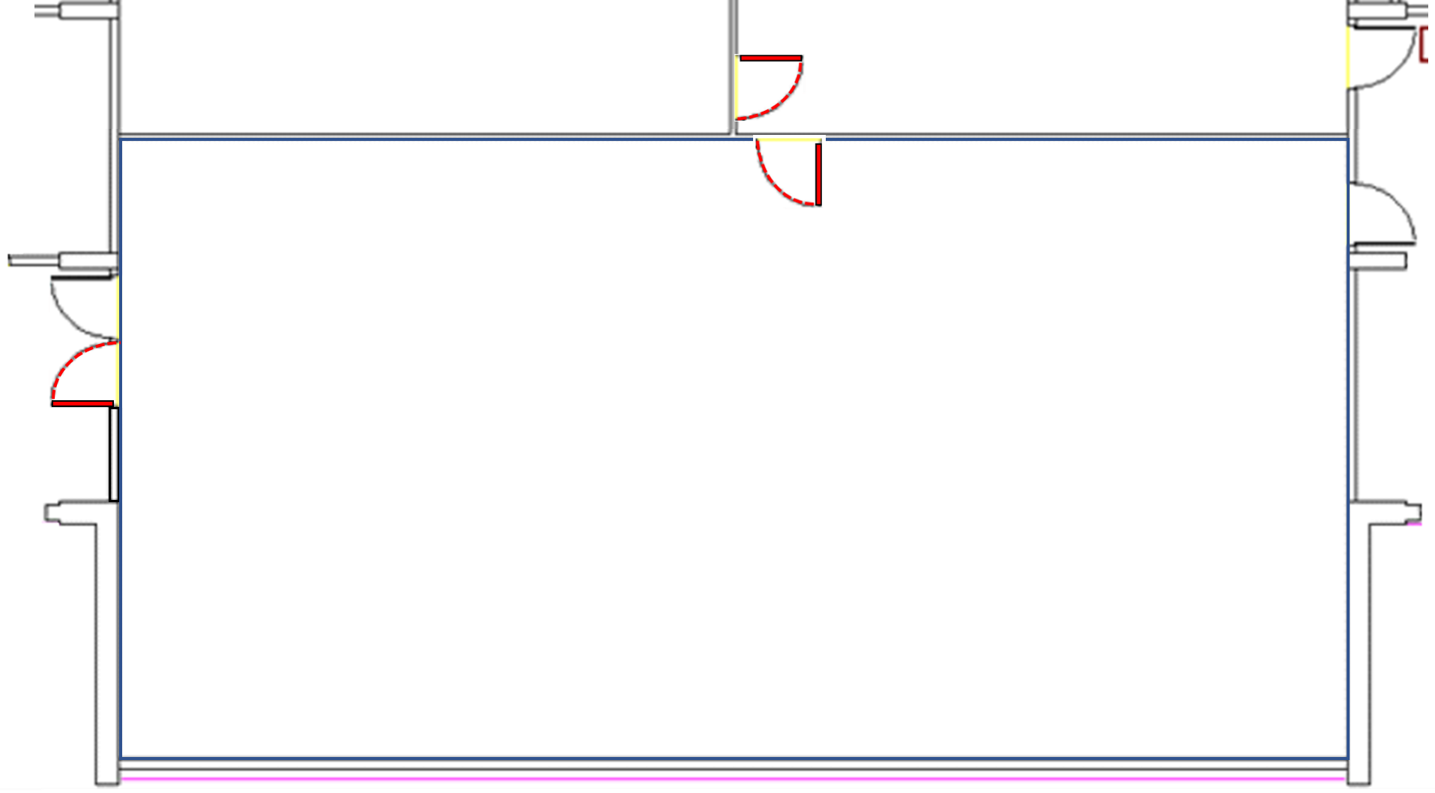
E35 construction: Doors & ventilation fans
Approx. Scale: 1:65
With proposed new doors…
❶ Double door, West wall of E35
❷ Connecting door, North wall of E35
❸ Connecting door, E34-E36
… and ventilation fans (❹)
and interior windows (❺)
E34
❸
E36
❺
❺
❺
❷
❶
E35
❹
❹

Slide 13
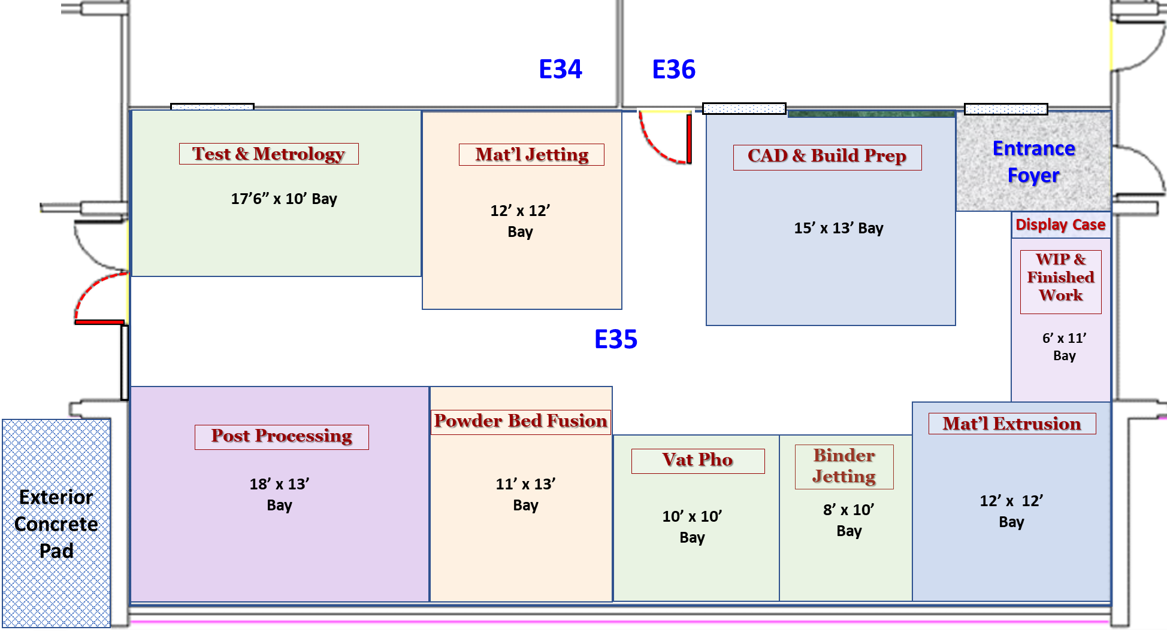
E35: Divided by furniture into functional Bays

Slide 14
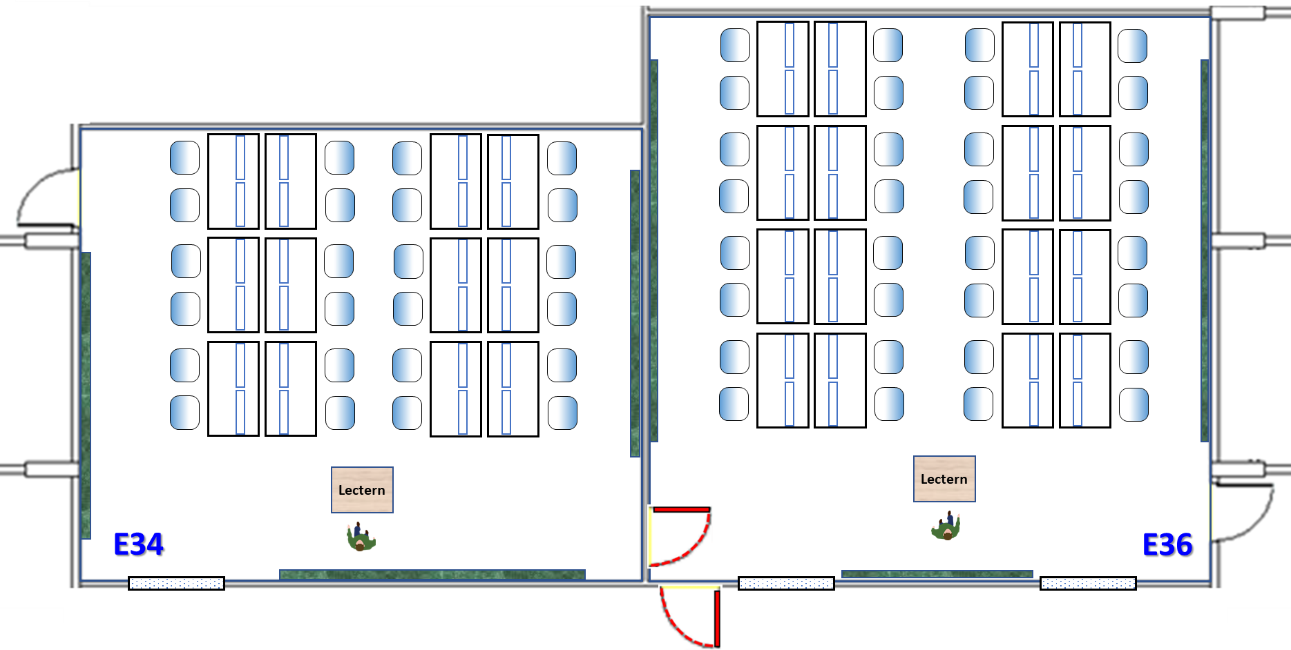
E36 and E34 – Classroom layout
Approx. Scale: 1:65
E34:
E-W: 352”
N-S: 284”
24 CAD seats
E36:
E-W: 352”
N-S: 354”
32 CAD seats
24 Seats
32 Seats

Slide 15
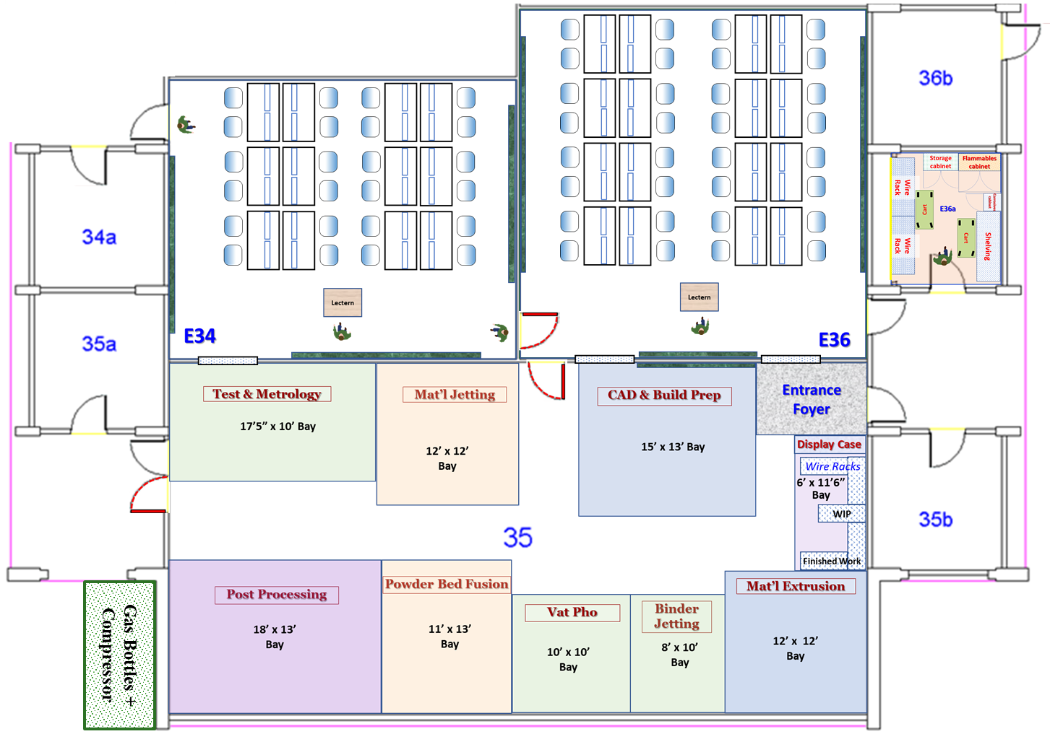
E35, E36, E34 – Full layout
Approx. Scale: 1:110

Slide 16
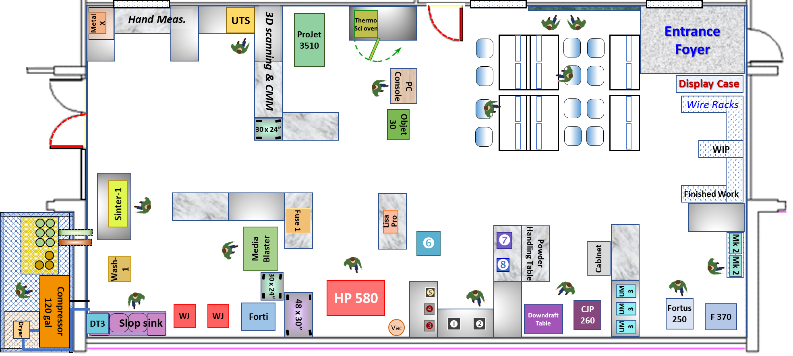
E35 – AM Lab layout detail
Approx. Scale: 1:65

Slide 17
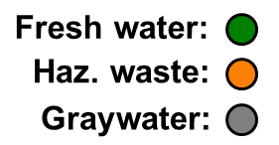
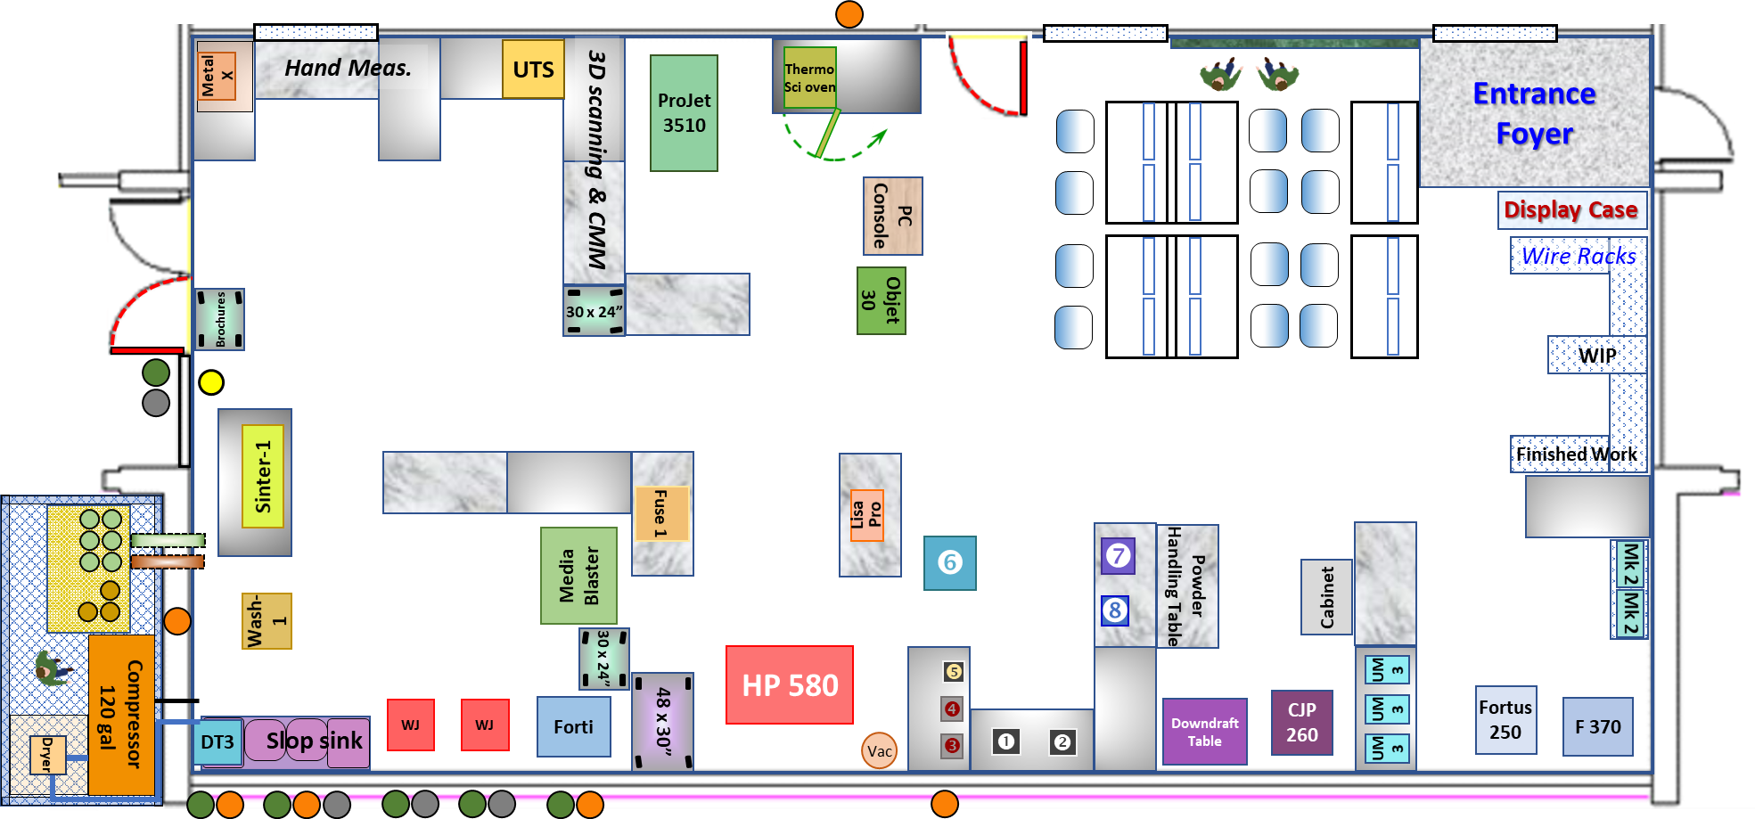
E35 – AM Lab plumbing detail
Approx. Scale: 1:70

Slide 18
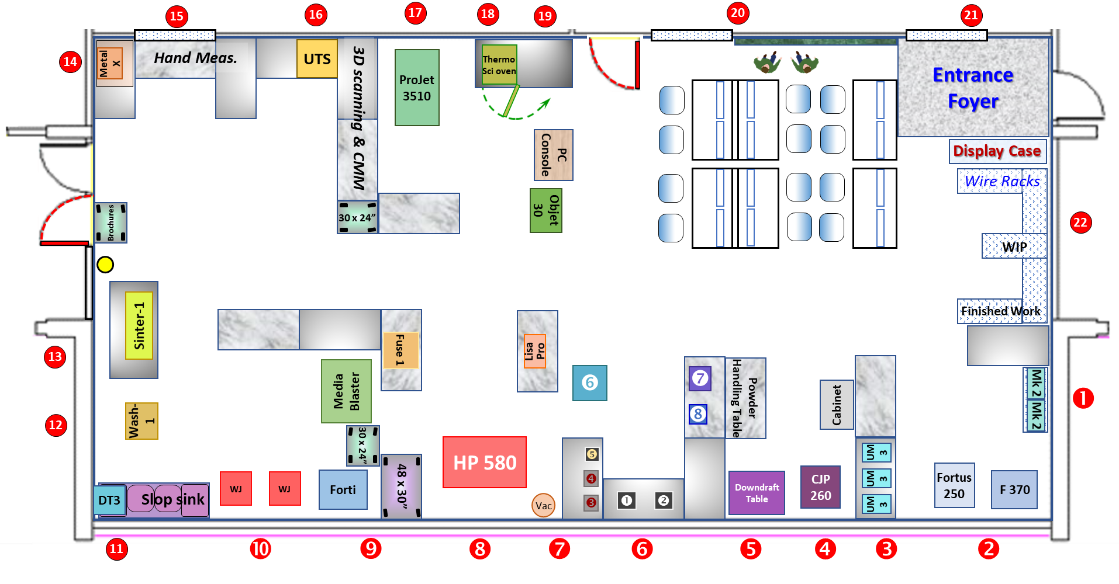
E35 – AM Lab electrical detail
Approx. Scale: 1:70

Slide 19

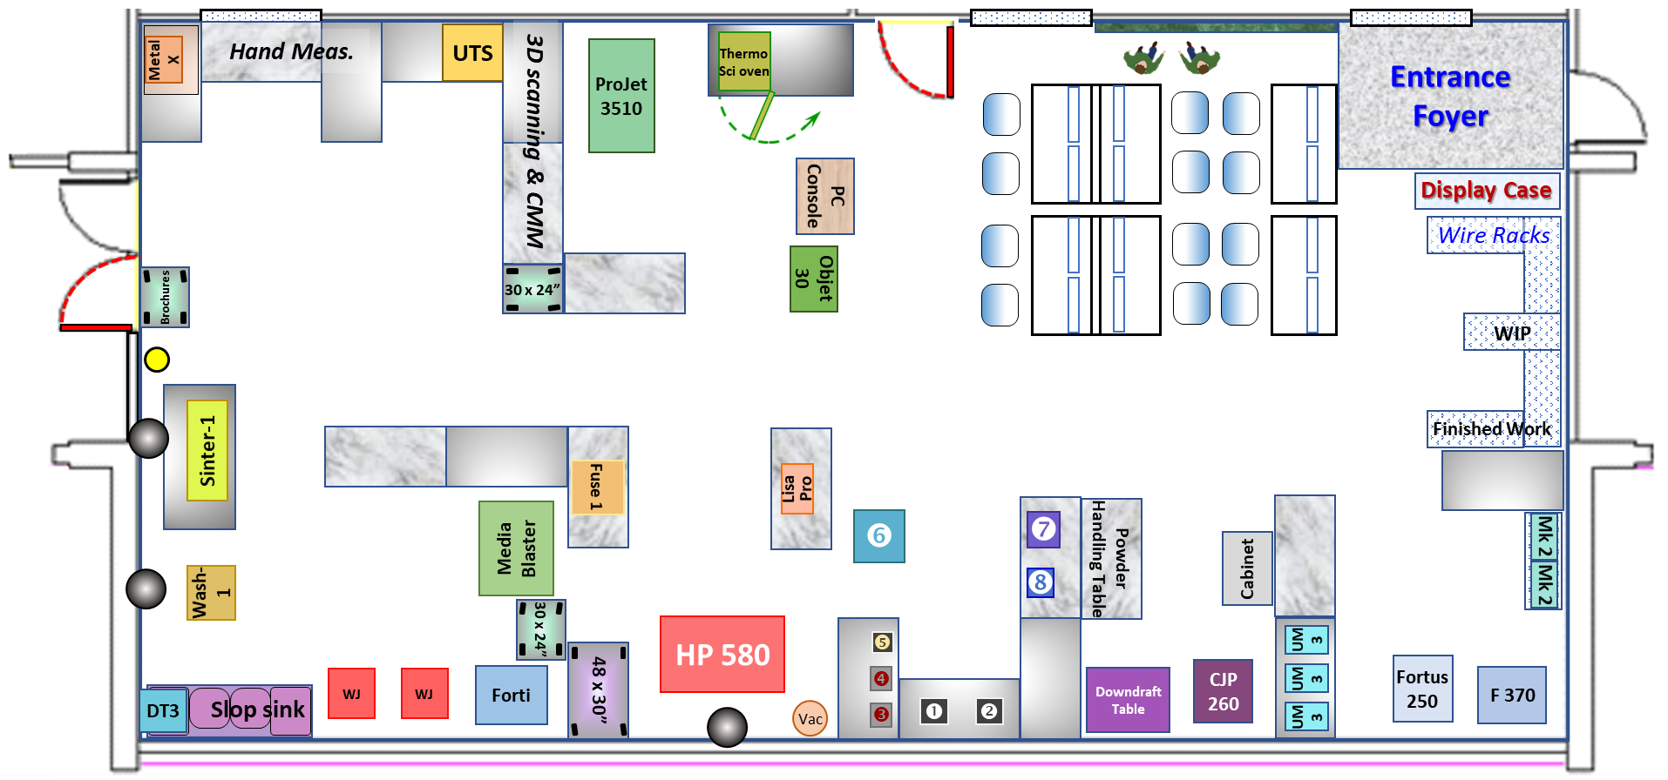
E35 – AM Lab roof ventilation detail
Approx. Scale: 1:70

Slide 20
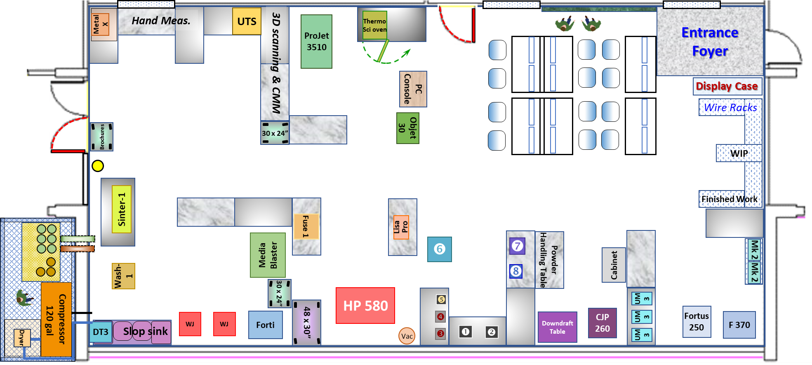
E35 – AM Lab compressed air detail
Approx. Scale: 1:70
Compressed Air drop:

Slide 21
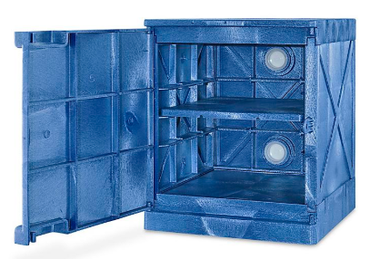
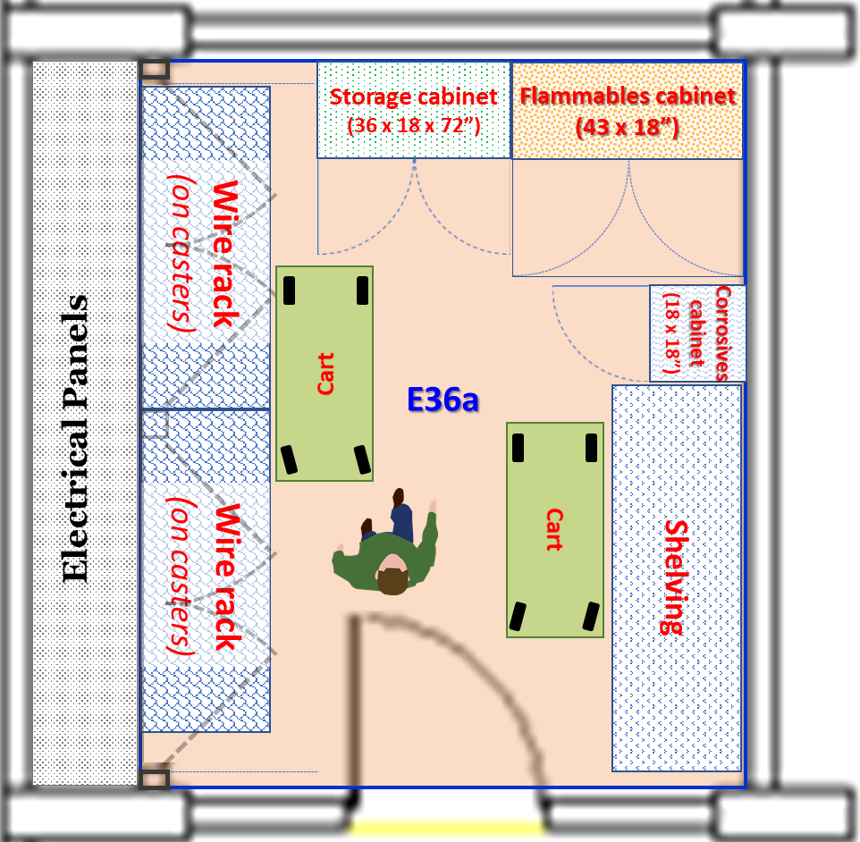
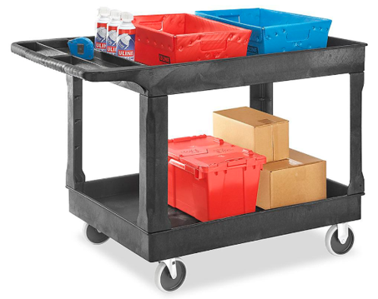
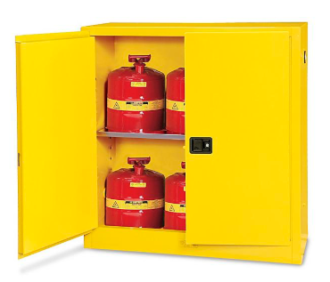
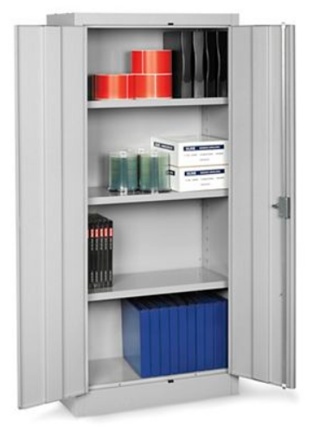
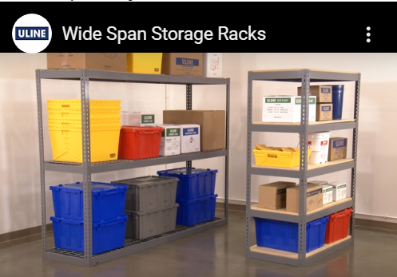
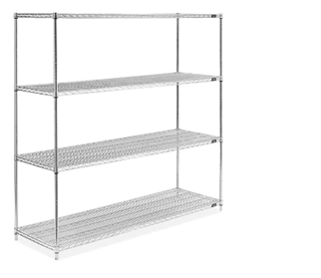
STORAGE – E36a
Approx. Scale: 1:28
Room | Width | Depth
E36a | 9 ft 3 in (111”) (usable) | 11 ft (132”)
Shelving units (3)
  3 or 4 shelves ea.
  Suitable for bulky items
Storage cabinets (1)
  4 shelves ea.
  Suitable for supplies and consumables
Flammables cabinet (1)
Corrosives cabinet (1)
Carts
  For work flow management

Slide 22
Capital Cost & Timeframe

Slide 23
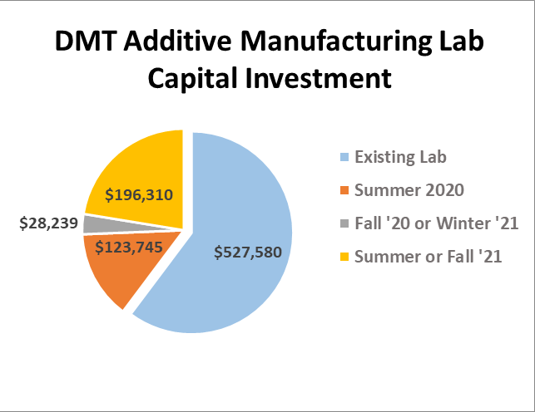
Total Capital Equipment Investment
Existing equipment:
Total value: $527,580
Discounts & Donations: -$161,242
De Anza expenditure to date: $366,338

Slide 24
Proposed overall investment plan
Critical Equipment investment needed
Summer ‘20
Summer/Fall ‘20
Summer/Fall ‘20
Spring/summer ‘20
Fall ’20 / Winter ‘21
ASAP
Detail on next slide

Slide 25
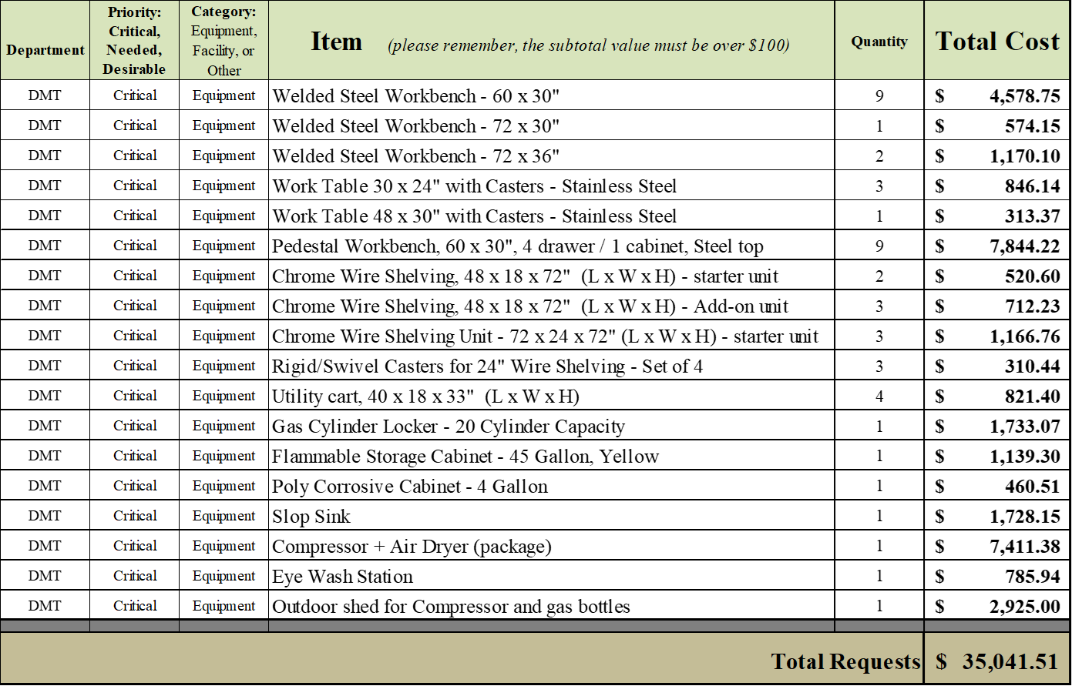
Proposed spending – Basic lab equipment
Needed for day-to-day operation of the Lab
Purchase timeframe:
  Rolling start: Spring 2020
  Major share: Summer 2020

Slide 26
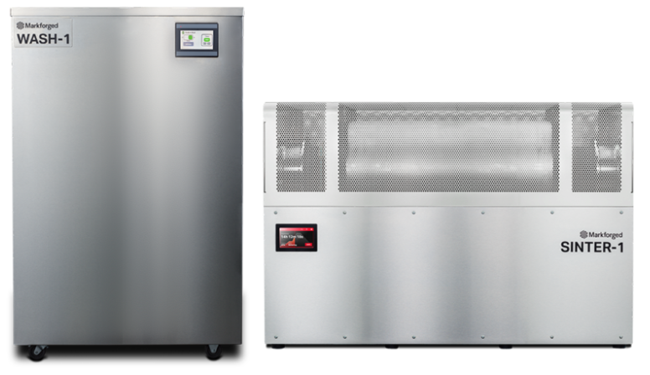
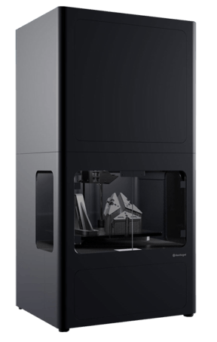
Proposed spending – Big ticket items
Planned curriculum and lab expansion
Purchase timeframe: Summer / Fall 2021
https://hawkridgesys.com/store/markforged/markforged-metal-x

Slide 27
