Slide 1


Streamlining the
Lottery Materials Allocation Process at De Anza College
This presentation outlines our plan to streamline the lottery materials funding process at De Anza College. We'll examine historical context, current challenges, and propose a simplified allocation model.
Presented by Lydia Hearn
Deans and managers’ meeting 3/6/25

Slide 2
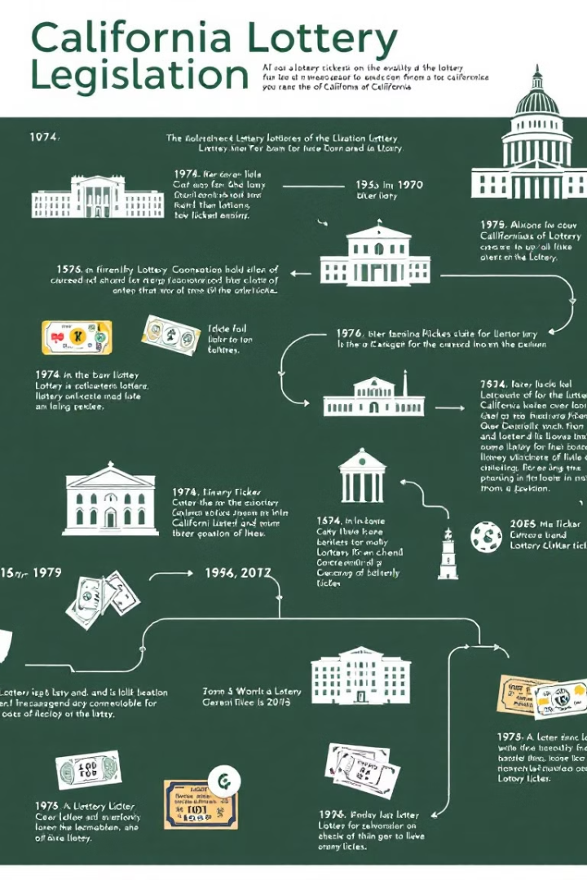
Origin of Funding
1
Proposition 37 (1984)
Established the California State Lottery Act. Created supplemental education funding without additional taxes.
2
Proposition 20 (2000)
The Cardenas Textbook Act directed more lottery resources to K-12 and community colleges.
3
SB 820 and AB 2884 (2020)
Recently expanded uses

Slide 3




Current Process Challenges
Time Intensive
Incorrect Funding Source
Efficiency
Itemization process is lengthy. It diverts staff from core educational duties.
Too many different accounts to track efficiently.
Expenses are frequently miscategorized (lottery, instructional equipment, or other expenditures)
Need for a stable and predictable budget

Slide 4

Defining Lottery Materials
Education Code Definition
Expanded Definitions
Prohibited Uses
"Materials designed for use by pupils and teachers as learning resources. They help acquire facts, skills, or develop cognitive processes." Materials may be printed or non-printed. They include textbooks, technology-based materials, and tests.
Now include student housing, student food assistance needs, laptops and hotspots for students, teachers, and faculty as learning resources,
No funds for real property acquisition, facility construction, research, or non-instructional purposes.

Slide 5








Typical Qualifying Expenditures
Literature
Software
Art Supplies
Athletic Needs
Library books
Licenses
Brushes
Athletic tape
Library databases (including video)
Subscriptions
Clay
Balls
Periodicals
Paint
Helmets
Textbooks
Photography film
Pads
Teachers' resources
Uniforms
Automotive Supplies
Science Materials
General classroom materials
Other
Auto parts and accessories
Biological specimens
Printed tests
Laptops and hotsports
Gasoline
Bones
Printed handouts
Basic needs related to housing and food
Oil
Chemicals
Medical supplies for instruction

Slide 6

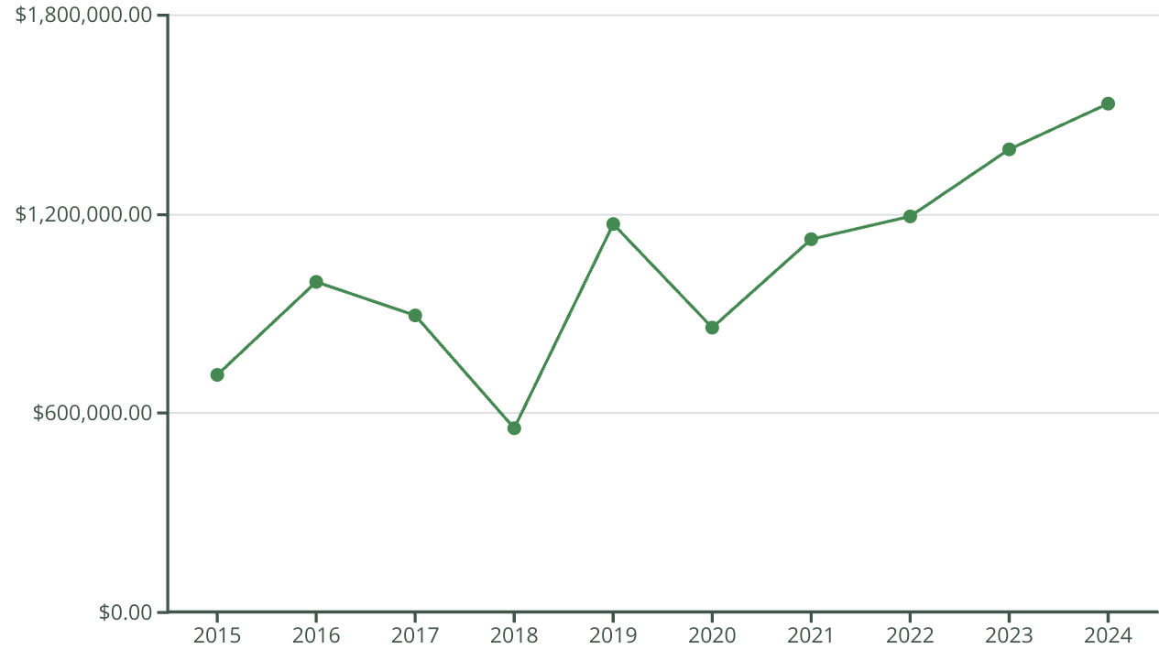
State Allocation Historical Funding
State funding has shown variability but maintains a general upward trend. This allows us to establish a reliable baseline.

Slide 7




Proposed New Model
Base Allocation: $1,000,000
Based on expected minimum allocation.
Contingency Fund
Any amount received from the State over base allocation goes to VPI contingency. Covers additional needs or shortfalls.
Regular Review
Swept every 2 years. Process evaluation after two years of implementation.

Slide 8

Typical Division Spending
Division | 3-year average | Proposed amount
Academic Services (campuswide software) | $185,451.00 | $ 245,000.00
BCAT | $68,834.00 | $ 75,000.00
BHES | $50,396.00 | $ 60,000.00
CA * | $20,900.00 | $ 35,000.00
Enrollment Services (one-time allocation) | $ 230,395.00 | $ 100,000.00
EE | --- | $ 2,000.00
IIS | $605.00 | $ 3,000.00
LA | $45,780.00 | $ 50,000.00
LR | $141,788.00 | $ 155,000.00
PEA | $192,777.00 | $ 190,000.00
PSME | $69,274.00 | $ 70,000.00
SSHUM | $12,846.00 | $ 13,000.00
COUN/DSPS |  | $ 2,000.00
 |  | $ 1,000,000.00

Slide 9

Implementation Guide
Evaluation Process
Online Resources
Full review after two years to assess effectiveness and make adjustments.
Review distribution of funding every 6 years (to align with the campus’s planning cycles).
Training
New webpage with common expenditure types
Decision tree for less common expenses.
Provide more training for employees to distinguish between types of funding (e.g. lottery, instructional equipment, Strong Workforce, B budget)

