Slide 1
Proposed Process for Requesting/Prioritizing New Technology Projects at De Anza
A Presentation Given to the Technology Task Force by Byron Lilly on February 16, 2011

Slide 2
The Old Project Prioritization Process
Many project requests are sent directly to ETS personnel
Users frequently describe projects as “critical” and insist they must be completed in a short period of time
Users frequently have not involved ETS personnel in the planning process, and additional resources, either initial or on-going or both, are identified after college administration have been persuaded by users that project is “critical” and “worthwhile.”
Requestors (and ETS personnel) are often frustrated
Notes:
Read title, then say this if from ETS’s perspective, now.
And by ETS personnel I mean people like Jose Rueda, Tom Roza, and Sharon Luciw. People at a high enough level that they have some ability and willingness to ask the caller some questions and get some idea of the relative costs and benefits of this particular project.
3. How can college administration decide if a project is “worthwhile” if they are not being shown all of the costs, such as an additional server and/or a permanent maintenance, support, and/or training burden for ETS?

Slide 3
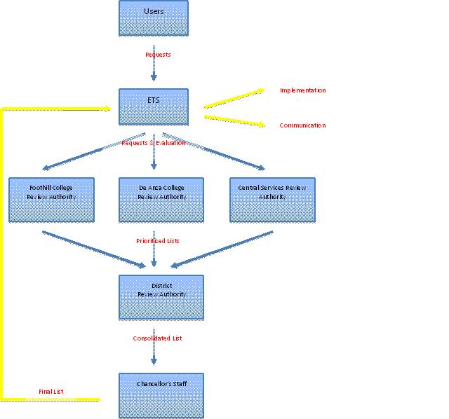
Proposed New Project Prioritization Process
Notes:
Our job is to figure out what should go in this box & make a recommendation to College Council for possible adoption by College Council. I think if College Council blesses it, we’re done. (Anybody disagree?)

Slide 4
Proposed New Project Prioritization Process
President
Senior Staff
College Council
Tech Task Force

Slide 5
Some of the Outstanding Issues
Will all projects that require ETS labor time go through this process, or will some projects be excluded and have their own process?
What will the role of the following groups be vis-à-vis this process?:
  The Campus Technology Prioritization Committee
  The Campus Budget Committee
Notes:
Other candidate groups for the question in bullet #2:
Senior Staff
College Council
The Lab and Multimedia Classroom Equipment Upgrade Prioritization Committee
The PBTs

Slide 6
Measure C Prioritization Process 1: Replacement Equipment
President
Campus Tech Prioritization Committee
Vice Presidents
Deans and Managers

Slide 7
Measure C Prioritization Process 2:
New Equipment
President
College Council
Campus Budget & TTF Committees
Deans & Mgrs submit to VPs and PBTs
Senior Staff

Slide 8
Things Fred and/or Letha Have Suggested Would Not Be Prioritized by TTF
Measure C work
Banner functionality improvements that are within the original project scope
Projects that take less than 40 ETS man-hours to complete
Routine break/fixes

Slide 9
Additional Outstanding Issues
Is it sufficient for the prioritization process to continue to bucket projects into one of three priority levels, or do we need to produce a numbered ranking of the projects?
  Fred said Monday (2/14/11) that “just the C’s will probably take my group 5 years to complete.” That suggests to me that we need to cut the C’s finer.
Who will negotiate with ETS on such issues as
  How many phases to break a given project into?
  What the committed completion date of each project phase is?
  Changes in the prioritization levels and committed completion dates of the various projects over time?

Slide 10
Additional Outstanding Issues
Should we be concerned that we are proposing one process for prioritizing ETS’s labor time and a different process for allocating budget to projects? What will happen if there are significant differences in the priorities established by these two groups?
  Most likely, projects would need both budget and labor time in order to get completed. Projects missing either would languish.

Slide 11
Proposed New Project Prioritization Process
Notes:
As a point of interest, Fred Sherman has proposed that the District Review Authority be a committee composed of just 4 people: one rep. each from De Anza, Foothill, and the District, plus Fred. There’s a lot to be said for having the prioritization group be small but well informed. Frankly I wish we could duplicate that at the De Anza level.

Slide 12
Next Steps
Forward a recommendation to College Council to accept and approve ETS’s proposal that “projects and project phases that have been started cannot be stopped midstream.”
  In the interests of ETS efficiency, no new projects could be started until all projects or project phases that have been started are completed.”
Forward to College Council a recommendation to adopt, on a provisional or pilot test basis, ETS’s proposed flowchart and prioritization methodology (the Excel spreadsheet.)

Slide 13
Next Steps
Develop and forward to College Council a recommended process to occupy the “De Anza College Review Authority” box in ETS’s prioritization flowchart.

