Slide 1
2015 Campus Convocation
De Anza College

Slide 2
Convocation Schedule
9:00-10:30 Morning Program
  An overview of assessing the “Physical/Mental Wellness and Personal Responsibility” ICC
10:40-11:25 Breakout Session I
11:30-12:15 Breakout Session II
12:20-1:10 Lunch (with special guests!)
1:10-3:00 Dept/Program Assessment Work
  Afternoon ‘ask’: SLO Assessment Plan (due 4/20)

Slide 3
ICC Assessment at De Anza College
Communication and Expression
Information Literacy
Civic Capacity for Global, Cultural, Social and Environmental Justice
  Addressed during 2013 and 2014 Convocations
Critical Thinking
  Addressed during 2012 Convocation
Physical/Mental Wellness and Personal Responsibility

Slide 4
ICC Assessment:
Physical/Mental Wellness and Personal Responsibility
“Students will recognize lifestyles that promote physical and mental well-being, engage in self-reflection and ethical decision-making, explore career choices and life goals, practice effective individual and collaborative work habits, and demonstrate a commitment to ongoing learning.”

Slide 5
ICC Assessment:
Physical/Mental Wellness and Personal Responsibility
Five examples of innovative assessment work:
  The Tobacco Cessation Program (Health Services)
  “Chill City” (Health Services)
  The Food Pantry (Occupational Training Institute)
  PLO assessment for Physical Education department
  Psychological Services

Slide 6
ICC Assessment:
Physical/Mental Wellness and Personal Responsibility
Example #1: The Tobacco Cessation Program
Health Education and Wellness’ Tobacco Cessation Program offers students individualized counseling and support while they quit using tobacco products. This program is student driven. Students work with a trained counselor to identify their tobacco trigger-response systems, develop coping skills and alternate behaviors with the goal of becoming tobacco-free through behavior change.

Slide 7
ICC Assessment:
Physical/Mental Wellness and Personal Responsibility
Example #1: The Tobacco Cessation Program
Services Include:
  1:1 counseling sessions that include education, advice, support, and encouragement for each student.
  Free nicotine patches and gum according to the individual student’s needs.
  Tips, tricks, and other resources for making quitting successful.
  Quit kits: A collection of items used by students when they feel the need to use tobacco.

Slide 8
ICC Assessment:
Physical/Mental Wellness and Personal Responsibility
Example #1: The Tobacco Cessation Program
Data from a three year-assessment:
  2011/12: Recruited students from smoking areas on campus
    36 enrolled, 4% success rate
  2012/13: More active recruitment practices
    47 enrolled, few completed the program
  2013/14: Informed students of service, rather than active recruitment:
    30 enrolled, 17% successfully completed

Slide 9
ICC Assessment:
Physical/Mental Wellness and Personal Responsibility
Example #1: The Tobacco Cessation Program
Evidence-based program enhancement:
  We will continue to exercise our new recruiting strategies in the coming school years in hopes of sustaining growth. Practice changes are anticipated as guidelines and best practices are identified. Always, our goal is to engage and encourage more DeAnza students to become tobacco-free.

Slide 10
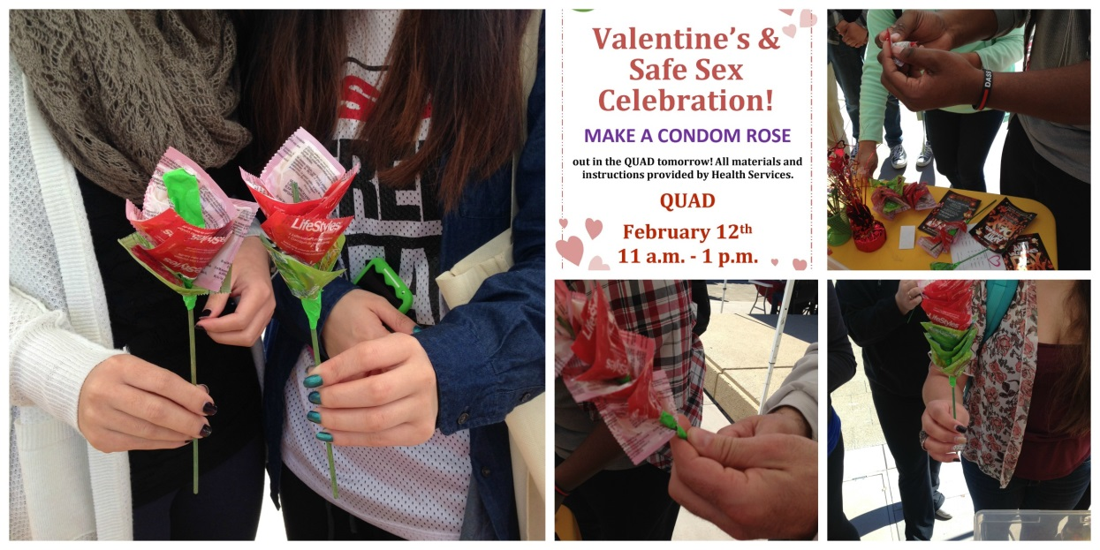
ICC Assessment:
Physical/Mental Wellness and Personal Responsibility
Example #2: “Chill City”
One of several quarterly events facilitated by Health Services

Slide 11
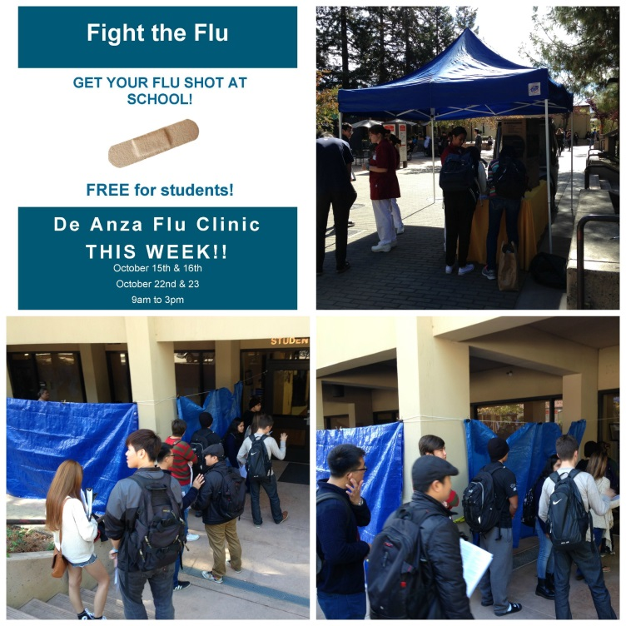
ICC Assessment:
Physical/Mental Wellness and Personal Responsibility
Example #2: “Chill City”
One of several quarterly events facilitated by Health Services

Slide 12
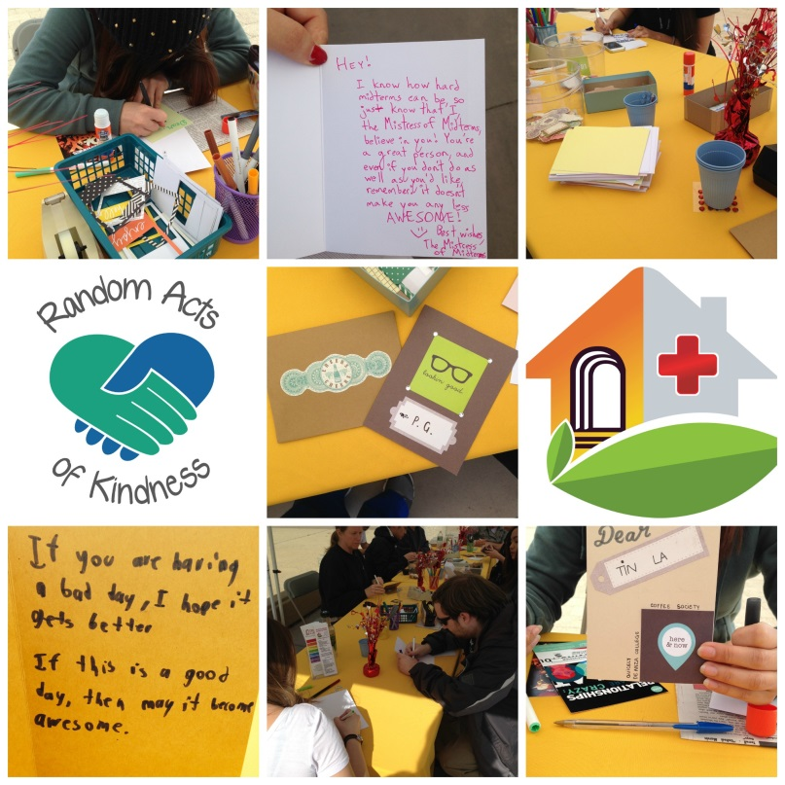
ICC Assessment:
Physical/Mental Wellness and Personal Responsibility
Example #2: “Chill City”
One of several quarterly events facilitated by Health Services

Slide 13
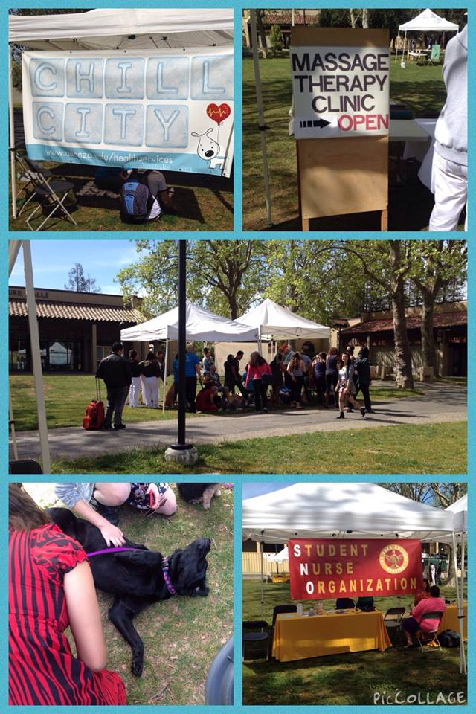
ICC Assessment:
Physical/Mental Wellness and Personal Responsibility
Example #2: “Chill City”
One of several quarterly events facilitated by Health Services

Slide 14
ICC Assessment:
Physical/Mental Wellness and Personal Responsibility
Example #2: “Chill City”
“Get your chill on while you de-stress before finals. Special guests will help keep your stress levels in check to enable you to study for finals. Held in the S-Quad the week before finals.”

Slide 15
ICC Assessment:
Physical/Mental Wellness and Personal Responsibility
Example #2: “Chill City”
An assessment challenge:
  Survey-based assessment would seem to interfere with the aims of the event itself
  The idea is to decrease stress, after all…

Slide 16
ICC Assessment:
Physical/Mental Wellness and Personal Responsibility
Example #2: “Chill City”
An assessment solution: Anecdotal evidence can be valuable, too!

Slide 17
ICC Assessment:
Physical/Mental Wellness and Personal Responsibility
Example #3: The Food Pantry (OTI)
Sometimes asking the right questions can result in a profound impact on our students’ lives

Slide 18
ICC Assessment:
Physical/Mental Wellness and Personal Responsibility
Example #3: The Food Pantry (OTI)
From Veronica Acevedo Avila’s January 2014 article in the SLO Newsletter:
  “As much as Dan and the OTI staff would like to think that all affiliated students know about every service they offer, they knew this wasn’t the case. So his team conducted a survey to find out which OTI services students knew versus which ones they needed to better advertise.”

Slide 19
ICC Assessment:
Physical/Mental Wellness and Personal Responsibility
Example #3: The Food Pantry (OTI)
From Veronica Acevedo Avila’s January 2014 article in the SLO Newsletter:
  “The SSLO assessment survey results showed that the majority of students didn’t know about food and shelter services. But more importantly, the team found out the true extent to which this service was needed because students reported that they were coming to class hungry.”

Slide 20
ICC Assessment:
Physical/Mental Wellness and Personal Responsibility
Example #3: The Food Pantry (OTI)
From Veronica Acevedo Avila’s January 2014 article in the SLO Newsletter:
  “These individuals didn’t have the money to buy food for themselves nor their families. The SSLO assessment survey results helped identify food insecurity issues amongst students and OTI took action.”

Slide 21
ICC Assessment:
Physical/Mental Wellness and Personal Responsibility
Example #4: PLO Assessment for the P.E. Program
The assessment of this ICC is often directly embedded into the assessment work that we already do for our course and program level outcomes

Slide 22
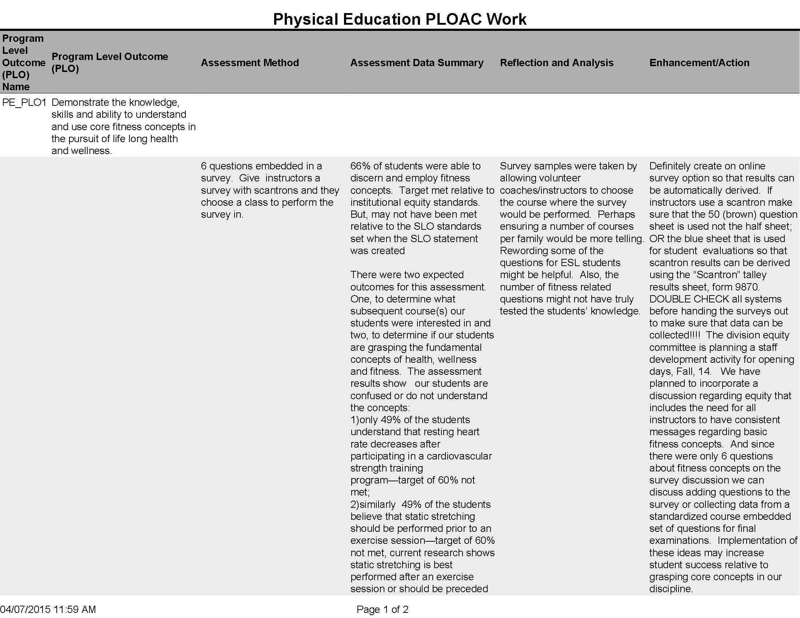
ICC Assessment:
Physical/Mental Wellness and Personal Responsibility
Example #4: PLO Assessment for the P.E. Program

Slide 23
ICC Assessment:
Physical/Mental Wellness and Personal Responsibility
Example #4: PLO Assessment for the P.E. Program
PLO Statement:
  “Demonstrate the knowledge, skills and ability to understand and use core fitness concepts in the pursuit of life long health and wellness.”
Assessment method:
  “6 questions embedded in a survey. Give instructors a survey with scantrons and they choose a class to perform the survey in.”

Slide 24
ICC Assessment:
Physical/Mental Wellness and Personal Responsibility
Example #4: PLO Assessment for the P.E. Program
“66% of students were able to discern and employ fitness concepts. Target met relative to institutional equity standards. But, may not have been met relative to the SLO standards set when the SLO statement was created.”

Slide 25
ICC Assessment:
Physical/Mental Wellness and Personal Responsibility
Example #5: Psychological Services
This program more directly emphasizes the mental wellness addressed by the ICC language.
A relatively new program, Psychological Services was first introduced in the winter of 2014.

Slide 26
ICC Assessment:
Physical/Mental Wellness and Personal Responsibility
Example #5: Psychological Services
Siew Kuek, director of the PS program, brought her own assessment work from her previous field experience and education to bear in the development of the program itself.

Slide 27
ICC Assessment:
Physical/Mental Wellness and Personal Responsibility
Example #5: Psychological Services
An innovative approach meets both aims simultaneously:
  By working with practicum students currently working toward state licensure, Siew is now able to also offer unlimited appointments with trained therapists to students who want them.
  Appointments beyond the initial limit of five now incur a nominal $10 charge per meeting for students—less than the cost community clinics, and less than the cost of a standard co-payment.

Slide 28
ICC Assessment:
Physical/Mental Wellness and Personal Responsibility
Example #5: Psychological Services
Siew is confident that the Outcome Measures that she is collecting this year will demonstrate that year-long student-clinician relationships greatly enhance the efficacy of the PS program.

Slide 29
ICC Assessment:
Physical/Mental Wellness and Personal Responsibility
The Bigger Picture
These examples illustrate ways in which the college does seem to be meeting the aim of improving student health and wellness. But they also leave us with three questions:
  Where else do we find examples of this kind of work?
  How can we improve?
  How are we meeting the aim of enhancing our students’ sense of responsibility?

Slide 30
ICC Assessment:
Physical/Mental Wellness and Personal Responsibility
Assessing “Personal Responsibility”: A Focus Group
  Our student panelists represent three programs that emphasize students’ sense of personal responsibility:
  From the LEAD (Latino/a Empowerment at De Anza) program:
    Nicholas Estrada
    Mia Hernandez
    Naresa Hussaini
    Stacey Ochoa

Slide 31
ICC Assessment:
Physical/Mental Wellness and Personal Responsibility
Assessing “Personal Responsibility”: A Focus Group
  Our student panelists represent three programs that emphasize students’ sense of personal responsibility:
  From the FYE (First Year Experience) program:
    Vanessa Mae Flanagan
    Kiyonna Simms

Slide 32
ICC Assessment:
Physical/Mental Wellness and Personal Responsibility
Assessing “Personal Responsibility”: A Focus Group
  Our student panelists represent three programs that emphasize students’ sense of personal responsibility:
  From the LINC (Learning in Communities) program:
    Emily Lovelace
    Cristina Maravilla

Slide 33
ICC Assessment:
Physical/Mental Wellness and Personal Responsibility
Assessing “Personal Responsibility”: A Focus Group
  As we listen to our students, consider the following questions:
  Are there ways in which these experiences remind you of practices that you employ in your work on campus?
  Are there ways in which you can integrate any of these practices in your work?
  Can you suggest ideas/practices for promoting students’ sense of personal responsibility that have not been discussed by our panelists?

Slide 34
As we prepare to reflect and discuss…

Slide 35
ICC Assessment:
Physical/Mental Wellness and Personal Responsibility
Assessing “Personal Responsibility”: A Focus Group
  Having heard from our panelists, please discuss these questions at your table, and briefly record a few of your responses on the forms provided:
  Are there ways in which these experiences remind you of practices that you employ in your work on campus?
    Reflection
  Are there ways in which you can integrate any of these practices in your work?
    Enhancement
  Can you suggest ideas/practices for promoting students’ sense of personal responsibility that have not been discussed by our panelists?
    Enhancement

Slide 36
Convocation Schedule
9:00-10:30 Morning Program
  An overview of assessing the “Physical/Mental Wellness and Personal Responsibility” ICC
10:40-11:25 Breakout Session I
11:30-12:15 Breakout Session II
12:20-1:10 Lunch (with special guests!)
1:10-3:00 Dept/Program Assessment Work
  Afternoon ‘ask’: SLO Assessment Plan (due 4/20)

Slide 37
Convocation Schedule
Workshop Sessions
10:40-11:25
“Wellness and Responsibility Across Boundaries” (Veronica Neal)
  AT 202
“The Cup is Half Empty” (Toño Ramirez)
  AT 204
“Harm Reduction at De Anza” (Michele LeBleu-Burns)
  AT 311
“Everything you wanted to know about writing an assessment with (or without) TracDat” (Amy Leonard)
  AT 203
“Department Chairs/Program Coordinators and the SLO Assessment Process” (Mary Pape)
  AT 205

Slide 38
Convocation Schedule
Workshop Sessions
11:30-12:15
“Wellness and Responsibility Across Boundaries” (Veronica Neal)
  AT 202
“The Cup is Half Empty” (Toño Ramirez)
  AT 204
“Harm Reduction at De Anza” (Michele LeBleu-Burns)
  AT 311
“Everything you wanted to know about writing an assessment with (or without) TracDat” (Amy Leonard)
  AT 203
“Department Chairs/Program Coordinators and the SLO Assessment Process” (Mary Pape)
  AT 205

