Slide 1
Introduction to SLO Assessment SLO Workshop
Mary Pape
Amy Leonard
Notes:
Bring Slides, flowchart handout, list of accounts

Slide 2
Outcomes for today’s workshop:
Each participant will be able to find reports, documents and program review for their and all departments.
Each Phase I faculty member will be able to run reports.
Each participant will be able to respond to an emailed assignment.
Each participant will be able to complete SLOAC Worksheet.
Notes:
Each partipant is logging into computer, deanza.edu, and Tracdat. Expect login issues.

Slide 3
First, a bit of background . . .

Slide 4
Program/Certificate/Degree
Level Outcomes
PLOs
Institutional
Level Outcomes
Course Outcomes
SLOs
At De Anza College we chose to write the course student learning outcome statements first.
Notes:
Student Learning Outcomes are directed at assessing and improving the extent to which students are achieving the skills recognized as the outcomes in individual courses.
Program Level Outcomes assess how well the program area is reaching the needs of the students considering the program as a whole as well as the certificates and degrees offered through the program.
Institutional Learning Outcomes are aimed at assessing to what extent the Institutional Core Competencies.
All outcome statements should be agreed upon by the group that is responsible for delivering the learning experience; for example, all the instructors who teach the same course should agree to and teach to the SLOs for that course; all members of a program or department should agree to the program/certificate/degree SLOs; the entire college is involved in defining and assessing the institutional SLOs through committees such as College Council.

Slide 5
College Planning Committee
DRAFT 9/13
2011-12
2012-13
2013-14
2014-15
2015-16
2016-17
2017-18
Year 1
Year 2
Year 3
Year 4
Year 5
Year 6
Year 1
SITE
VISIT
Follow-up Site Visit
(Recs #1,#2,#3)
Follow-up Letter
(Rec #1)
MID-TERM
REPORT
Form Teams
SELF
STUDY
SITE
VISIT
ACCJC
Cycles/
Reports
Ongoing Preparation and Submission of ACCJC Reports
CPC
Assessment/
Planning
Governance
Review
Values
Review
Mission
Review
EMP
REVIEW
“Quilt”
Review
Outcomes
Review
Governance
Review
Ongoing Assessment of Governance (annual survey)
PBTs &
College
Council
Planning & Resource
Allocation
(PRA)
Planning & Resource
Allocation
(PRA)
Planning & Resource
Allocation
(PRA)
Planning & Resource
Allocation
(PRA)
Planning & Resource
Allocation
(PRA)
Planning & Resource
Allocation
(PRA)
Planning & Resource
Allocation
(PRA)
Equity
Assessment/
Planning
Ongoing Development and Assessment of Student Equity Plans
DAC - Detailed Planning Cycle - 2011 - 2017
APRU # 3
APRU #4
CPR
&
5-Year
Plan
Reflection Year Report
APRU #1
APRU #2
APRU #3
Six-Year Program Review Process
ICC/GE
Assessment
Cycles
1st ICC Selection
Critical Thinking
GCS&E
3rd ICC
4th ICC
5th ICC
ILO Assessment
Outcomes
Assessment Cycles
Outcomes
Assessment Cycles
Program
Level
Outcomes
Calendar
Assessment Cycles
Outcomes
Assessment Cycles
Outcomes
Assessment Cycles
Outcomes
Assessment Cycles
Outcome/
Assessment
Cycles
Curriculum
Review
Cycles
5 Year cycle
5 Year cycle
5 Year cycle
5 Year cycle
5 Year cycle
5 Year cycle
5 Year cycle
Notes:
5

Slide 6
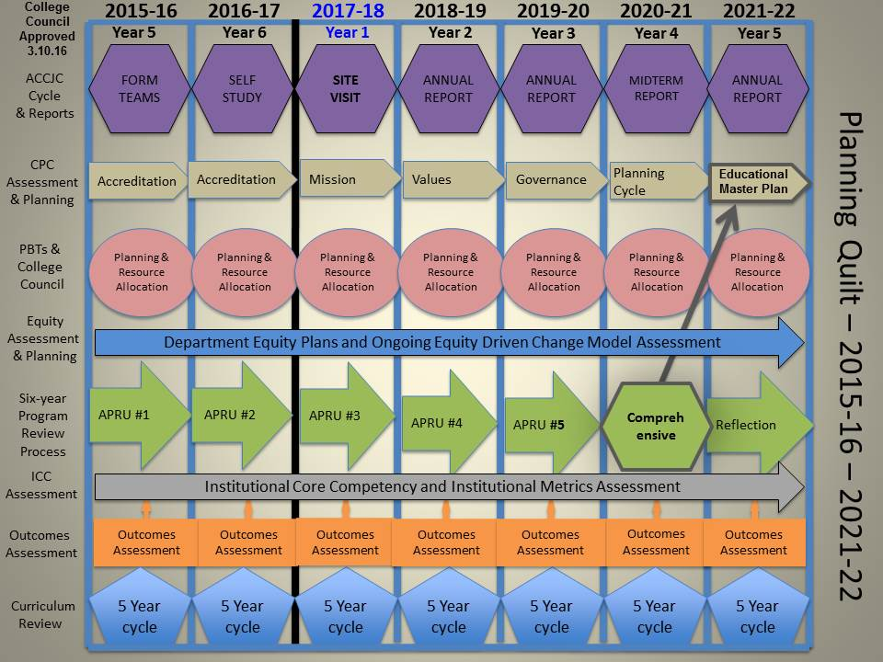

Slide 7
SLO Defined
(Redefined)
Conduct assessments
Summarizing data
Reflection
Enhancement
Plan methods of assessment

Slide 8
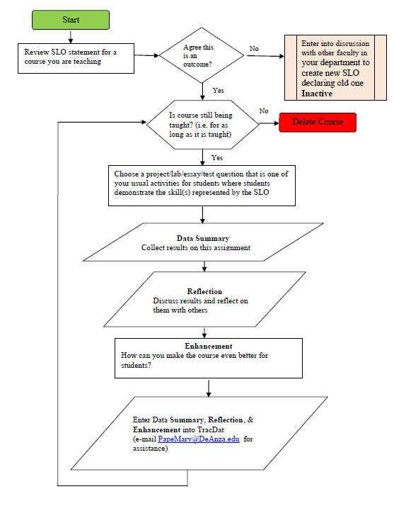
SLO Process

Slide 9
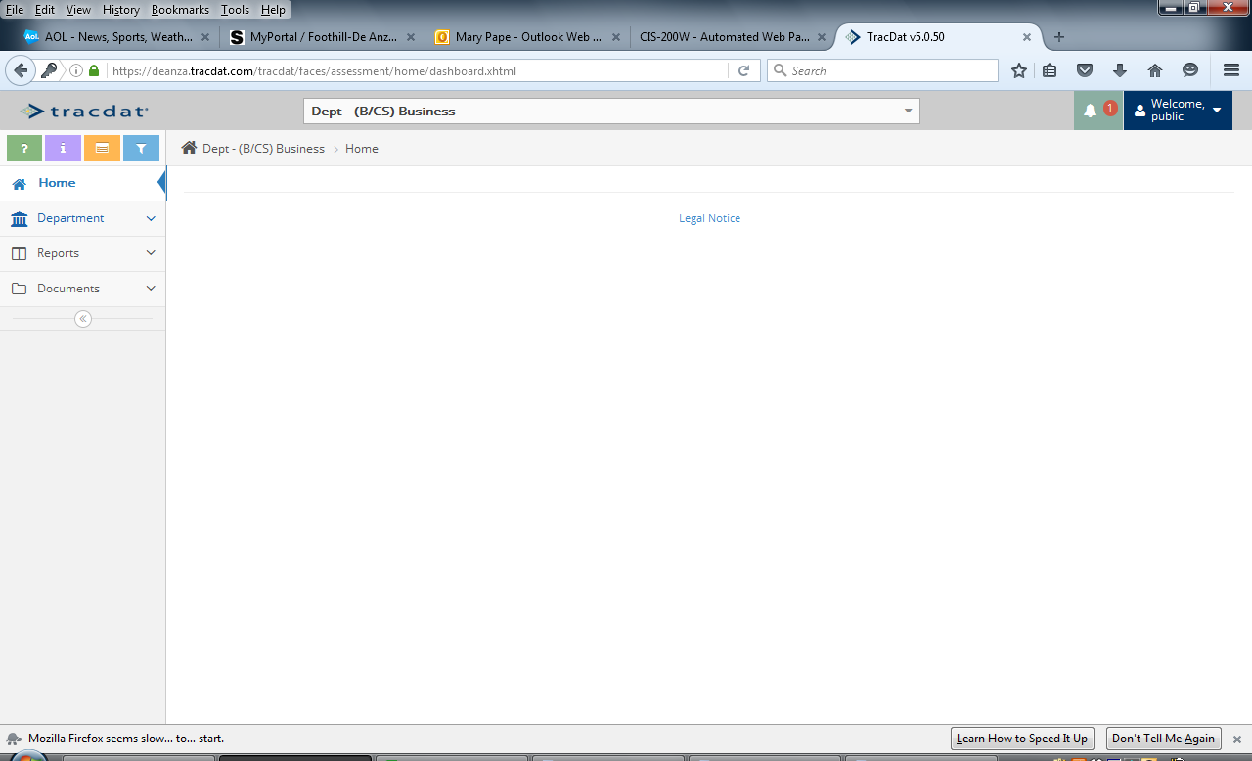
Each participant will be able to find reports, documents and program review for their and all departments.
Type into URL Bar: Deanza.tracdat.com
Username: public
Password: view

Slide 10
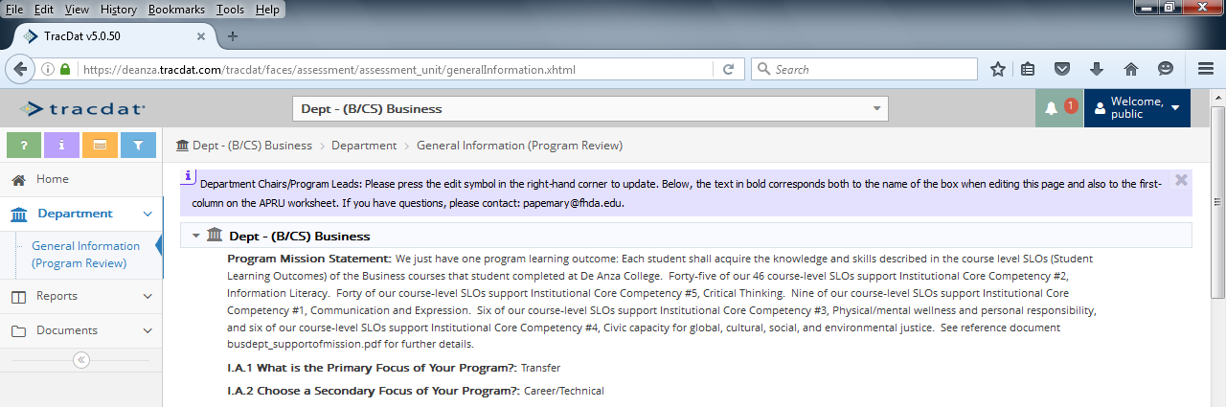
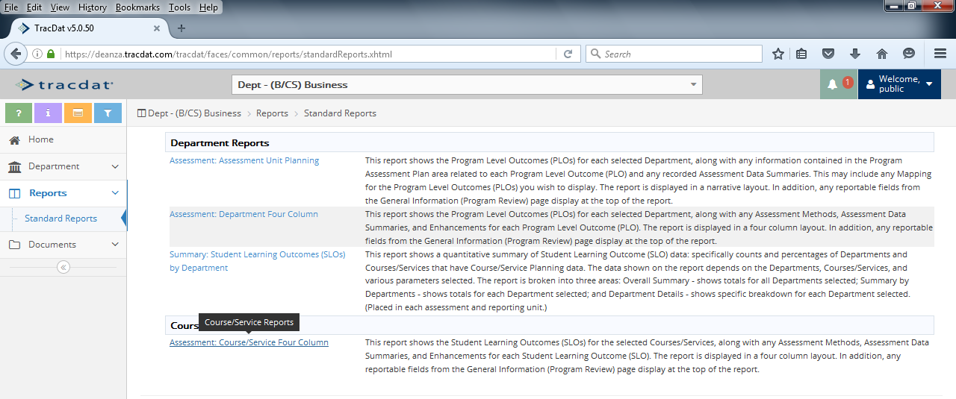
Look at Program Review
Run Standard reports

Slide 11
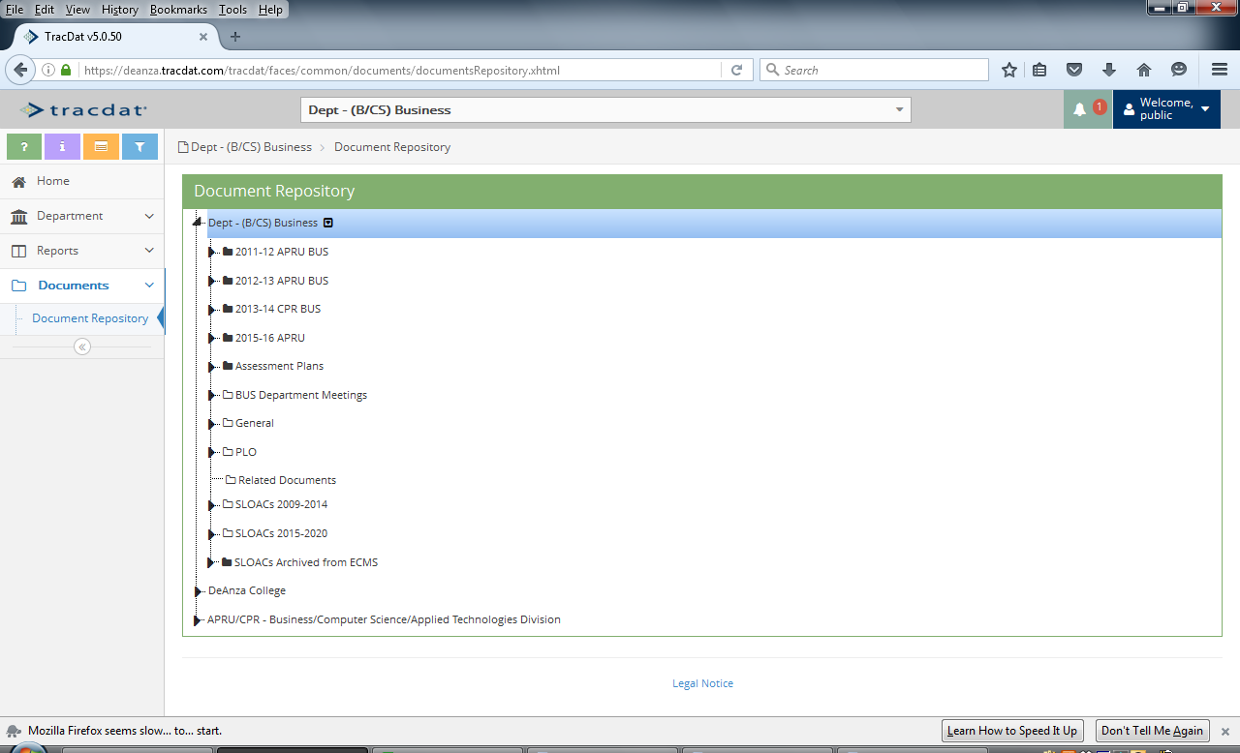
View Documents

Slide 12
Each participant will be able to respond to an emailed assignment.

Slide 13
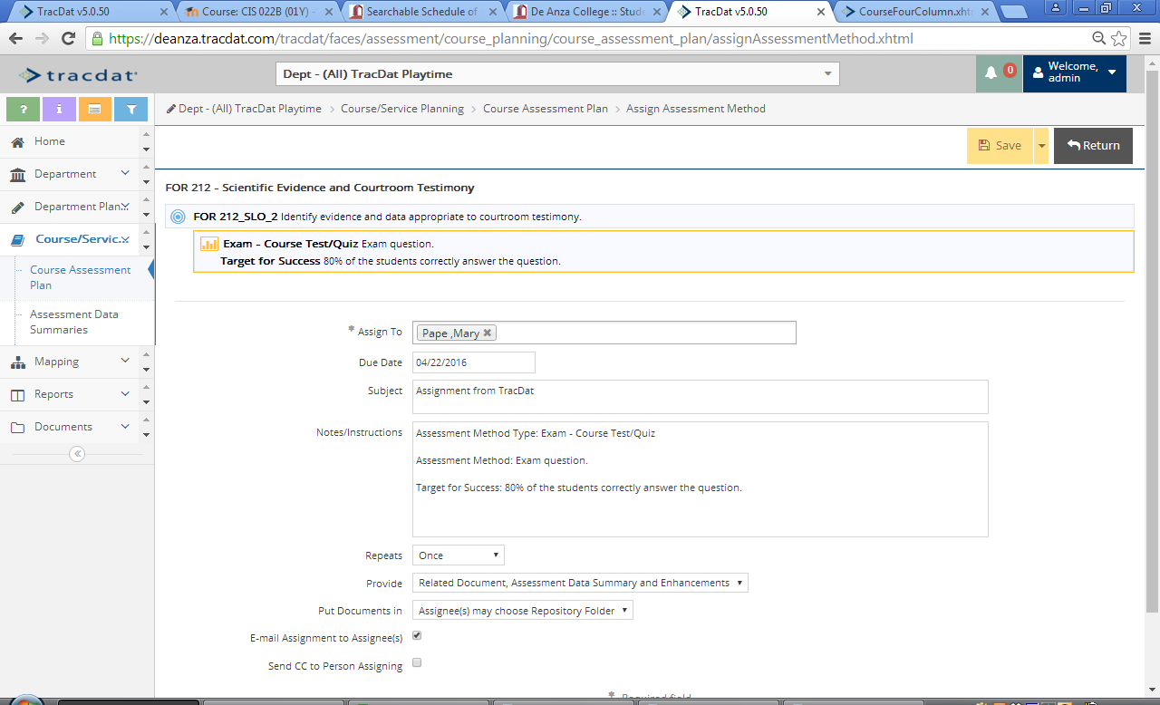

Slide 14
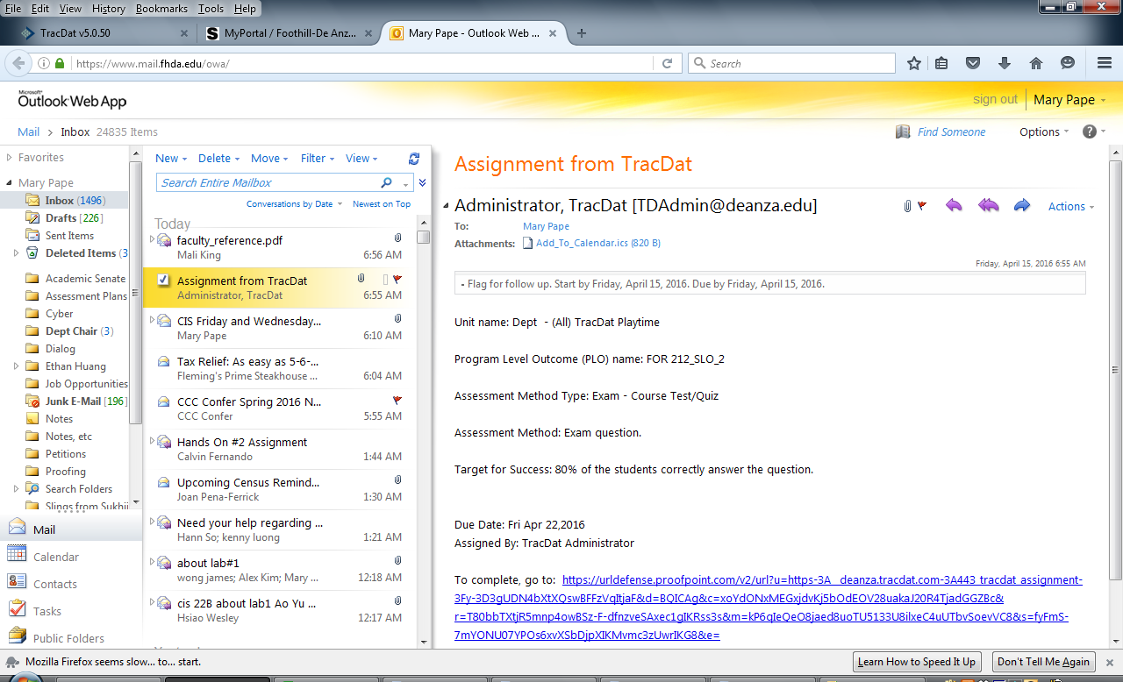

Slide 15
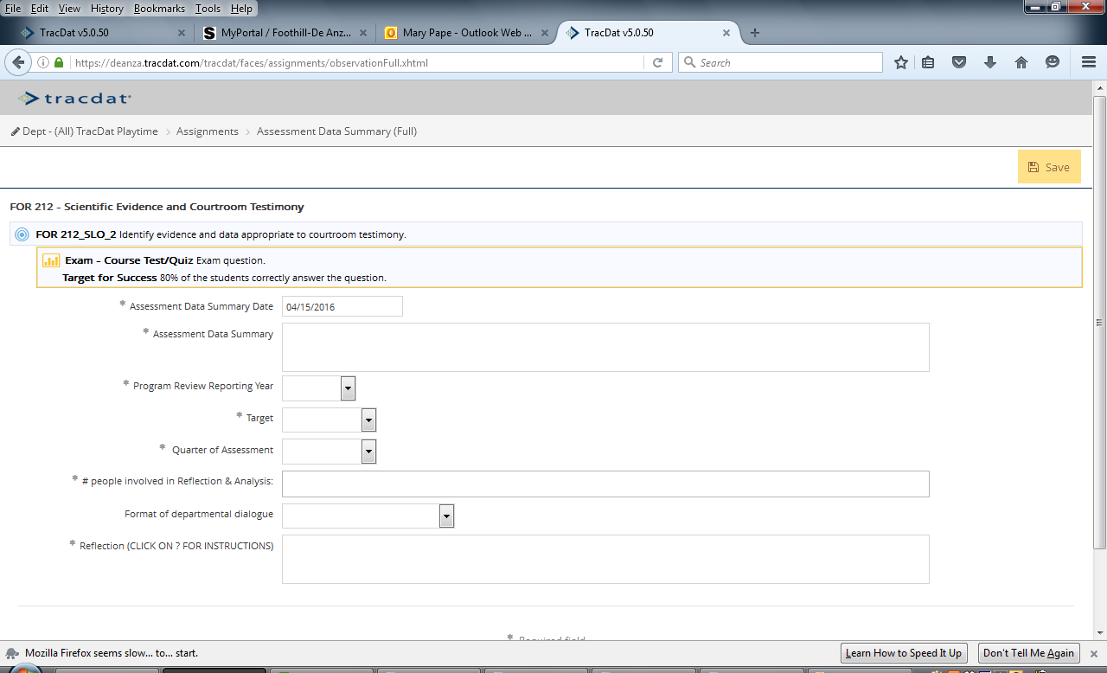

Slide 16
Each participant will be able to complete SLOAC Worksheet.

Slide 17
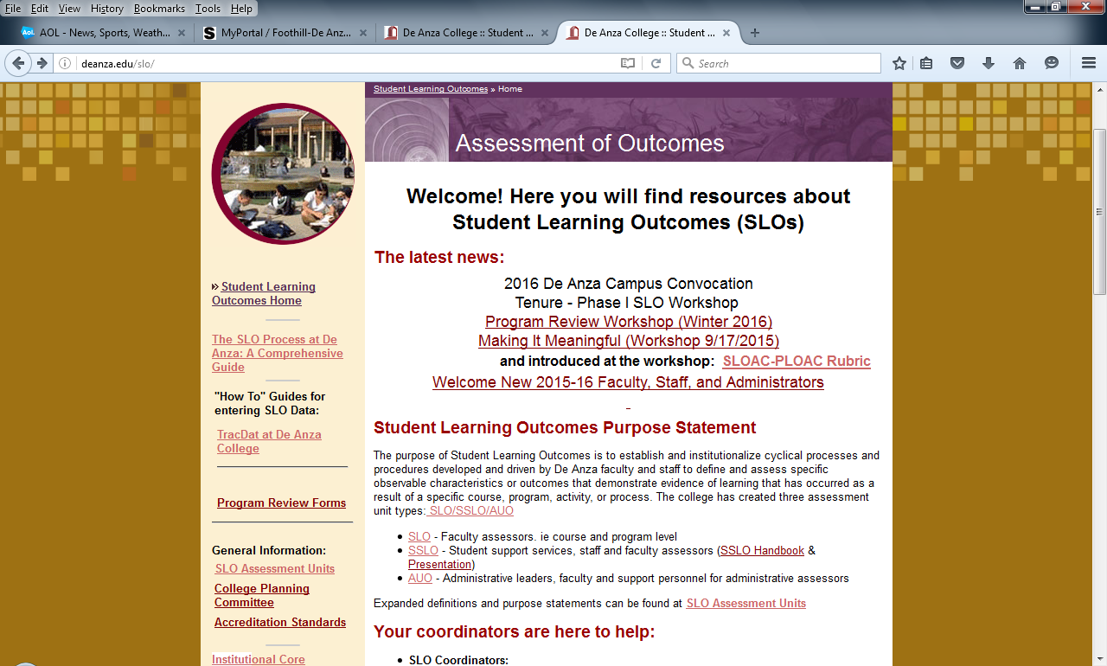
Resources
Notes:
Participants will navigate to home page of SLO website at De Anza College

Slide 18
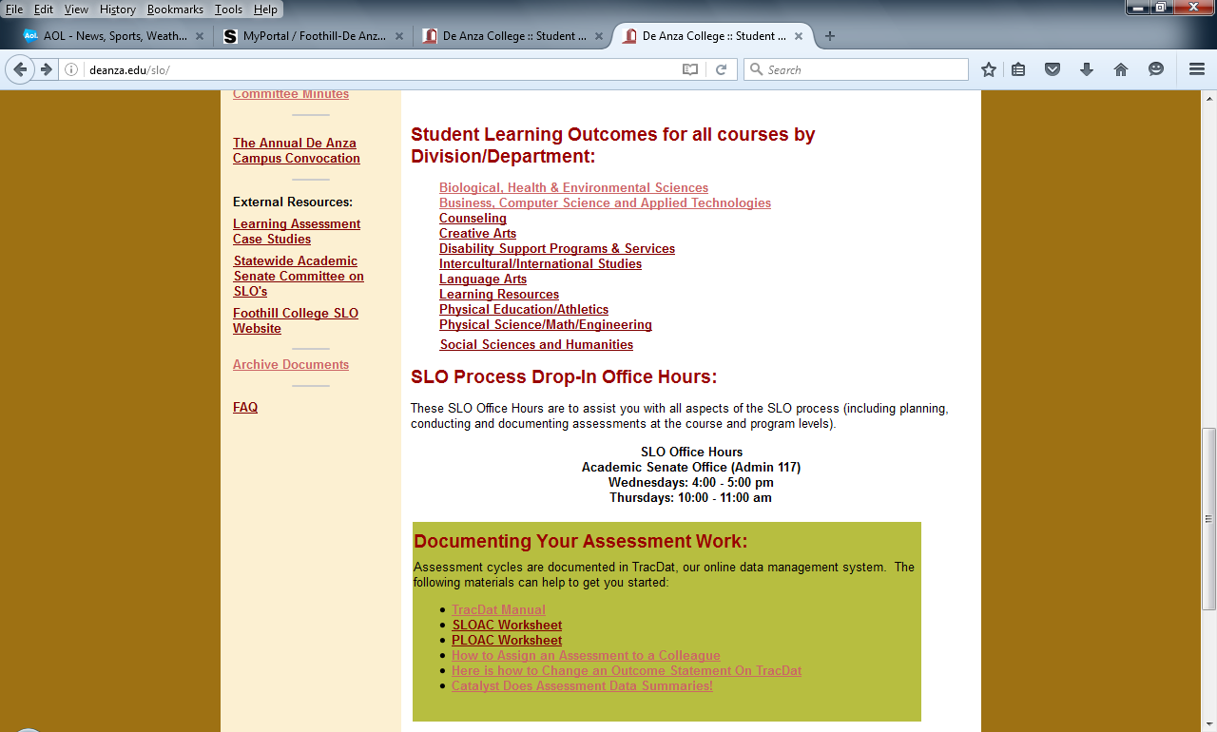
Resources continued
Notes:
Participants will navigate to home page of SLO website at De Anza College

